Slide 1
Soft computing techniques for handling imperfect information
Prof. Dr. Guy De Tré
Warsaw, June 22-26 2015
The Project is co-financed by the European Union from resources of the European Social Fund

Slide 2
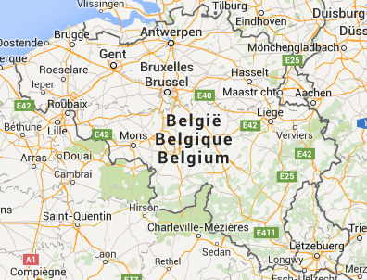
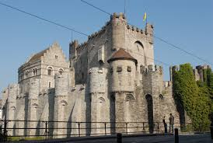
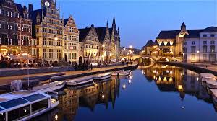
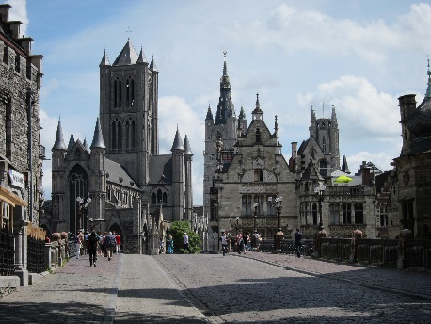
Contact
Coordinates
Database, Document and Content Management
Sint-Pietersnieuwstraat 41
B9000 Gent (BELGIUM)
Tel.: +32 9 264 42 20
E-mail: Guy.DeTre@UGent.be http://ddcm.ugent.be/
http://telin.ugent.be/~gdetre/Summer School Poland/
The Project is co-financed by the European Union from resources of the European Social Fund

Slide 3
Outline
SOFT COMPUTING TECHNIQUES FOR INFORMATION MODELLING
The modelling of imperfect data
Basic techniques (2hrs.)
Advanced techniques (1hr.)
Data quality and big data challenges (2hrs.)
SOFT COMPUTING TECHNIQUES IN SEARCHING AND QUERYING
Soft computing in searching and querying
Basic techniques (2hrs.)
Advanced techniques (1hr.)
Soft computing in decision support (2hrs.)
The Project is co-financed by the European Union from resources of the European Social Fund

Slide 4
Discussion
The Project is co-financed by the European Union from resources of the European Social Fund

