Slide 1







Part I: Soft computing techniques for information modelling
Prof. Dr. Guy De Tré
Warsaw, June 22-26 2015
The Project is co-financed by the European Union from resources of the European Social Fund

Slide 2
Preliminaries
Information systems
Information systems
in a company
0
Making
Decisions
End User
Increasing potential for supporting business decision making
Data Presentation
Business Analyst
Visualization techniques
Data Mining
Data Analyst
Discovery of new information
Data exploration
Statistical analyses, querying and reporting
Data Warehouses / Data Marts
OLAP, Business Intelligence
DBA
Data Sources
Files, Data Providers, Database systems, OLTP
The Project is co-financed by the European Union from resources of the European Social Fund

Slide 3
Preliminaries
Information systems
back flushing
business
intelligence


extract
data
audit
load
data
statistics

detail
summary
decision
support
transform
meta data
data mining
data sources
ETL process
data warehouse
& data marts
new data
search and
querying
information modelling
The Project is co-financed by the European Union from resources of the European Social Fund

Slide 4
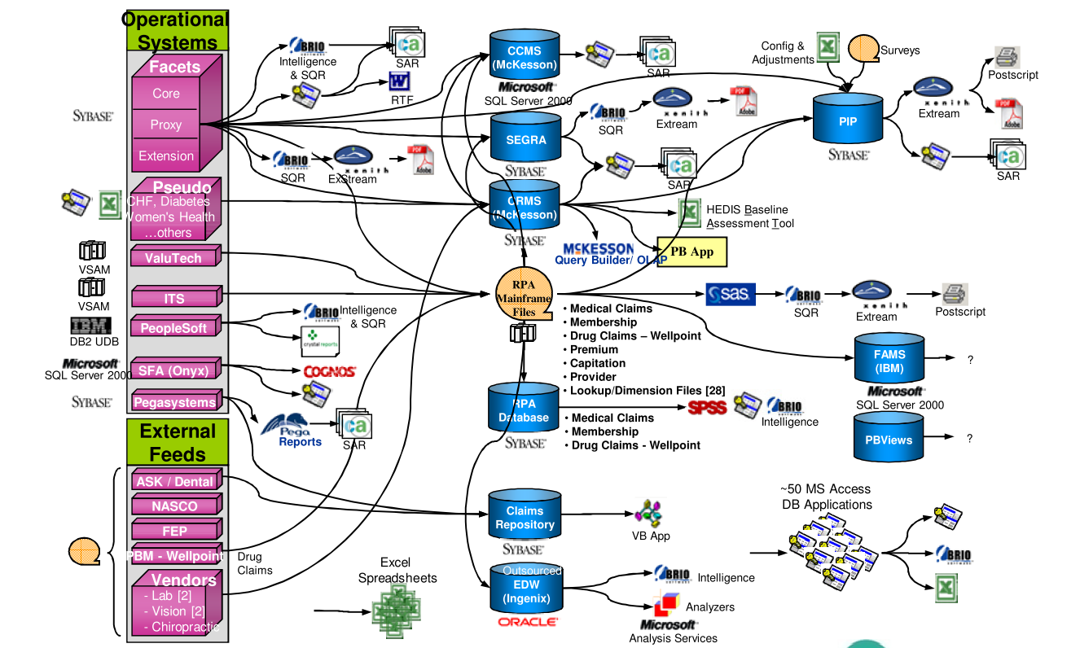
Preliminaries
Information systems
in practice…
The Project is co-financed by the European Union from resources of the European Social Fund

Slide 5
Outline
The modelling of imperfect data: basic techniques (2hrs.)
The modelling of imperfect data: advanced techniques (1hr.)
Data quality issues and big data challenges (2hrs.)
The Project is co-financed by the European Union from resources of the European Social Fund

Slide 6
Outline
The modelling of imperfect data: basic techniques
What is meant with imperfect information?
What is soft computing?
  Fuzzy set theory
  Possibility theory
  Fuzzy logic
Modelling imperfect data
The Project is co-financed by the European Union from resources of the European Social Fund

Slide 7

Modelling imperfect data: basic techniques
What is meant by
imperfect information?
imprecision and vagueness
uncertainty
incompleteness and missing information
inconsistency
The Project is co-financed by the European Union from resources of the European Social Fund

Slide 8







Modelling imperfect data: basic techniques
The need for handling
imperfect data
The Project is co-financed by the European Union from resources of the European Social Fund

Slide 9
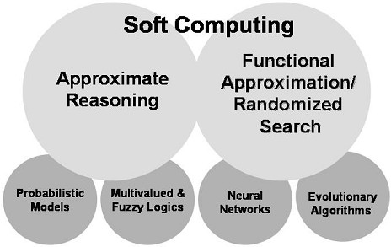
Modelling imperfect data: basic techniques
What is soft computing?
The main goal of soft computing is to develop intelligent machines to
provide solutions to real world problems, which are not modelled, or
too difficult to model mathematically
It’s aim is to exploit the tolerance for approximation, uncertainty,
imprecision and partial truth in order to achive close resemblance with
human like reasoning and decision making
The Project is co-financed by the European Union from resources of the European Social Fund

Slide 10

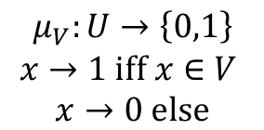

Modelling imperfect data: basic techniques
Fuzzy set theory
L.A. Zadeh
“Fuzzy Sets”
Information and Control 8 3 (1965) 338-353.
$$\begin{matrix}μ_{V}:U→\left\{0,1\right\} \\ \begin{aligned}x→1 iff x∈V \\ x→0 \text{else}\end{aligned}\end{matrix}$$
set
fuzzy set
$$\begin{matrix}μ_{\tilde{V}}:U→\left[0,1\right] \\ x→μ_{\tilde{V}}\left(x\right)\end{matrix}$$
The Project is co-financed by the European Union from resources of the European Social Fund

Slide 11

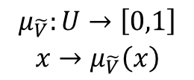


Modelling imperfect data: basic techniques
Fuzzy set theory
fuzzy sets
membership function
$$\begin{matrix}μ_{\tilde{V}}:U→\left[0,1\right] \\ x→μ_{\tilde{V}}\left(x\right)\end{matrix}$$
notation
$$\tilde{V}=\left\{\left(x,μ_{\tilde{V}}\left(x\right)\right)|∀x∈U:μ_{\tilde{V}}\left(x\right)>0\right\}$$
$$\tilde{V}=\left\{\left(x_{1},μ_{\tilde{V}}\left(x_{1}\right)\right),…,\left(x_{n},μ_{\tilde{V}}\left(x_{n}\right)\right)\right\}, n∈\text{IN}$$
$$\tilde{2^{U}}=\left\{\tilde{V}|\tilde{V} \text{is} \text{a} \text{fuzzy} \text{set} \text{over} U\right\}$$
The Project is co-financed by the European Union from resources of the European Social Fund

Slide 12

Modelling imperfect data: basic techniques
Fuzzy set theory
basic concepts
α-cut ($≥$) and strict α-cut (>)
α
α
α=0 : support
α=1 : core
normalized fuzzy set
The Project is co-financed by the European Union from resources of the European Social Fund

Slide 13
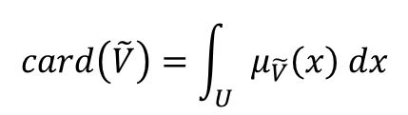
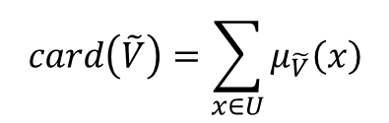
Modelling imperfect data: basic techniques
Fuzzy set theory
basic concepts
cardinality
$$card\left(\tilde{V}\right)=\sum_{x∈U}{μ_{\tilde{V}}\left(x\right)}$$
$$card\left(\tilde{V}\right)=\int_{U}{μ_{\tilde{V}}\left(x\right) dx}$$
The Project is co-financed by the European Union from resources of the European Social Fund

Slide 14

Modelling imperfect data: basic techniques
Fuzzy set theory
basic concepts
(standard) complement
$$\overline{\tilde{V}}=\left\{\left(x,1−μ_{\tilde{V}}\left(x\right)\right)|∀x∈U:{1−μ}_{\tilde{V}}\left(x\right)>0\right\}$$
The Project is co-financed by the European Union from resources of the European Social Fund

Slide 15
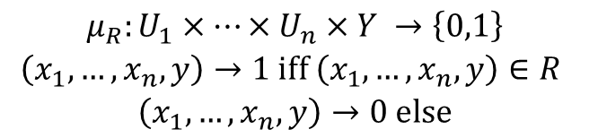

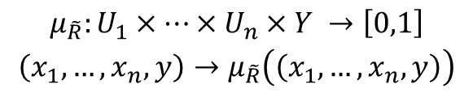

Modelling imperfect data: basic techniques
Fuzzy set theory
fuzzy relations
$$R:U_{1}×…×U_{n}→Y$$
subset of Cartesian product
$$U_{1}×…×U_{n}×Y$$
$$\begin{matrix}μ_{R}:U_{1}×…×U_{n}×Y →\left\{0,1\right\} \\ \begin{aligned}\left(x_{1},…,x_{n},y\right)→1 iff \left(x_{1},…,x_{n},y\right)∈R \\ \left(x_{1},…,x_{n},y\right)→0 \text{else}\end{aligned}\end{matrix}$$
relation
$$\begin{matrix}μ_{\tilde{R}}:U_{1}×…×U_{n}×Y →\left[0,1\right] \\ \left(x_{1},…,x_{n},y\right)→μ_{\tilde{R}}\left(\left(x_{1},…,x_{n},y\right)\right)\end{matrix}$$
fuzzy relation
The Project is co-financed by the European Union from resources of the European Social Fund

Slide 16

Modelling imperfect data: basic techniques
Fuzzy set theory
basic operations: aggregation
intersection and union
standard intersection
$$\tilde{V_{1}}∩\tilde{V_{2}}=\left\{\left(x, min\left(μ_{\tilde{V_{1}}}\left(x\right),μ_{\tilde{V_{2}}}\left(x\right)\right)\right)|∀x∈U:min\left(μ_{\tilde{V_{1}}}\left(x\right),μ_{\tilde{V_{2}}}\left(x\right)\right)>0\right\}$$
standard union
$$\tilde{V_{1}}∪\tilde{V_{2}}=\left\{\left(x, max\left(μ_{\tilde{V_{1}}}\left(x\right),μ_{\tilde{V_{2}}}\left(x\right)\right)\right)|∀x∈U:max\left(μ_{\tilde{V_{1}}}\left(x\right),μ_{\tilde{V_{2}}}\left(x\right)\right)>0\right\}$$
The Project is co-financed by the European Union from resources of the European Social Fund

Slide 17
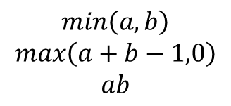
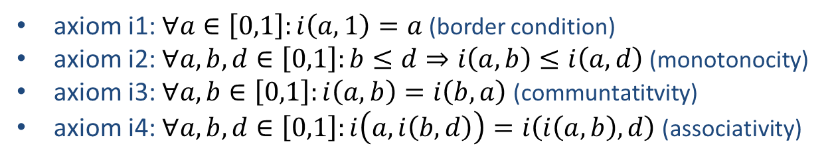
Modelling imperfect data: basic techniques
Fuzzy set theory
basic operations: aggregation
intersection and union
general intersection: t-norms
axiom i1: $∀a∈\left[0,1\right]:i\left(a,1\right)=a$ (border condition)
axiom i2: $∀a,b,d∈\left[0,1\right]:b≤d⇒i\left(a,b\right)≤i\left(a,d\right)$(monotonocity)
axiom i3: $∀a,b∈\left[0,1\right]:i\left(a,b\right)=i\left(b,a\right)$(communtatitvity)
axiom i4: $∀a,b,d∈\left[0,1\right]:i\left(a,i\left(b,d\right)\right)=i\left(i\left(a,b\right),d\right)$(associativity)
examples
Zadeh
Lukasiewics
Probabilistic
$$min\left(a,b\right)$$
$$max\left(a+b−1,0\right)$$
$$ab$$
The Project is co-financed by the European Union from resources of the European Social Fund

Slide 18
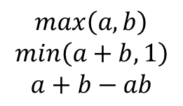
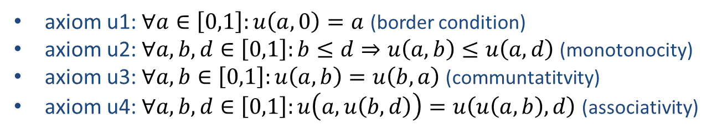
Modelling imperfect data: basic techniques
Fuzzy set theory
basic operations: aggregation
intersection and union
general union: t-conorms
axiom u1: $∀a∈\left[0,1\right]:u\left(a,0\right)=a$ (border condition)
axiom u2: $∀a,b,d∈\left[0,1\right]:b≤d⇒u\left(a,b\right)≤u\left(a,d\right)$(monotonocity)
axiom u3: $∀a,b∈\left[0,1\right]:u\left(a,b\right)=u\left(b,a\right)$(communtatitvity)
axiom u4: $∀a,b,d∈\left[0,1\right]:u\left(a,u\left(b,d\right)\right)=u\left(u\left(a,b\right),d\right)$(associativity)
examples
Zadeh
Lukasiewics
Probabilistic
$$max\left(a,b\right)$$
$$min\left(a+b,1\right)$$
$$a+b−ab$$
The Project is co-financed by the European Union from resources of the European Social Fund

Slide 19


Modelling imperfect data: basic techniques
Fuzzy set theory
basic operations: aggregation
intersection and union
de Morgan law
$$i\left(a,b\right)=1−u\left(1−a,1−b\right)$$
The Project is co-financed by the European Union from resources of the European Social Fund

Slide 20
Modelling imperfect data: basic techniques
Fuzzy set theory
basic operations: aggregation
set difference
$$\tilde{V_{1}}\backslash \tilde{V_{2}}=\left\{\left(x, i\left(μ_{\tilde{V_{1}}}\left(x\right),{1−μ}_{\tilde{V_{2}}}\left(x\right)\right)\right)|∀x∈U:i\left(μ_{\tilde{V_{1}}}\left(x\right),1−μ_{\tilde{V_{2}}}\left(x\right)\right)>0\right\}$$
The Project is co-financed by the European Union from resources of the European Social Fund

Slide 21
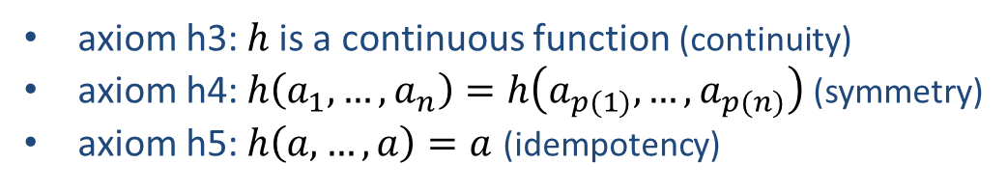

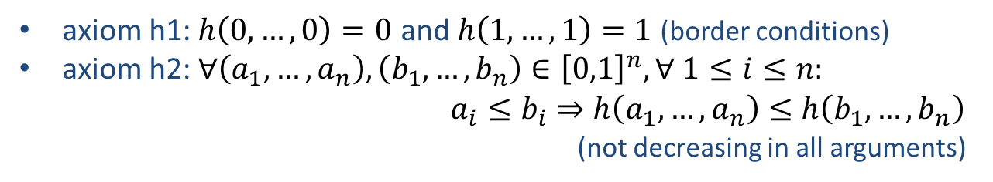
Modelling imperfect data: basic techniques
Fuzzy set theory
basic operations: aggregation
aggregators
$$h:{\left[0,1\right]}^{n}→\left[0,1\right]$$
axiom h1: $h\left(0,…,0\right)=0$ and $h\left(1,…,1\right)=1$ (border conditions)
axiom h2: $∀\left(a_{1},…,a_{n}\right),\left(b_{1},…,b_{n}\right)∈{\left[0,1\right]}^{n}, ∀ 1≤i≤n:$
$a_{i}≤b_{i}⇒h\left(a_{1},…,a_{n}\right)≤h\left(b_{1},…,b_{n}\right)$
(not decreasing in all arguments)
extra
axiom h3: $h$ is a continuous function (continuity)
axiom h4: $h\left(a_{1},…,a_{n}\right)=h\left(a_{p(1)},…,a_{p(n)}\right)$ (symmetry)
axiom h5: $h\left(a,…,a\right)=a$ (idempotency)
The Project is co-financed by the European Union from resources of the European Social Fund

Slide 22
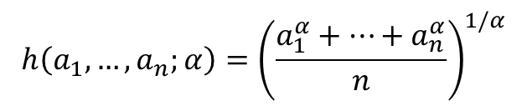

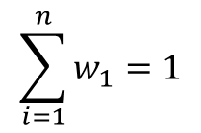
Modelling imperfect data: basic techniques
Fuzzy set theory
basic operations: aggregation
aggregators: examples
generalized average
$$h\left(a_{1},…,a_{n};α\right)={\left(\frac{a_{1}^{α}+…+a_{n}^{α}}{n}\right)}^{1/α}$$
ordered weighted average
$$h\left(a_{1},…,a_{n};w\right)=w_{1}b_{1}+…+w_{n}b_{n}$$
$$\sum_{i=1}^{n}{w_{1}}=1$$
and
$$∀i,j∈\left\{1,…,n\right\}:i<j⇒b_{i}≥b_{j}$$
The Project is co-financed by the European Union from resources of the European Social Fund

Slide 23


Modelling imperfect data: basic techniques
Fuzzy set theory
basic operations: comparison
standard inclusion
inclusion
1
~
1
~
~
V₂
~
V₂
V₁
V₁
0
U
0
U
(a)
(b)
$$\left(\tilde{V_{1}}⊆\tilde{V_{2}}\right)⇔\left(∀x∈U:μ_{\tilde{V_{1}}}\left(x\right)≤μ_{\tilde{V_{2}}}\left(x\right)\right)$$
The Project is co-financed by the European Union from resources of the European Social Fund

Slide 24

Modelling imperfect data: basic techniques
Fuzzy set theory
basic operations: comparison
standard inclusion
strong inclusion
1
~
~
V₂
V₁
0
U
$$\left(\tilde{V_{1}}⊑\tilde{V_{2}}\right)⇔supp\left(\tilde{V_{1}}\right)⊆core\left(\tilde{V_{2}}\right)$$
The Project is co-financed by the European Union from resources of the European Social Fund

Slide 25


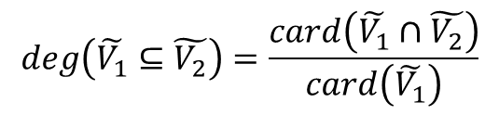
Modelling imperfect data: basic techniques
Fuzzy set theory
basic operations: comparison
gradual inclusion
$$deg\left(\tilde{V_{1}}⊆\tilde{V_{2}}\right)=\frac{card\left(\tilde{V_{1}}∩\tilde{V_{2}}\right)}{card\left(\tilde{V_{1}}\right)}$$
$$\left(V_{1}⊆V_{2}\right)⟺\left(\left(V_{1}∩V_{2}\right)=V_{1}\right)$$
The Project is co-financed by the European Union from resources of the European Social Fund

Slide 26

Modelling imperfect data: basic techniques
Fuzzy set theory
basic operations: comparison
equality
standard equality
$$\left(\tilde{V_{1}}=\tilde{V_{2}}\right)⟺\left(∀x∈U:μ_{\tilde{V_{1}}}\left(x\right)=μ_{\tilde{V_{2}}}\left(x\right)\right)$$
gradual equality
$$deg\left(\tilde{V_{1}}=\tilde{V_{2}}\right)=i\left(deg\left(\tilde{V_{1}}⊆\tilde{V_{2}}\right),deg\left(\tilde{V_{2}}⊆\tilde{V_{1}}\right)\right)$$
The Project is co-financed by the European Union from resources of the European Social Fund

Slide 27

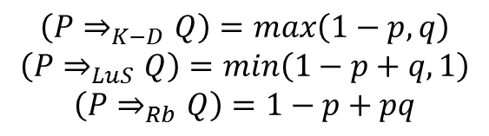

Modelling imperfect data: basic techniques
Fuzzy set theory
basic operations: implication
S-implications
$$\left(P⇒_{S−i}Q\right)=u\left(1−p,q\right)$$
$$\left(P⇒Q\right)⇔\left(\left(¬P\right)∨Q\right)$$
examples
Kleene-Dienes
Lukasiewics
Reichenbach
$$\left(P⇒_{K−D}Q\right)=max\left(1−p,q\right)$$
$$\left(P⇒_{LuS}Q\right)=min\left(1−p+q,1\right)$$
$$\left(P⇒_{Rb}Q\right)=1−p+pq$$
The Project is co-financed by the European Union from resources of the European Social Fund

Slide 28
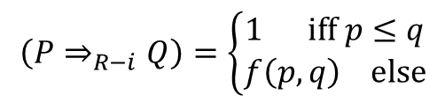

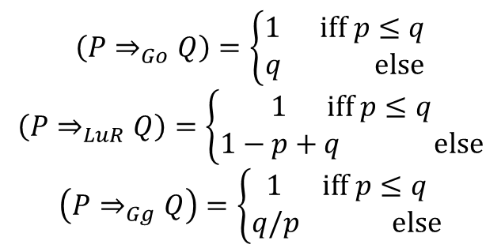
Modelling imperfect data: basic techniques
Fuzzy set theory
basic operations: implication
residuation
$$\left(P∧\left(\left(¬P\right)∨Q\right)\right)⟺\left(\left(P∧¬P\right)∨\left(P∧Q\right)\right)⟺\left(P∧Q\right)$$
so
$$\left(P∧\left(P⇒Q\right)\right)≤Q$$
R-implications
$$\left(P⇒_{R−i}Q\right)=\left\{\begin{matrix}1 \text{iff} p≤q \\ f\left(p,q\right) \text{else}\end{matrix}\right.$$
examples
$$\left(P⇒_{Go}Q\right)=\left\{\begin{matrix}1 \text{iff} p≤q \\ q \text{else}\end{matrix}\right.$$
$$\left(P⇒_{LuR}Q\right)=\left\{\begin{matrix}1 \text{iff} p≤q \\ 1−p+q \text{else}\end{matrix}\right.$$
$$\left(P⇒_{Gg}Q\right)=\left\{\begin{matrix}1 \text{iff} p≤q \\ q/p \text{else}\end{matrix}\right.$$
Gödel
Lukasiewics
Goguen
The Project is co-financed by the European Union from resources of the European Social Fund

Slide 29



Modelling imperfect data: basic techniques
Fuzzy set theory
basic operations: quantifiers
absolute quantifiers
$$μ_{Q_{A}}:\text{IN}→\left[0,1\right]$$
or
$$μ_{Q_{A}}:\text{IR}→\left[0,1\right]$$
examples
around 20, at least 12, all, at least 1, much more than 10
relative quantifiers
$$μ_{Q_{R}}:\left[0,1\right]→\left[0,1\right]$$
examples
most, a few, an average number
The Project is co-financed by the European Union from resources of the European Social Fund

Slide 30








Modelling imperfect data: basic techniques
Fuzzy set theory
basic operations: extension principle for relations
$$R:U_{1}×…×U_{n}→Y$$
$$\tilde{R}:\tilde{2^{U_{1}}}×…×\tilde{2^{U_{n}}}→\tilde{2^{Y}}$$
example
$$+:\text{IN}×\text{IN}→\text{IN}$$
example
$$\tilde{+}:\tilde{\text{IN}}×\tilde{\text{IN}}→\tilde{\text{IN}}$$
$$2+4$$
$\text{around} 2 +$ more or less 4
Zadeh’s extension principle
$$\tilde{R}\left(\tilde{V_{1},}…,\tilde{V_{n}}\right):Y→\left[0,1\right]$$
$y→\sup_{\left(x_{1},…,x_{n}\right)∈V_{\left(R,y\right)}}min\left(μ_{\tilde{V_{1}}}\left(x_{1}\right),…,μ_{\tilde{V_{n}}}\left(x_{n}\right)\right)$, iff $y∈wd\left(R\right)$
$y→0$, iff $y∉wd\left(R\right)$
where
$$wd\left(R\right)=\left\{y|y∈Y∧∃\left(x_{1},…,x_{n}\right)∈U_{1}×…×U_{n}:R\left(x_{1},…,x_{n}\right)=y\right\}$$
$$V_{\left(R,y\right)}=\left\{\left(x_{1},…,x_{n}\right)|\left(x_{1},…,x_{n}\right)∈U_{1}×…×U_{n}∧R\left(x_{1},…,x_{n}\right)=y\right\}$$
The Project is co-financed by the European Union from resources of the European Social Fund

Slide 31
Modelling imperfect data: basic techniques
Fuzzy set theory
shape functions and practical issues
shape functions
1
~
1
~
V
V
0.5
0.5
β
0
α
β
γ
U
0
γ
U
(a) S-function
(b) π-function
1
~
1
~
V
V
0
α
β
γ
δ
0
α
γ
U
β=
δ
U
(c) trapezoidal Π-function
(d) triangular Π-function
The Project is co-financed by the European Union from resources of the European Social Fund

Slide 32
Modelling imperfect data: basic techniques
Fuzzy set theory
shape functions and practical issues
interpretation of fuzzy sets
degree of compatibility (with ‘prototype’)
e.g. young persons, fast cars, expensive paintures,…
degree of truth (or applicability)
e.g. the languages a spoken by a person
degree of uncertainty
e.g. the age of a person
conjunctive
disjunctive
The Project is co-financed by the European Union from resources of the European Social Fund

Slide 33



Modelling imperfect data: basic techniques
Possibility theory
L.A. Zadeh
“Fuzzy Sets as the Basis for a Theory of Possibility”
Fuzzy Sets and Systems 1 (1978) 3-28.
ISBN-13: 978-1468452891
The Project is co-financed by the European Union from resources of the European Social Fund

Slide 34
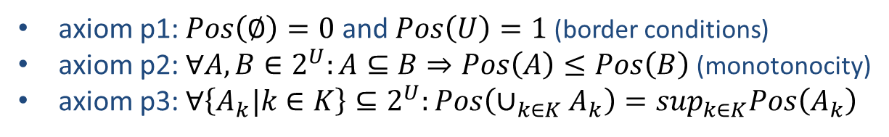

Modelling imperfect data: basic techniques
Possibility theory
fuzzy measures
possibility measure
$$Pos:2^{U}→\left[0,1\right]$$
axiom p1: $Pos\left(∅\right)=0$ and $Pos\left(U\right)=1$(border conditions)
axiom p2: $∀A,B∈2^{U}:A⊆B⇒Pos\left(A\right)≤Pos\left(B\right)$(monotonocity)
axiom p3: $∀\left\{A_{k}|k∈K\right\}⊆2^{U}:Pos\left(∪_{k∈K}A_{k}\right)=\sup_{k∈K}Pos\left(A_{k}\right)$
$Pos\left(A\right)$ denotes to which extent it is possible that $x∈U$belongs to $A$
The Project is co-financed by the European Union from resources of the European Social Fund

Slide 35
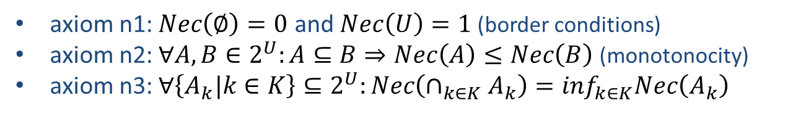
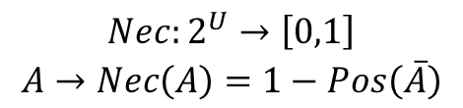
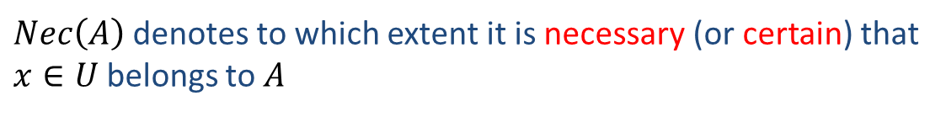
Modelling imperfect data: basic techniques
Possibility theory
fuzzy measures
necessity measure
$$\begin{matrix}Nec:2^{U}→\left[0,1\right] \\ A→Nec\left(A\right)=1−Pos\left(\overline{A}\right)\end{matrix}$$
axiom n1: $Nec\left(∅\right)=0$ and $Nec\left(U\right)=1$(border conditions)
axiom n2: $∀A,B∈2^{U}:A⊆B⇒Nec\left(A\right)≤Nec\left(B\right)$(monotonocity)
axiom n3: $∀\left\{A_{k}|k∈K\right\}⊆2^{U}:Nec\left(∩_{k∈K}A_{k}\right)=\inf_{k∈K}Nec\left(A_{k}\right)$
$Nec\left(A\right)$ denotes to which extent it is necessary (or certain) that
$x∈U$belongs to $A$
The Project is co-financed by the European Union from resources of the European Social Fund

Slide 36
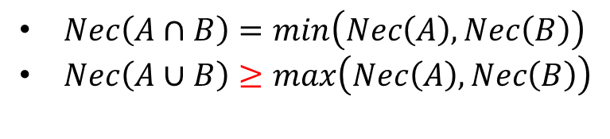
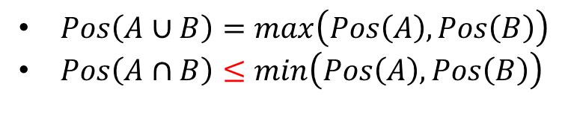
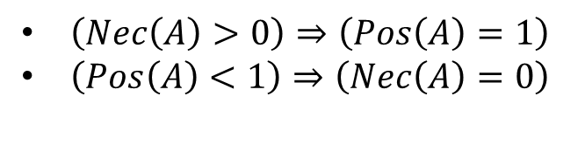
Modelling imperfect data: basic techniques
Possibility theory
fuzzy measures
main properties
$Pos\left(A∪B\right)=max\left(Pos\left(A\right),Pos\left(B\right)\right)$
$Pos\left(A∩B\right)≤min\left(Pos\left(A\right),Pos\left(B\right)\right)$
$Nec\left(A∩B\right)=min\left(Nec\left(A\right),Nec\left(B\right)\right)$
$Nec\left(A∪B\right)≥max\left(Nec\left(A\right),Nec\left(B\right)\right)$
$\left(Nec\left(A\right)>0\right)⇒\left(Pos\left(A\right)=1\right)$
$\left(Pos\left(A\right)<1\right)⇒\left(Nec\left(A\right)=0\right)$
The Project is co-financed by the European Union from resources of the European Social Fund

Slide 37



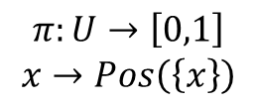




Modelling imperfect data: basic techniques
Possibility theory
possibility distributions
$$\begin{matrix}π:U→\left[0,1\right] \\ x→Pos\left(\left\{x\right\}\right)\end{matrix}$$
$$∀A∈2^{U}:Pos\left(A\right)=\sup_{x∈A}π\left(x\right)$$
$$∀A∈2^{U}:Nec\left(A\right)=\inf_{x∈A}\left(1−π\left(x\right)\right)$$
fuzzy set approach
$$∀x∈U:π_{X}\left(x\right)=μ_{\tilde{V}}\left(x\right)$$
with $X$ being a variable
$${Pos}_{X}\left(A\right)=\sup_{x∈A}μ_{\tilde{V}}\left(x\right)$$
$${Nec}_{X}\left(A\right)=\inf_{x∈A}\left(1−μ_{\tilde{V}}\left(x\right)\right)$$
if $\tilde{V}$ is normalized
The Project is co-financed by the European Union from resources of the European Social Fund

Slide 38
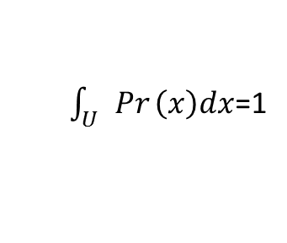

Modelling imperfect data: basic techniques
Possibility theory
connection with probability theory
possibility theory
probability theory
$\sup_{x∈U}π\left(x\right)$=1
$\int_{U}{Pr}\left(x\right)dx$=1
normalization
semantics
express preferences
(only comparative information)
express relative occurence
(quantitative information)
informativeness
less informative
more informative
applicability
more general
less general
NOT competitive to each other
interrelationships
what is not possible, is also not certain
what is certain, is also possible
The Project is co-financed by the European Union from resources of the European Social Fund

Slide 39



Modelling imperfect data: basic techniques
Possibility theory
experiment
possibility of being
unhealthy is 1
probability of being
unhealthy is 1
from which glass would you like to drink?
The Project is co-financed by the European Union from resources of the European Social Fund

Slide 40
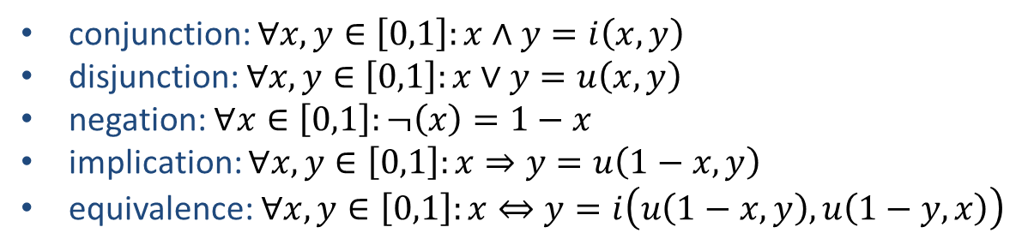
Modelling imperfect data: basic techniques
Fuzzy logic
fuzzy logic
truth values as fuzzy sets
1
true
μ_{true}(x)
μ_{false}(x)
false
0
x
1
conjunction: $∀x,y∈\left[0,1\right]:x∧y=i\left(x,y\right)$
disjunction: $∀x,y∈\left[0,1\right]:x∨y=u\left(x,y\right)$
negation: $∀x∈\left[0,1\right]:¬\left(x\right)=1−x$
implication: $∀x,y∈\left[0,1\right]:x⇒y=u\left(1−x,y\right)$
equivalence: $∀x,y∈\left[0,1\right]:x⇔y=i\left(u\left(1−x,y\right),u\left(1−y,x\right)\right)$
The Project is co-financed by the European Union from resources of the European Social Fund

Slide 41




Modelling imperfect data: basic techniques
Fuzzy logic
fuzzy logic
(extended) possibilistic truth values
T(rue)
F(alse)
⊥(inapplicable)
from bivalence to trivalence…
The Project is co-financed by the European Union from resources of the European Social Fund

Slide 42

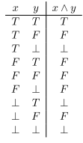
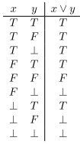
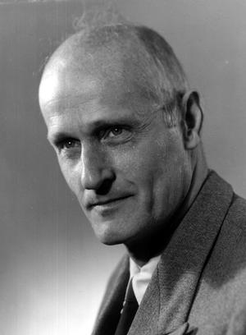
Modelling imperfect data: basic techniques
Fuzzy logic
fuzzy logic
(extended) possibilistic truth values
three-valued Kleene logic
Stephen Cole Kleene
partial ordering relation
$$≤=\left\{\left(F,F\right),\left(F,⊥\right),\left(F,T\right),\left(⊥,⊥\right),\left(⊥,T\right),\left(T,T\right)\right\}$$
The Project is co-financed by the European Union from resources of the European Social Fund

Slide 43
Modelling imperfect data: basic techniques
Fuzzy logic
fuzzy logic
(extended) possibilistic truth values
from trivalence to valence…
T(rue)
F(alse)
⊥(inapplicable)
uncertainty
The Project is co-financed by the European Union from resources of the European Social Fund

Slide 44

Modelling imperfect data: basic techniques
Fuzzy logic
fuzzy logic
(extended) possibilistic truth values
no extra truth value, but modelling
via possibility distributions
The Project is co-financed by the European Union from resources of the European Social Fund

Slide 45





Modelling imperfect data: basic techniques
Fuzzy logic
fuzzy logic
(extended) possibilistic truth values
$$I=\left\{T,F\right\}$$
$$\tilde{t:}P→\tilde{2^{I}}:p→\tilde{t}\left(p\right)$$
$$\tilde{t}\left(p\right)=\left\{\left(T,μ_{\tilde{t}\left(p\right)}\left(T\right)\right),\left(F,μ_{\tilde{t}\left(p\right)}\left(F\right)\right) \right\}$$
$$I^{∗}=\left\{T,F,⊥\right\}$$
$${\tilde{t}}^{∗}:P→\tilde{2^{I^{∗}}}:p→{\tilde{t}}^{∗}\left(p\right)$$
$${\tilde{t}}^{∗}\left(p\right)=\left\{\left(T,μ_{{\tilde{t}}^{∗}\left(p\right)}\left(T\right)\right),\left(F,μ_{{\tilde{t}}^{∗}\left(p\right)}\left(F\right)\right),\left(⊥,μ_{{\tilde{t}}^{∗}\left(p\right)}\left(⊥\right)\right)\right\}$$
degrees of uncertainty
The Project is co-financed by the European Union from resources of the European Social Fund

Slide 46
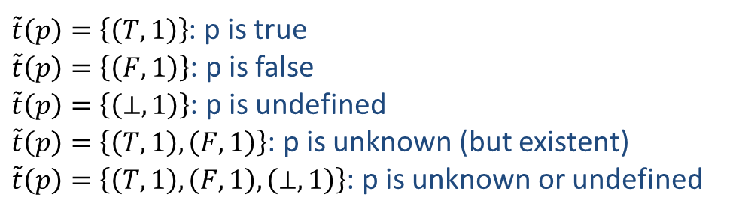
Modelling imperfect data: basic techniques
Fuzzy logic
fuzzy logic
(extended) possibilistic truth values
special cases
$\tilde{t}\left(p\right)=\left\{\left(T,1\right)\right\}$: p is true
$\tilde{t}\left(p\right)=\left\{\left(F,1\right)\right\}$: p is false
$\tilde{t}\left(p\right)=\left\{\left(⊥,1\right)\right\}$: p is undefined
$\tilde{t}\left(p\right)=\left\{\left(T,1\right),\left(F,1\right)\right\}$: p is unknown (but existent)
$\tilde{t}\left(p\right)=\left\{\left(T,1\right),\left(F,1\right),\left(⊥,1\right)\right\}$: p is unknown or undefined
The Project is co-financed by the European Union from resources of the European Social Fund

Slide 47
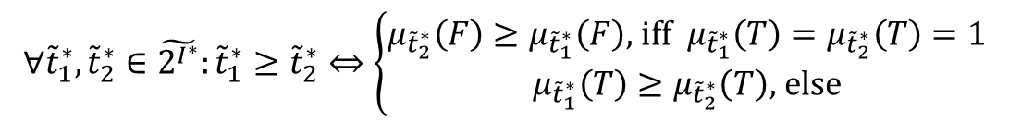
Modelling imperfect data: basic techniques
Fuzzy logic
fuzzy logic
(extended) possibilistic truth values
calculus
The computation rules for negation, conjunction, disjunction, implication
and equivalence are defined as generalizations of their counterparts in
three-valued Kleene logic. For this generalization, Zadeh's extension principle
can be used.
partial ordering relation
$$∀{\tilde{t}}_{1}^{∗},{\tilde{t}}_{2}^{∗}∈\tilde{2^{I^{∗}}}:{\tilde{t}}_{1}^{∗}≥{\tilde{t}}_{2}^{∗}⇔\left\{\begin{matrix}μ_{{\tilde{t}}_{2}^{∗}}\left(F\right)≥μ_{{\tilde{t}}_{1}^{∗}}\left(F\right)\text{, }\text{iff} μ_{{\tilde{t}}_{1}^{∗}}\left(T\right)=μ_{{\tilde{t}}_{2}^{∗}}\left(T\right)=1 \\ μ_{{\tilde{t}}_{1}^{∗}}\left(T\right)≥μ_{{\tilde{t}}_{2}^{∗}}\left(T\right)\text{, }\text{else}\end{matrix}\right.$$
The Project is co-financed by the European Union from resources of the European Social Fund

Slide 48
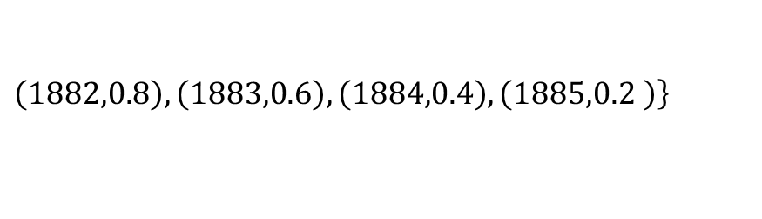
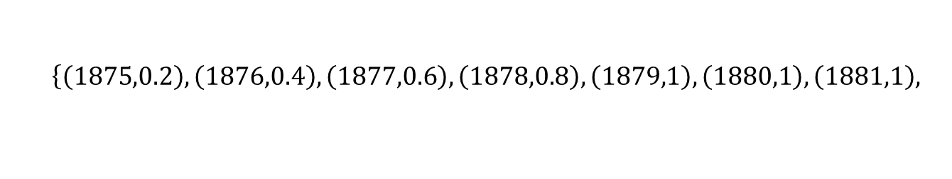
Modelling imperfect data: basic techniques
Modelling imperfect data
modelling imprecision and vagueness in information systems
modelling linguistic terms
depends on context and user
‘around 1880’
$$\left\{\left(1875,0.2\right),\left(1876,0.4\right),\left(1877,0.6\right),\left(1878,0.8\right),\left(1879,1\right),\left(1880,1\right),\left(1881,1\right), \right.$$
$$\left.\left(1882,0.8\right),\left(1883,0.6\right),\left(1884,0.4\right),\left(1885,0.2 \right)\right\}$$
‘high score’
$$\left\{\left(16,0.35\right),\left(17,0.65\right),\left(18,1\right),\left(19,1\right),\left(20,1\right)\right\}$$
degrees of compatibility
The Project is co-financed by the European Union from resources of the European Social Fund

Slide 49
Modelling imperfect data: basic techniques
Modelling imperfect data
modelling imprecision and vagueness in information systems
modification functions (linguistic hedges)
to weaken or strengthen the semantics of a linguistic term
1
μ_{L}(x)
1
μ_{L}(x)
μ_{L}(m_{pre}(x))
m_{post} (μ_{L}(x))
0
U
0
U
post modification
pre modification
The Project is co-financed by the European Union from resources of the European Social Fund

Slide 50




Modelling imperfect data: basic techniques
Modelling imperfect data
modelling imprecision and vagueness in information systems
modification functions (linguistic hedges)
strengthening
weakening
$$.^{2}$$
$$.^{1/2}$$
$$.^{4}$$
$$.^{1/4}$$
twofold piecewise linear modification
α,β
f_{m}
1
0.5
α
β
0
m
min
max
U
The Project is co-financed by the European Union from resources of the European Social Fund

Slide 51
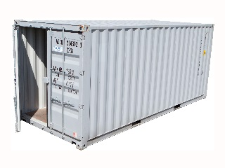
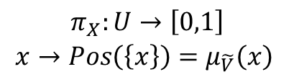

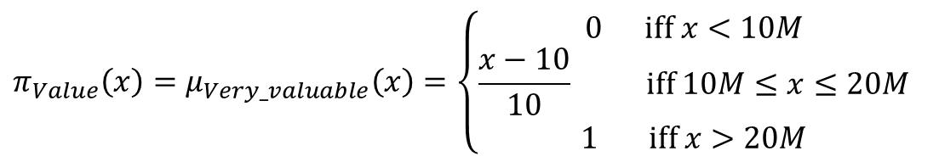
Modelling imperfect data: basic techniques
Modelling imperfect data
modelling imprecision and vagueness in information systems
possibilistic approach
using ‘linguistic’ variables: $X$
possibility distribution:
$$\begin{matrix}π_{X}:U→\left[0,1\right] \\ x→Pos\left(\left\{x\right\}\right)=μ_{\tilde{V}}\left(x\right) \end{matrix}$$
example:
$$π_{Value}\left(x\right)=μ_{Very_valuable}\left(x\right)=\left\{\begin{aligned}0 \text{iff} x<10M \\ \frac{x−10}{10} \text{iff} 10M≤x≤20M \\ 1 \text{iff} x>20M\end{aligned}\right.$$
degrees of uncertainty
The Project is co-financed by the European Union from resources of the European Social Fund

Slide 52


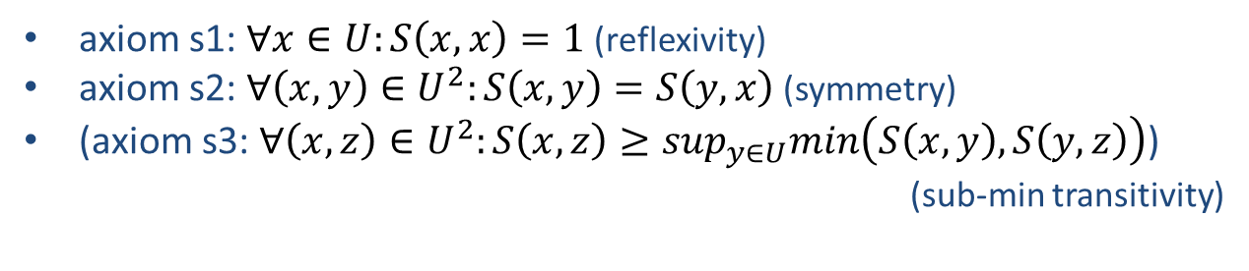
Modelling imperfect data: basic techniques
Modelling imperfect data
modelling imprecision and vagueness in information systems
similarity-based approach
extend domain of assigned data type with a similarity relation $S$
$$S:U×U→\left[0,1\right]$$
axiom s1: $∀x∈U:S\left(x,x\right)=1$ (reflexivity)
axiom s2: $∀\left(x,y\right)∈U^{2}:S\left(x,y\right)=S\left(y,x\right)$(symmetry)
(axiom s3: $∀\left(x,z\right)∈U^{2}:S\left(x,z\right)≥\sup_{y∈U}min\left(S\left(x,y\right),S\left(y,z\right)\right)$)
(sub-min transitivity)
fuzzy sets of related domain values
$${\tilde{V}}_{x}=\left\{\left(y,S\left(x,y\right)\right)|y∈U\right\}$$
degrees of compatibility
The Project is co-financed by the European Union from resources of the European Social Fund

Slide 53
Modelling imperfect data: basic techniques
Modelling imperfect data
modelling imprecision and vagueness in information systems
similarity-based approach
example
S green light green kaki green light brown
green 1 0.8 0.6 0.2
light green 0.8 1 0.8 0.4
kaki green 0.6 0.8 1 0.6
light brown 0.2 0.4 0.6 1
$${\tilde{V}}_{green}=\left\{\left(\text{green},1\right),\left(\text{light} \text{green},0.8\right),\left(\text{kaki} \text{green},0.6\right),\left(\text{light} \text{brown},0.2\right)\right\}$$
$${\tilde{V}}_{light green}=\left\{\left(\text{green},0.8\right),\left(\text{light} \text{green},1\right),\left(\text{kaki} \text{green},0.8\right),\left(\text{light} \text{brown},0.4\right)\right\}$$
$${\tilde{V}}_{kaki green}=\left\{\left(\text{green},0.6\right),\left(\text{light} \text{green},0.8\right),\left(\text{kaki} \text{green},1\right),\left(\text{light} \text{brown},0.6\right)\right\}$$
$${\tilde{V}}_{light brown}=\left\{\left(\text{green},0.2\right),\left(\text{light} \text{green},0.4\right),\left(\text{kaki} \text{green},0.6\right),\left(\text{light} \text{brown},1\right)\right\}$$
The Project is co-financed by the European Union from resources of the European Social Fund

Slide 54

Modelling imperfect data: basic techniques
Modelling imperfect data
modelling uncertainty in information systems
possibilistic approach (in general)
probabilistic approach (if possible)
The Project is co-financed by the European Union from resources of the European Social Fund

Slide 55
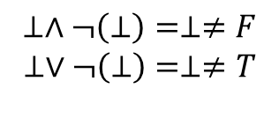
Modelling imperfect data: basic techniques
Modelling imperfect data
modelling incompleteness and missing data in information systems
from the database field: null values and default values
information loss
law of excluded middle does not hold
$$⊥∧¬\left(⊥\right)=⊥≠F$$
$$⊥∨¬\left(⊥\right)=⊥≠T$$
possibilistic approach
Kleene logic
The Project is co-financed by the European Union from resources of the European Social Fund

Slide 56
Modelling imperfect data: basic techniques
Modelling imperfect data
modelling incompleteness and missing data in information systems
the modelling of unknown data
‘unknown’
1
0
dom_{t}
The Project is co-financed by the European Union from resources of the European Social Fund

Slide 57
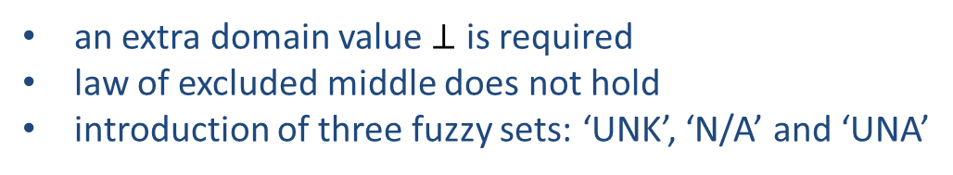
Modelling imperfect data: basic techniques
Modelling imperfect data
modelling incompleteness and missing data in information systems
the modelling of inapplicability (or undefined data)
an extra domain value $⊥$ is required
law of excluded middle does not hold
introduction of three fuzzy sets: ‘UNK’, ‘N/A’ and ‘UNA’
‘UNK’
‘N/A’
‘UNA’
1
1
1
0
⊥_{t}
dom_{t}
0
⊥_{t}
dom_{t}
0
⊥_{t}
dom_{t}
degrees of uncertainty
The Project is co-financed by the European Union from resources of the European Social Fund

Slide 58

Modelling imperfect data: basic techniques
Modelling imperfect data
modelling inconsistent data in information systems
can be seen as a special case of uncertainty
possibilistic approach can be used (no information loss)
strategies for resolving conflict
  majority
  most trusted
  data lineage (keep track of data life cycle)
degrees of uncertainty
The Project is co-financed by the European Union from resources of the European Social Fund

Slide 59

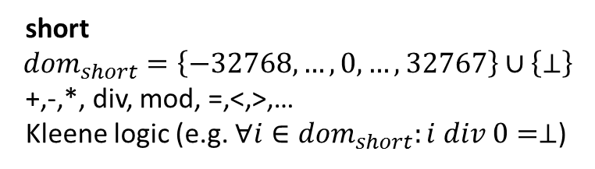
Modelling imperfect data: basic techniques
Modelling imperfect data
modelling imperfect data in information systems
data types and type system
short
$${dom}_{short}=\left\{−32768,…,0,…,32767\right\}∪\left\{⊥\right\}$$
+,-,*, div, mod, =,<,>,…
Kleene logic (e.g. $∀i∈{dom}_{short}:i div 0=⊥$)
domain
operators
axioms
extending type system vs. generalizing the type system
once declared and implemented it is difficult to change the strategy
The Project is co-financed by the European Union from resources of the European Social Fund

Slide 60

Modelling imperfect data: basic techniques
Modelling imperfect data
modelling imperfect data in information systems
extra meta data describing:
data types
fuzzy sets
linguistic terms
hedges
similarities
ontologies
user profiles
considering that interpretation might be subjective
The Project is co-financed by the European Union from resources of the European Social Fund

Slide 61
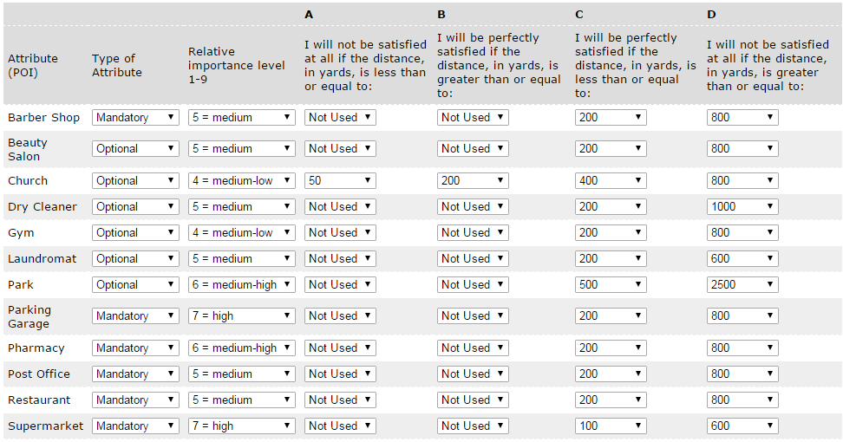
Modelling imperfect data: basic techniques
Modelling imperfect data
modelling imperfect data in information systems
modelling of membership functions
The Project is co-financed by the European Union from resources of the European Social Fund

Slide 62
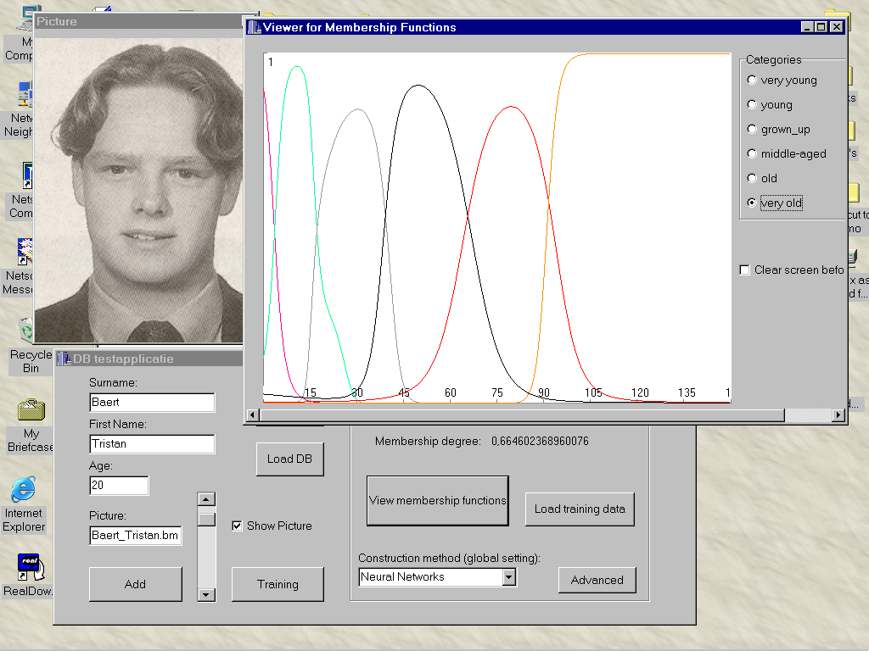
Modelling imperfect data: basic techniques
Modelling imperfect data
modelling imperfect data in
information systems
modelling of linguistic terms
The Project is co-financed by the European Union from resources of the European Social Fund

Slide 63

Questions?
Warsaw, June 22-26 2015
The Project is co-financed by the European Union from resources of the European Social Fund

