Slide 1
Outline
Data quality and big data challenges
Big data
Challenges
The CAP theorem
Data quality
Data profiling
Data deduplication
Data merging
The Project is co-financed by the European Union from resources of the European Social Fund

Slide 2
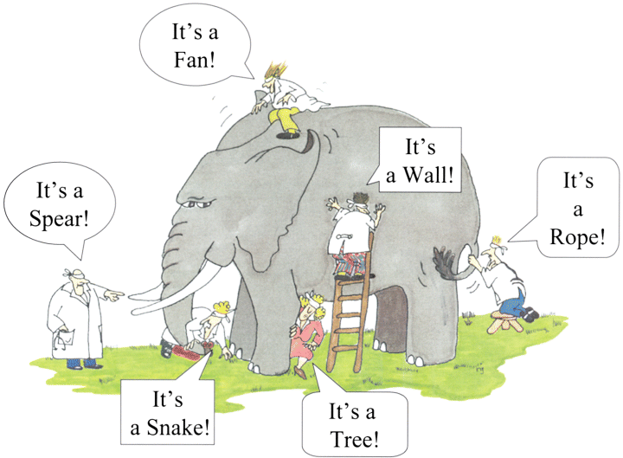
Data quality and big data challenges
Big data
what are big data?
The Project is co-financed by the European Union from resources of the European Social Fund

Slide 3
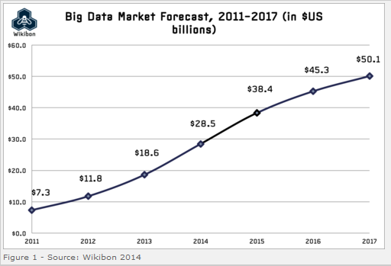
Data quality and big data challenges
Big data
are big data the next hype or reality?
The Project is co-financed by the European Union from resources of the European Social Fund

Slide 4
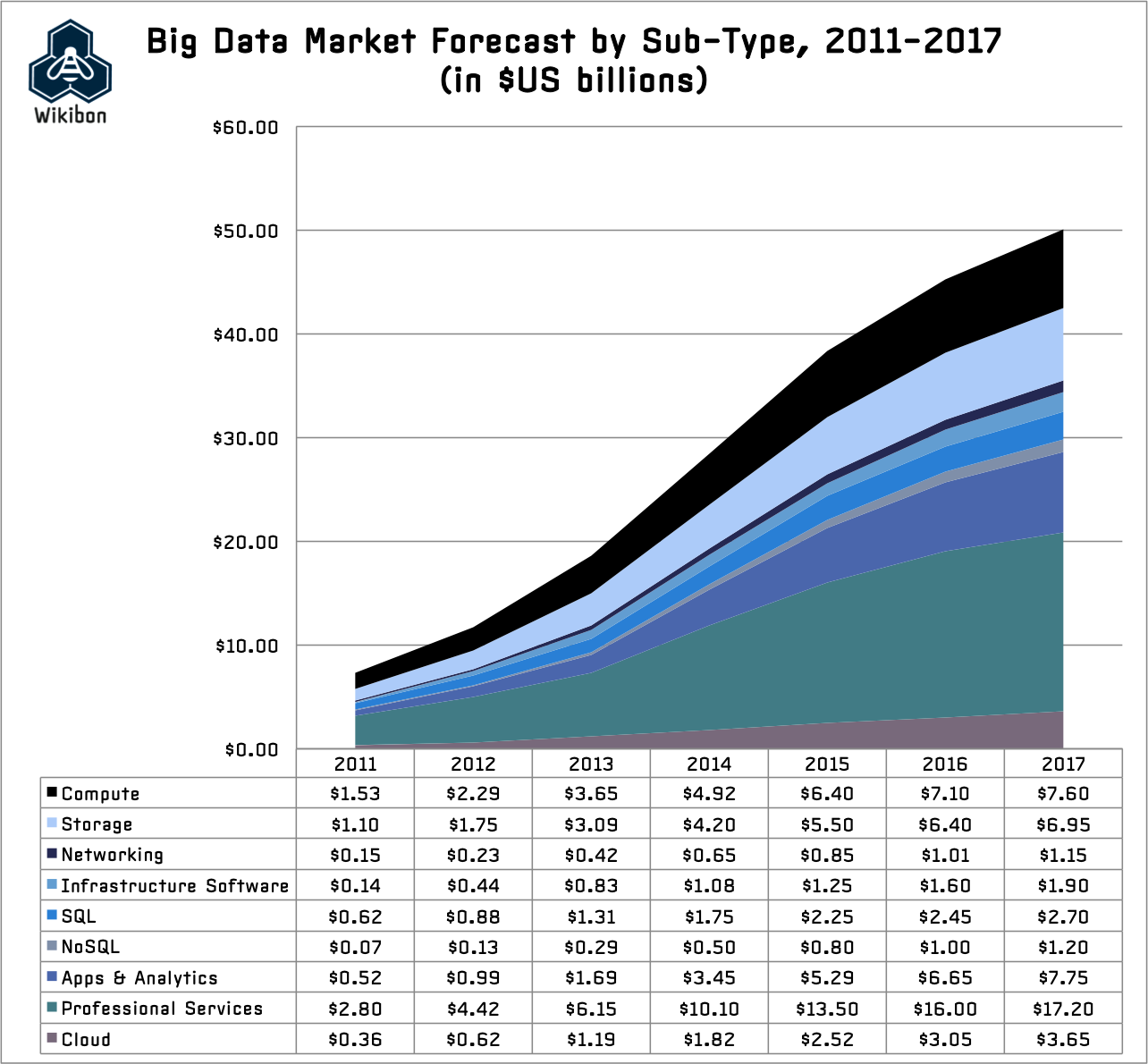
Data quality and big data challenges
Big data
are big data the next hype or reality?
The Project is co-financed by the European Union from resources of the European Social Fund

Slide 5
Data quality and big data challenges
Big data
where are big data?
The Project is co-financed by the European Union from resources of the European Social Fund

Slide 6
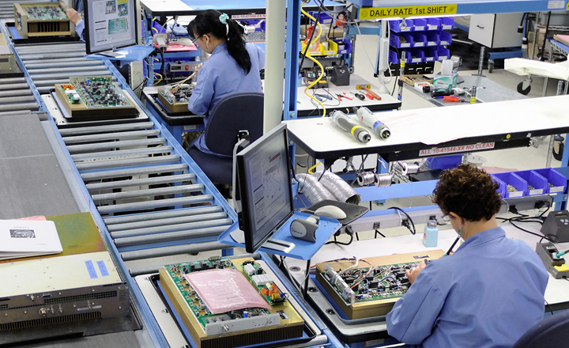
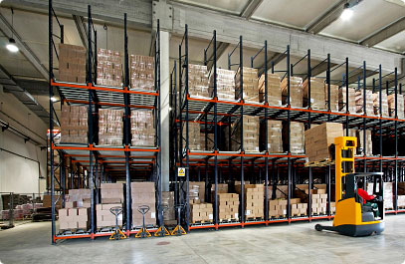
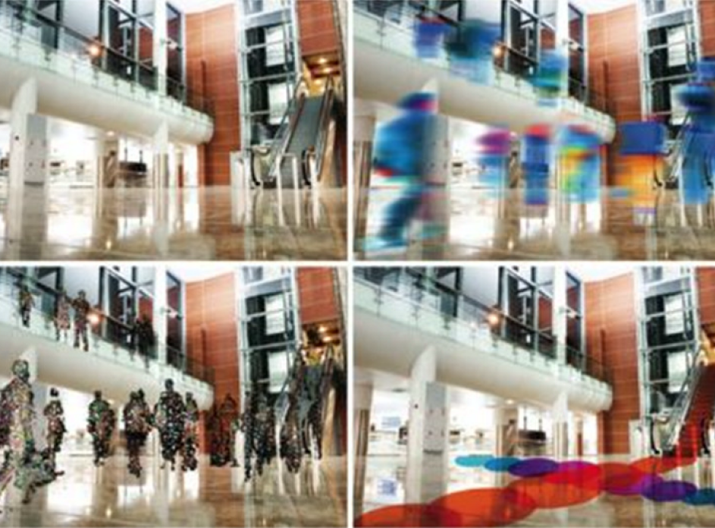
Data quality and big data challenges
Big data
where are big data?
The Project is co-financed by the European Union from resources of the European Social Fund

Slide 7
Data quality and big data challenges
Big data
what are big data?
Oxford English Dictionary:
“data of a very large size, typically to the extent that its manipulation and management present significant logistical challenges.”
Wikipedia:
“an all-encompassing term for any collection of data sets so large and complex that it becomes difficult to process using on-hand data management tools or traditional data processing applications.”
The Project is co-financed by the European Union from resources of the European Social Fund

Slide 8
Data quality and big data challenges
Big data
the four V’s of big data
Volume
Scale of Data
Variety
Different Forms of Data
Velocity
Streaming Data
Veracity
Imperfections of Data
The Project is co-financed by the European Union from resources of the European Social Fund

Slide 9
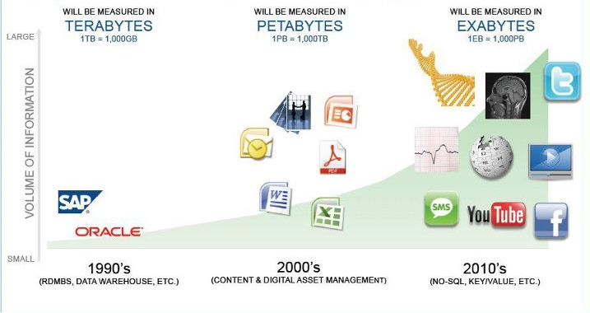
Data quality and big data challenges
Big data
volume: scale of data
The Project is co-financed by the European Union from resources of the European Social Fund

Slide 10
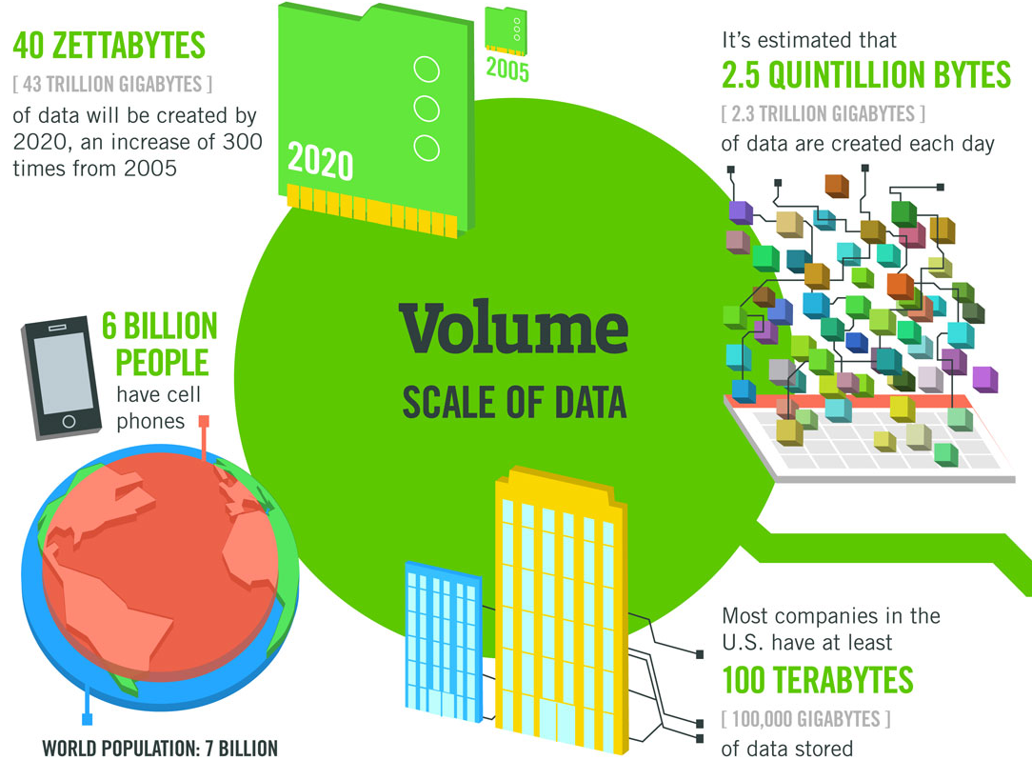
Data quality and big data challenges
Big data
The Project is co-financed by the European Union from resources of the European Social Fund

Slide 11
Data quality and big data challenges
Big data
variety: different forms of data
The Project is co-financed by the European Union from resources of the European Social Fund

Slide 12
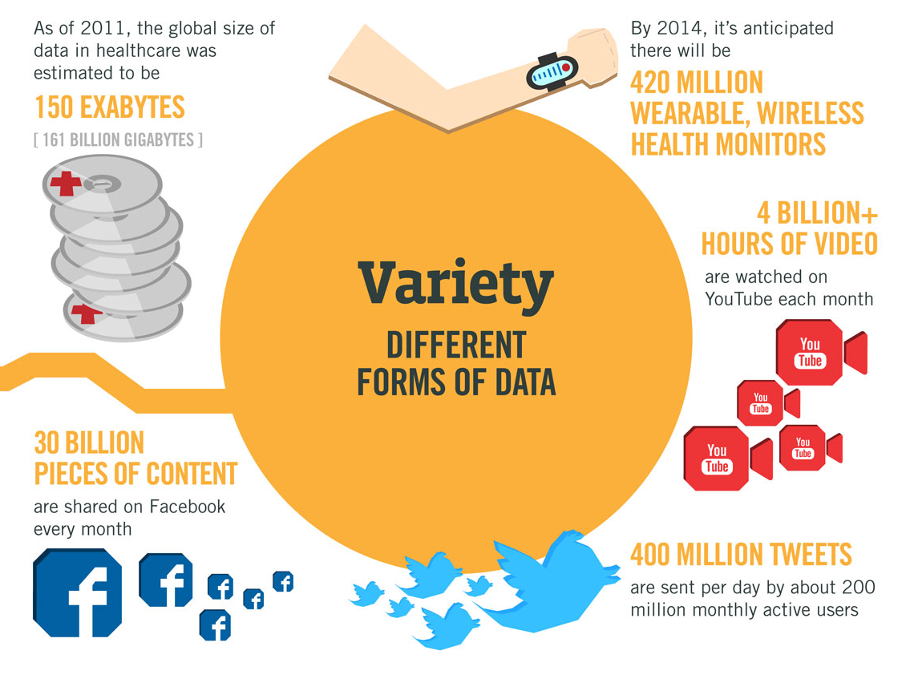
Data quality and big data challenges
Big data
The Project is co-financed by the European Union from resources of the European Social Fund

Slide 13
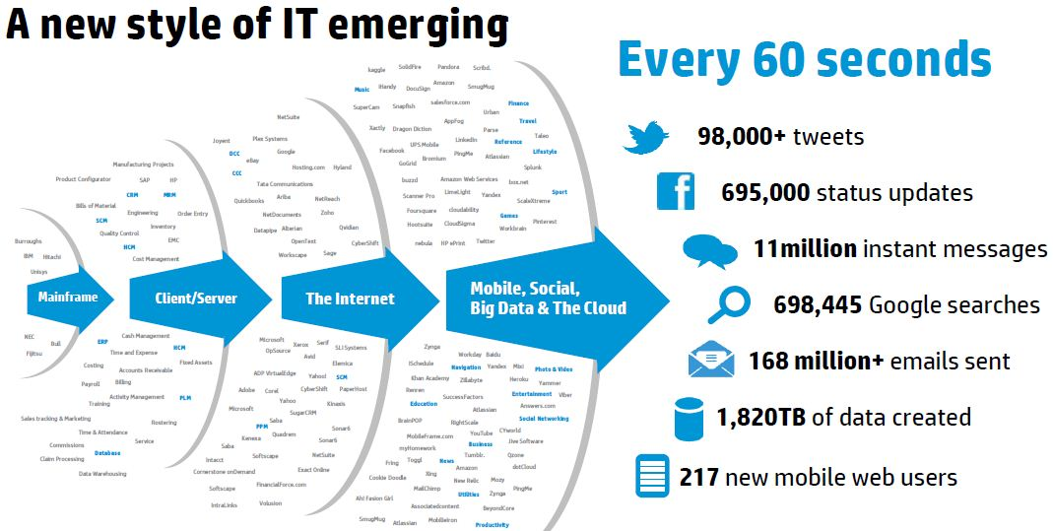
Data quality and big data challenges
Big data
velocity: streaming data
The Project is co-financed by the European Union from resources of the European Social Fund

Slide 14
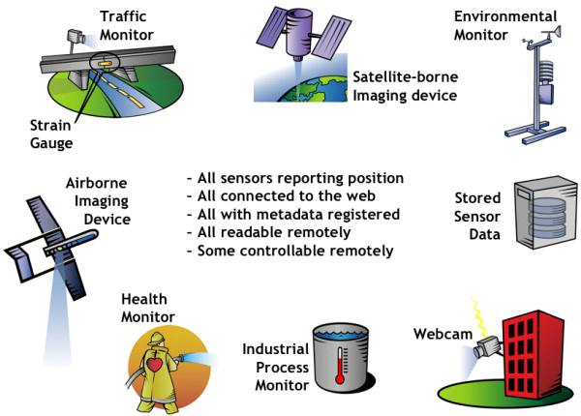
Data quality and big data challenges
Big data
The Project is co-financed by the European Union from resources of the European Social Fund

Slide 15
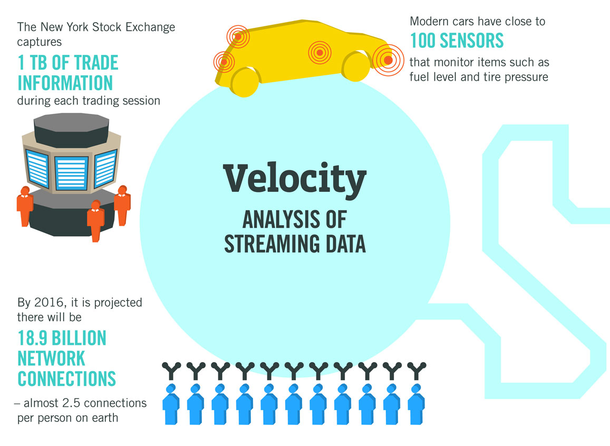
Data quality and big data challenges
Big data
The Project is co-financed by the European Union from resources of the European Social Fund

Slide 16
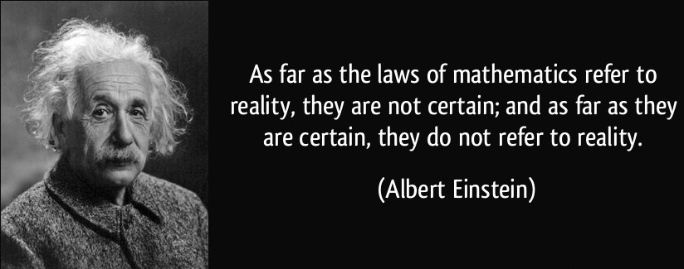
Data quality and big data challenges
Big data
veracity: imperfections of data
Imprecise data
Vague data
Uncertain data
Incomplete (missing) data
Inconsistent data
The Project is co-financed by the European Union from resources of the European Social Fund

Slide 17
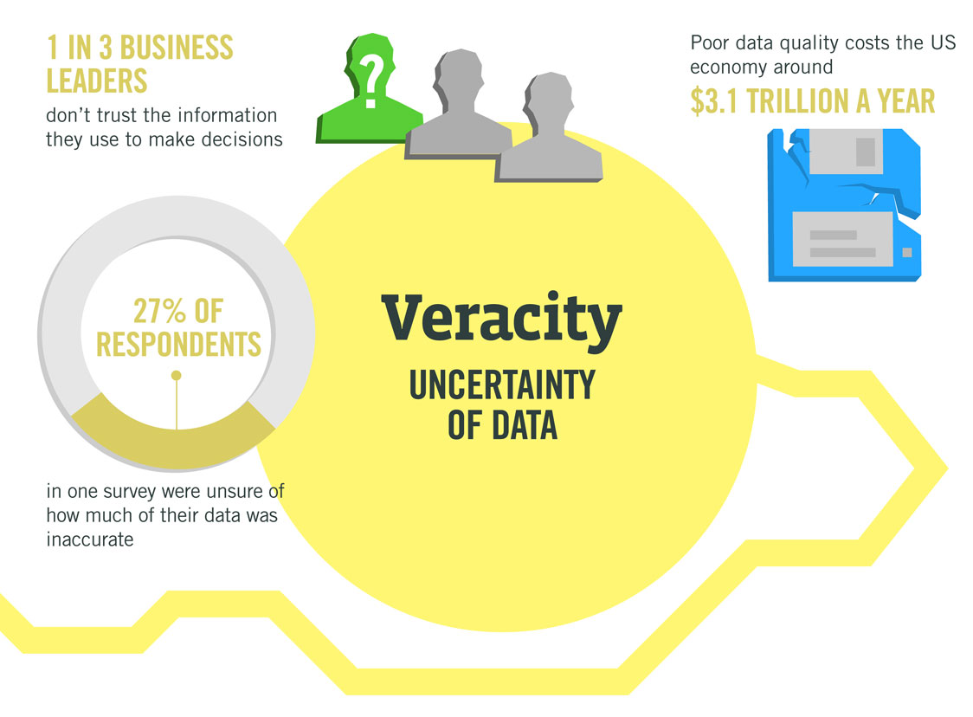
Data quality and big data challenges
Big data
The Project is co-financed by the European Union from resources of the European Social Fund

Slide 18
Data quality and big data challenges
Big data
back flushing
business
intelligence

?

extract
data
audit
load
data
statistics

detail
summary
decision
support
transform
meta data
data mining
data sources
ETL process
data warehouse & data marts
new data
The Project is co-financed by the European Union from resources of the European Social Fund

Slide 19
Data quality and big data challenges
Big data
back flushing
business
intelligence
Velocity

Velocity
Volume
data

extract
data
audit
load
statistics
Volume

detail
summary
Variability
decision
support
Variability
transform
meta data
Veracity
data mining
data sources
ETL process
data warehouse & data marts
Veracity
new data
The Project is co-financed by the European Union from resources of the European Social Fund

Slide 20
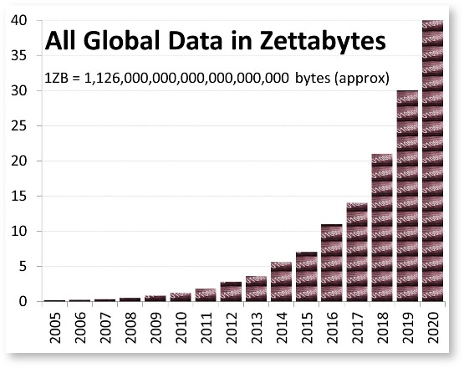
Data quality and big data challenges
Big data
what do we have to cope with?
Huge volumes
Consistency
Connectivity
Variety
Cloud Computing
Concurrency
The Project is co-financed by the European Union from resources of the European Social Fund

Slide 21
Data quality and big data challenges
Big data
the CAP theorem
Consistency
Availability
Partition tolerance
“Of three properties of shared systems: data consistency, system availability and tolerance to network partitions, only two can be achieved at any given moment in time”
Eric Brewer
We have to make a compromise! → CP, AP (or CA)
The Project is co-financed by the European Union from resources of the European Social Fund

Slide 22
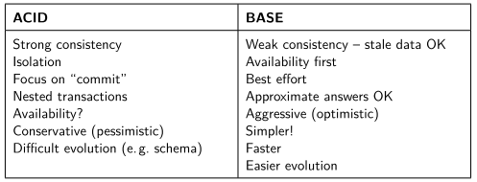
Data quality and big data challenges
Big data
Base
Basically available
Soft-state (not consistent all the time)
Eventual consistency (consistent in some known-state)
The Project is co-financed by the European Union from resources of the European Social Fund

Slide 23
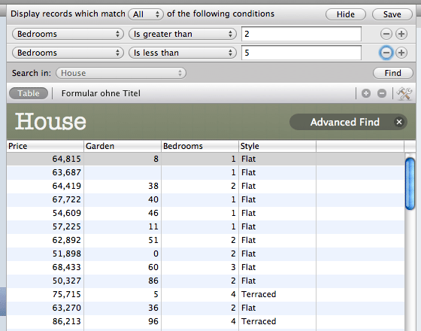
Data quality and big data challenges
Big data
Interface
Interface
Application
Application
responsibility for
data integrity/quality shifts
towards the application!
SQL based database system
NoSQL based database system
explicit quality control
becomes crucial
Increased consistency
Decreased consistency
The Project is co-financed by the European Union from resources of the European Social Fund

Slide 24
Data quality and big data challenges
Data quality
“There is a significant gap between perception and reality regarding the quality of data in many organisations.” (Report of the DWI, 2002)
“Data quality problems cost U.S. businesses more than 600 billion dollars per year.” (Report of the DWI, 2002)
“Data Quality is a multi-dimensional aspect that strongly influences the efficiency and effectiveness of an organization.” (Batini en Scannapieco, 2006)
The Project is co-financed by the European Union from resources of the European Social Fund

Slide 25
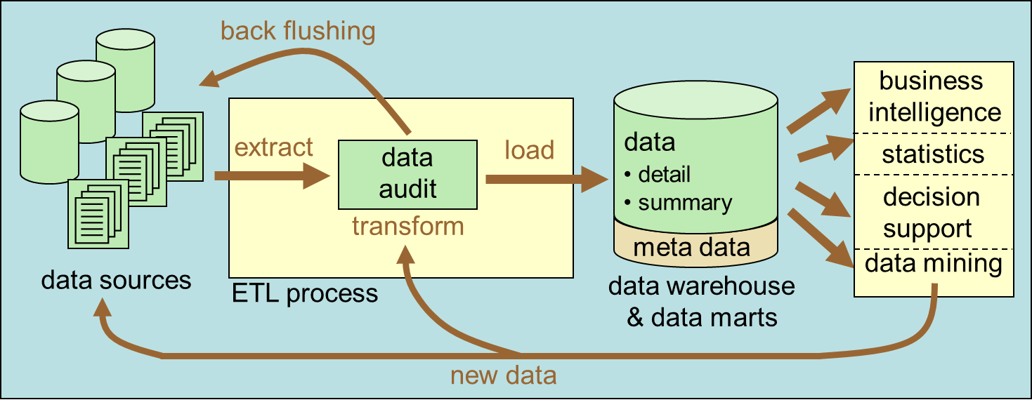
Data quality and big data challenges
Data quality
the ETL process
data extraction
data audit: error detection and correction
incorrect concept definitions
faulty field values
missing data
interpretation errors
data audit: data integration and transformation
duplicate and coreference detection
‘impedance mismatch’
unmatching data semantics
unmatching field formats
data loading
The Project is co-financed by the European Union from resources of the European Social Fund

Slide 26
Data quality and big data challenges
Data quality
data correctness
refers to the extent to which the data corresponds to reality
semantic vs. syntactic
attribute vs. relation vs. database
referential data
data consistency
refers to the extent to which a number of semantic rules are satisfied
keys
inclusion dependencies
functional dependencies
‘edit-imputation’
The Project is co-financed by the European Union from resources of the European Social Fund

Slide 27
Data quality and big data challenges
Data quality
Dependencies
Key
Functional
Inclusion
A group of attributes that functionally determines all other attributes.
Values of attributes functionally determine those of other attributes
Attribute values are included in the values of other attributes (e.g. foreign keys)
conditional and unconditional
R[ZIP] → R[City]
ID | city | zip
1 | Ghent | 9000
2 | Ghent | 9050
3 | Antwerp | 2000
SID | Name | Residence
1 | John | 1
2 | Lisa | 1
3 | Richard | 2
R[ID] → R[City]
R[ID] → R[ZIP]
S[Residence] $⊆$ R[ID]
The Project is co-financed by the European Union from resources of the European Social Fund

Slide 28
Data quality and big data challenges
Data quality
data completeness
refers to the extent to which enough data are available to perform a given task
schema
data: attribute vs. population
missing data
time-related aspects
volatility: speed of data changes; how actual are the data?
currency: speed of updates
timeliness: are the data available when needed?
quality of data vs. quality of schema
The Project is co-financed by the European Union from resources of the European Social Fund

Slide 29
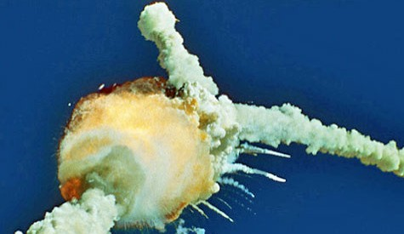
Data quality and big data challenges
Data quality
Something to read…
C.W. Fisher and B.R. Kingma, Criticality of data quality as exemplified in two disasters. Information & Management, 39, p. 109-116, 2001
28 January 1986: explosion Challenger
Rubber O-rings could not resist low temperatures, resulting in gas leaks.
July 1985: Problems with O-rings are reported as possibly catastrophic. Additional testing showed that problems with O-rings are not solved.
27 January 1986: Subcontractor Thiokol objects against launch because of O-rings. A six hour discussion with the NASA level III manager leads to the approval of Thiokol.
The Project is co-financed by the European Union from resources of the European Social Fund

Slide 30
Data quality and big data challenges
Data quality
Database NASA MIS
Consistency
Rubber O-rings were in some cases classified as redundant, in other cases as critical.
Correctness
Correctness
The O-ring issue was closed without an authorizing signature by one manager.
Schema completeness
Cross references between critical components and test planning was missing.
Data completeness
Thiokol used incomplete data in their temperature analysis for O-rings.
The Project is co-financed by the European Union from resources of the European Social Fund

Slide 31
Data quality and big data challenges
Data quality
data profiling
data cleansing
query optimization
data integration
Data profiling is the process of data inspection with the purpose of gathering statistics and information about those data
management of scientific data
analytics
The Project is co-financed by the European Union from resources of the European Social Fund

Slide 32
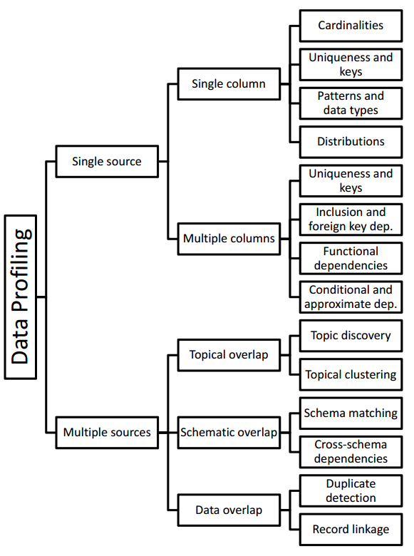
Data quality and big data challenges
Data quality
data profiling
query optimization
data integrity
deduplication/ coreference detection
The Project is co-financed by the European Union from resources of the European Social Fund

Slide 33
Data quality and big data challenges
Data quality
schema matching
Name | Surname | Gender | Telephone | Residence
Suzie | Klain | Female | 358-243.63.21 | Ghent
Firstname | Lastname | Phone | Email
Suzy | Klein | (358) 2436321 | suzy.klein@gmail.com
The Project is co-financed by the European Union from resources of the European Social Fund

Slide 34
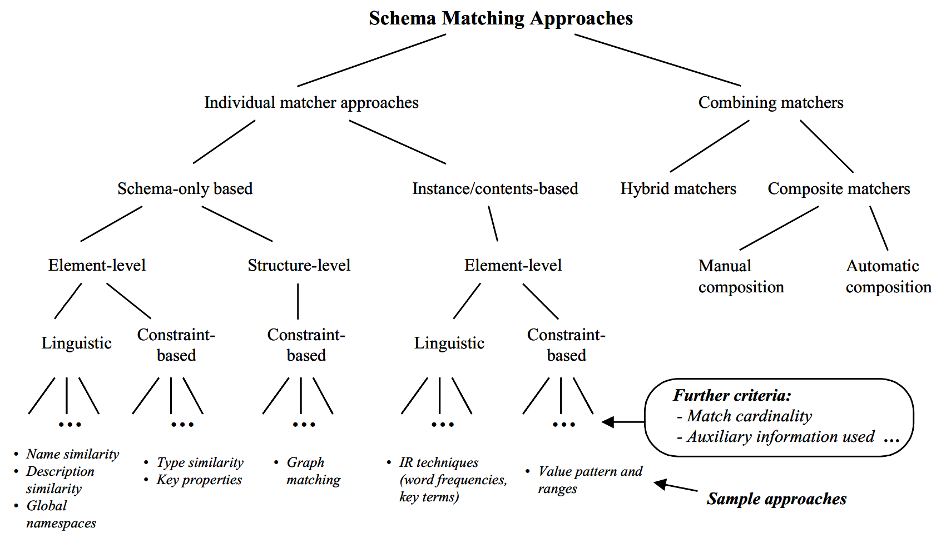
Data quality and big data challenges
Data quality
schema matching
The Project is co-financed by the European Union from resources of the European Social Fund

Slide 35
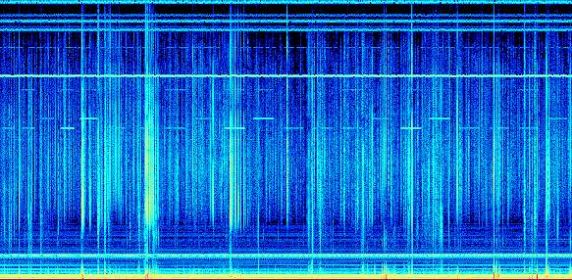
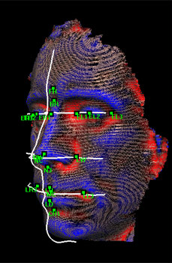
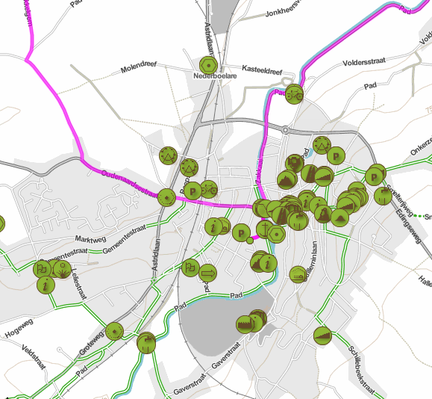
Data quality and big data challenges
Data quality
data deduplication
finding objects that describe the same real world entity: coreference detection
The Project is co-financed by the European Union from resources of the European Social Fund

Slide 36
Data quality and big data challenges
Data quality
data deduplication
assumption 1:
duplicate is beyond equal
Differences may occur
missing data
noise/errors
semantical differences
abbreviations
lack of standardization
subjective data
…
The Project is co-financed by the European Union from resources of the European Social Fund

Slide 37
Data quality and big data challenges
Data quality
data deduplication
assumption 2:
a suitable object representation is available
feature extraction
The Project is co-financed by the European Union from resources of the European Social Fund

Slide 38
Data quality and big data challenges
Data quality
data deduplication
assumption 3:
duplicates can be objectively recognized
Frozen
(Madonna, 1998)
Ma vie fout le camp
(S. Acquaviva, 1993)
Bloodnight
(S. Di Suoccio, 1983)
?
The Project is co-financed by the European Union from resources of the European Social Fund

Slide 39
Data quality and big data challenges
Data quality
data deduplication
assumption 4:
schema matching is done
Name | Surname | Telephone
Suzie | Klain | 358-243.63.21
Firstname | Lastname | Phone
Suzy | Klein | (358) 2436321
The Project is co-financed by the European Union from resources of the European Social Fund

Slide 40
Data quality and big data challenges
Data quality
data deduplication
an abstract model
Objects:
Entities:
$$O=U_{1}×…×U_{n}$$
$$E$$
goal: construct an equivalence relation $R$ over $O$
reflexive (each object is duplicate with itself)
symmetric (if $o_{1}$ and $o_{2}$ are duplicate, then so are $o_{2}$ and $o_{1}$)
(transitive) (if $o_{1}$ and $o_{2}$ are duplicate and if $o_{2}$ and $o_{3}$ are duplicate, then so are $o_{1}$ and $o_{3}$)
→ link with clustering
equivalent objects describe the same entity
The Project is co-financed by the European Union from resources of the European Social Fund

Slide 41
Data quality and big data challenges
Data quality
data deduplication
the size of an equivalence class $K$ is typically Zipf distributed
with $β>1$ and $M∈\text{IN}$
shape parameter
maximal number of elements in a cluster
The Project is co-financed by the European Union from resources of the European Social Fund

Slide 42
Data quality and big data challenges
Data quality
data deduplication
step 1: record linkage
Similarity measure $S_{i}$ for $U_{i}$
O₁ | O₂ | Score
Suzie | Suzy | 0.7
Klain | Klein | 0.8
358-243.63.21 | (358) 2436321 | 0.95
Calculate score vector
Map score vector to {match,no-match}
the typical distribution of equivalence class size has an important impact here
?
match
no-match
(manual revision)
The Project is co-financed by the European Union from resources of the European Social Fund

Slide 43
Data quality and big data challenges
Data quality
data deduplication
step 2: clustering
Generate clusters (match, no-match, revise) from the list of object pairs
Restore transitivity
 | o₁ | o₂ | o₃ | o₄ | o₅
o₁ | x | x
o₂ | x | x | x
o₃ | x | x | x
o₄ |  |  |  | x
o₅ |  |  |  |  | x
x
x
The Project is co-financed by the European Union from resources of the European Social Fund

Slide 44
Data quality and big data challenges
Data quality
data deduplication
indexed based methods for computing string similarity
a string is coded with a set of language specific rules such that similar sounds are mapped to the same code
examples: Soundex coding (Russel, 1918!), (Double) Metaphone
s | Soundex(s)
John | J500
Jon | J500
The Project is co-financed by the European Union from resources of the European Social Fund

Slide 45
Data quality and big data challenges
Data quality
data deduplication
indexed based methods for computing string similarity
Soundex coding
Keep the first letter of the surname as the prefix letter and completely ignore all occurrences of W and H in other positions.
Assign the following codes to the remaining letters:
{B, F, P, V } → 1
{C,G, J,K,Q, S,X,Z} → 2
{D, T} → 3
{L} → 4
{M,N} → 5
{R} → 6
A, E, I, O, U, and Y are not coded but serve as separators.
Consolidate sequences of identical codes by keeping only the first occurrence of the code.
Drop the separators.
Keep the letter prefix and the three first codes, padding with zeros if there are fewer than three codes.
s | Soundex(s)
John | J500
Jon | J500
The Project is co-financed by the European Union from resources of the European Social Fund

Slide 46
Data quality and big data challenges
Data quality
data deduplication
character based methods for computing string similarity
the similarity between two strings is calculated on a character-by-character comparison basis
examples: edit distance (Levenshtein, Damerau), heuristic method (Jaro, Winkler)
The Project is co-financed by the European Union from resources of the European Social Fund

Slide 47
Data quality and big data challenges
Data quality
data deduplication
character based methods for computing string similarity
edit distance
Keep track of the number of basic operations required to transform one string into the other.
Basic operations are insertion, deletion and substitution of a character. Each basic operation has a cost ($c_{I}$, $c_{D}$ and $c_{S}$).
The Levenshtein distance $d$ is a metric for which we have that:
$c_{I}=c_{D}=c_{S}=1$
$\left|len\left(a\right)−len\left(b\right)\right|≤d\left(a,b\right)≤max\left(len\left(a\right),len\left(b\right)\right)$
The Project is co-financed by the European Union from resources of the European Social Fund

Slide 48
Data quality and big data challenges
Data quality
data deduplication
character based methods for computing string similarity
edit distance
recursive algorithm: consider two strings $a=a_{1}…a_{n}$ and $b=b_{1}…b_{m}$
let $d_{i,j}$ be the distance between $a=a_{1}…a_{i}$ and $b=b_{1}…b_{j}$
initial step: $d_{i,0}=\sum_{k=1}^{i}{c_{D}}=i⋅c_{D} en d_{0,j}=\sum_{k=1}^{j}{c_{I}}=j⋅c_{I}$
recursive step:
$$d_{i,j}=\left\{\begin{matrix}d_{i−1,j−1} & a_{i}=b_{j} \\ \min\left(d_{i−1,j}+c_{D},d_{i,j−1}+c_{I},d_{i−1,j−1}+c_{S}\right) & a_{i}≠b_{j}\end{matrix}\right.$$
The Project is co-financed by the European Union from resources of the European Social Fund

Slide 49
Data quality and big data challenges
Data quality
initialisation
 |  | d | a | n | s
 | 0 | 1 | 2 | 3 | 4
t | 1
a | 2
n | 3
z | 4
e | 5
recursion
S
I
min
D
d → t: $\min\left(1+1, 1+1,0+1\right)=1$
Delete d + Insert t
Delete t + Insert d
Substitute d by t
The Project is co-financed by the European Union from resources of the European Social Fund

Slide 50
Data quality and big data challenges
Data quality
 |  | d | a | n | s
 | 0 | 1 | 2 | 3 | 4
t | 1 | 1 | 2 | 3 | 4
a | 2 | 2 | 1 | 2 | 3
n | 3 | 3 | 2 | 1 | 2
z | 4 | 4 | 3 | 2 | 2
e | 5 | 5 | 4 | 3 | 3
d a n s
t a n z e
S . . S I
The Project is co-financed by the European Union from resources of the European Social Fund

Slide 51
Data quality and big data challenges
Data quality
data deduplication
token based methods for computing string similarity
strings are transformed into a collection of substrings
example: Jaccard similarity of n-grams
n=3
transformation to a set of n-grams
i
n
f
o
r
m
a
t
i
o
n
p
o
o
l
$$\left\{inf,nfo,for,orm,rma,mat,ati,tio,ion,on_ ,n_p, _po,poo,ool\right\}$$
Jaccard similarity
The Project is co-financed by the European Union from resources of the European Social Fund

Slide 52
Data quality and big data challenges
Data quality
data deduplication
token based methods for computing string similarity
example: Cosine similarity of TF-IDF vectors
produce TF-IDF weight vectors
M
r
J
o
h
n
L
e
n
n
o
n
$$w_{t}={tf}_{t}∙{idf}_{t}$$
where
$${tf}_{t}=\frac{\# occurences of t in string}{\# terms in string}$$
TF-IDF engine
$${idf}_{t}=\log{\frac{\# strings}{\# strings that contain t}}$$
Cosine similarity
The Project is co-financed by the European Union from resources of the European Social Fund

Slide 53
Data quality and big data challenges
Data quality
data deduplication
soft computing
evaluation function (for co-reference detection)
$$E_{O}:O^{2}→\tilde{2^{I}}$$
where $E_{O}\left(o_{1},o_{2}\right)$ is a PTV expressing
the possibility that $o_{1}$ and $o_{2}$ are co-referent
the possibility that $o_{1}$ and $o_{2}$ are not co-referent
The Project is co-financed by the European Union from resources of the European Social Fund

Slide 54
Data quality and big data challenges
Data quality
data deduplication
soft computing: a two-level approach
inner-level: character based
weak string intersection via moving window
J
o
h
n
B
J
o
h
n
B
J
o
h
n
B
J
o
n
B
J
o
n
B
J
o
n
B
J
$$length=1$$
$${gap}_{1}=0$$
J
o
$$length=2$$
$${gap}_{2}=0$$
J
o
$$length=2$$
$${gap}_{3}=0$$
J
o
h
n
B
J
o
h
n
B
J
o
h
n
B
J
o
n
B
J
o
n
B
J
o
n
B
J
o
n
$$length=3$$
$${gap}_{4}=1$$
J
o
n
$$length=4$$
$${gap}_{5}=0$$
J
o
n
B
$$length=5$$
$${gap}_{6}=0$$
The Project is co-financed by the European Union from resources of the European Social Fund

Slide 55
Data quality and big data challenges
Data quality
data deduplication
inner-level: character based (cont‘d)
possibility of co-reference (PTV) of strings s and t
$$μ_{T}=\frac{length}{max\left(\left|s\right|,\left|t\right|\right)}$$
the longer the weak intersection, the better
$$μ_{F}=\frac{1}{max\left(\left|s\right|,\left|t\right|\right)}\sum_{i}{f\left({gap}_{i}\right)}$$
the larger the computation cost, the worser
function that reflects heuristics:
the more gaps, the worser
boundary gaps at the beginning or end are less worse
$$E_{O}\left(s,t\right)=\left\{\left(T, \frac{μ_{T}}{max\left(μ_{T},μ_{F}\right)}\right),\left(F,\frac{μ_{F}}{max\left(μ_{T},μ_{F}\right)}\right) \right\}$$
normalization
The Project is co-financed by the European Union from resources of the European Social Fund

Slide 56
Data quality and big data challenges
Data quality
data deduplication
outer-level: tokenization based
tokenization step
transform strings s and t into multisets $τ_{D}\left(s\right)$ and $τ_{D}\left(t\right)$ (with D a delimiter set)
substrings are not obliged to be in a specific order
M
r
J
o
h
n
L
e
n
n
o
n
{Mr, John, Lennon}
L
e
n
n
o
n
J
o
n
{Lennon, Jon}
evaluation step
step 1: injective mapping between multisets $τ_{D}\left(s\right)$ and $τ_{D}\left(t\right)$
each element of the smallest multiset is mapped to an element of the largest multiset yielding the largest PTV from the inner-level co-reference detection
{Lennon, Jon}
$$E_{O}\left(Lennon,Mr\right)=\left\{\left(F,1 \right)\right\}$$
$$E_{O}\left(Jon,Mr\right)=\left\{\left(F,1 \right)\right\}$$
$$E_{O}\left(Lennon,John\right)=\left\{\left(F,1 \right)\right\}$$
$$E_{O}\left(Jon,John\right)=\left\{\left(T,1\right),\left(F,0,2\right)\right\}$$
{Mr, John, Lennon}
$$E_{O}\left(Lennon,Lennon\right)=\left\{\left(T, 1\right)\right\}$$
$\left\{\left(T, 1\right)\right\}$, $\left\{\left(T,1\right),\left(F,0,2\right)\right\}$, $\left\{\left(F,1\right)\right\}$
The Project is co-financed by the European Union from resources of the European Social Fund

Slide 57
Data quality and big data challenges
Data quality
data deduplication
outer-level: tokenization based (cont‘d)
evaluation step
step 2: aggregation of the PTVs corresponding to the generated mapping
basic conjunctive aggregation for PTVs
$$\tilde{t_{1}}\tilde{∧}\tilde{t_{2}}=\left\{\left(T,i\left(μ_{\tilde{t_{1}}}\left(T\right),μ_{\tilde{t_{2}}}\left(T\right)\right)\right),\left(F,u\left(μ_{\tilde{t_{1}}}\left(F\right),μ_{\tilde{t_{2}}}\left(F\right)\right)\right) \right\}$$
too strict
ordered weighted conjunction
ordering $\tilde{{ t}_{1}}…\tilde{t_{n}}$ yields:$\tilde{t^{∗}}=\left[\tilde{t_{1}^{∗}},…,\tilde{t_{n}^{∗}}\right] \text{where} \tilde{t_{1}^{∗}}≥…≥\tilde{t_{n}^{∗}}$
$$\tilde{t_{1}}≥\tilde{t_{2}}⇔\left\{\begin{matrix}μ_{\tilde{t_{2}}}\left(F\right)≥μ_{\tilde{t_{1}}}\left(F\right)\text{, }\text{iff} μ_{\tilde{t_{1}}}\left(T\right)=μ_{\tilde{t_{2}}}\left(T\right)=1 \\ μ_{\tilde{t_{1}}}\left(T\right)≥μ_{\tilde{t_{2}}}\left(T\right)\text{, }\text{else}\end{matrix}\right.$$
weight vector: $w=\left[w_{1},…,w_{n}\right]$
$$E_{O}\left(s,t\right)={\tilde{⋀}}_{ow}\left(w,\tilde{t^{∗}}\right)={\tilde{ ⇒}}_{w}\left(w_{1},\tilde{t_{1}^{∗}}\right)\tilde{∧}…\tilde{∧}{\tilde{ ⇒}}_{w}\left(w_{n},\tilde{t_{n}^{∗}}\right)$$
The Project is co-financed by the European Union from resources of the European Social Fund

Slide 58
Data quality and big data challenges
Data quality
data deduplication
outer-level: tokenization based (cont‘d)
evaluation step (cont’d)
modelling the impact of a weight
$${\tilde{ ⇒}}_{w}\left(0,\tilde{t}\right)=\left\{\left(T,1\right)\right\}$$
$${\tilde{ ⇒}}_{w}\left(1,\tilde{t}\right)=\tilde{t}$$
$$\tilde{t}≤{\tilde{ ⇒}}_{w}\left(w,\tilde{t}\right)≤\left\{\left(T,1\right)\right\}$$
$$∀w∈\left[0,1\right]:\tilde{t_{1}}≤\tilde{t_{2}}⇒{\tilde{ ⇒}}_{w}\left(w,\tilde{t_{1}}\right)≤{\tilde{ ⇒}}_{w}\left(w,\tilde{t_{2}}\right)$$
$$∀\tilde{t}∈\tilde{2^{I}}:v≤w⇒{\tilde{ ⇒}}_{w}\left(v,\tilde{t}\right)≥{\tilde{ ⇒}}_{w}\left(w,\tilde{t}\right)$$
$$max\left(μ_{{\tilde{ ⇒}}_{w}\left(w,\tilde{t}\right)}\left(T\right),μ_{{\tilde{ ⇒}}_{w}\left(w,\tilde{t}\right)}\left(F\right)\right)=1$$
$${\tilde{ ⇒}}_{w}\left(w,\tilde{t}\right)=\left\{\begin{matrix}\left\{\left(T,1\right),\left(F,w∙μ_{\tilde{t}}\left(F\right)\right)\right\}\text{, }\text{iff} μ_{\tilde{t}}\left(T\right)=1 \\ \left\{\left(T,μ_{\tilde{t}}\left(T\right)+λ\right),\left(F,1\right)\right\}\text{, }\text{iff} μ_{\tilde{t}}\left(T\right)<min\left(1,1−λ\right) \\ \left\{\left(T,1\right),\left(F,w∙\left({2−μ}_{\tilde{t}}\left(T\right)\right)\right)\right\}\text{, }\text{else}\end{matrix}\right.$$
where
$$λ=\left(1−w\right)∙\left({2−μ}_{\tilde{t}}\left(T\right)\right)$$
The Project is co-financed by the European Union from resources of the European Social Fund

Slide 59
Data quality and big data challenges
Data quality
data deduplication
outer-level: tokenization based (cont‘d)
evaluation step (cont’d)
quatifier-based weight assignment (assuming that $\left|τ_{D}\left(s\right)\right|≤\left|τ_{D}\left(t\right)\right|$ )
$$q_{α,β,l}\left(x,\left|τ_{D}\left(s\right)\right| ,\left|τ_{D}\left(t\right)\right|\right)=\left\{\begin{matrix}1\text{, }\text{iff} x<α\left|τ_{D}\left(s\right)\right| \\ l\text{, }\text{iff} x>\left|τ_{D}\left(t\right)\right|+β\left(\left|τ_{D}\left(t\right)\right|−\left|τ_{D}\left(s\right)\right|\right) \\ 1+\frac{\left(l−1\right)\left(x−α\left|τ_{D}\left(s\right)\right|\right)}{\left(1−α−β\right)\left|τ_{D}\left(s\right)\right|+β\left|τ_{D}\left(t\right)\right|},\text{else}\end{matrix}\right.$$
1
$$q_{α,β,l}$$
else strong reflexivity is not guaranteed
l
weights should reflect the number of co-referent terms that are required to conclude that both strings are co-referent
0
$$α\left|τ_{D}\left(s\right)\right|$$
IN
$$\left|τ_{D}\left(t\right)\right|+β\left(\left|τ_{D}\left(t\right)\right|−\left|τ_{D}\left(s\right)\right|\right)$$
$$∀i∈\left\{1,…,\left|τ_{D}\left(t\right)\right|\right\}:w_{i}=q_{α,β,l}\left(i,\left|τ_{D}\left(s\right)\right| ,\left|τ_{D}\left(t\right)\right|\right)$$
The Project is co-financed by the European Union from resources of the European Social Fund

Slide 60
Data quality and big data challenges
Data quality
We have duplicates! What now?
Once duplicates are identified, they need to be merged/fused into a “master” object.
pbid | title | journal | pages
1 | Data fusion | Int. Journal of Something | -
2 | Studies of Data Fusion | - | -
3 | A study of Data fuson | Journal of Things | 10-18
Complete
Correct
Consistent
The Project is co-financed by the European Union from resources of the European Social Fund

Slide 61
Data quality and big data challenges
Data quality
data merging
Sort and select
Compositional
E.g.: Most Recent
Requires mergers for attributes
Composition may need constraints
Both strategies can benefit from taking into account dependencies between sources, especially if the data origins from the web.
The Project is co-financed by the European Union from resources of the European Social Fund

Slide 62
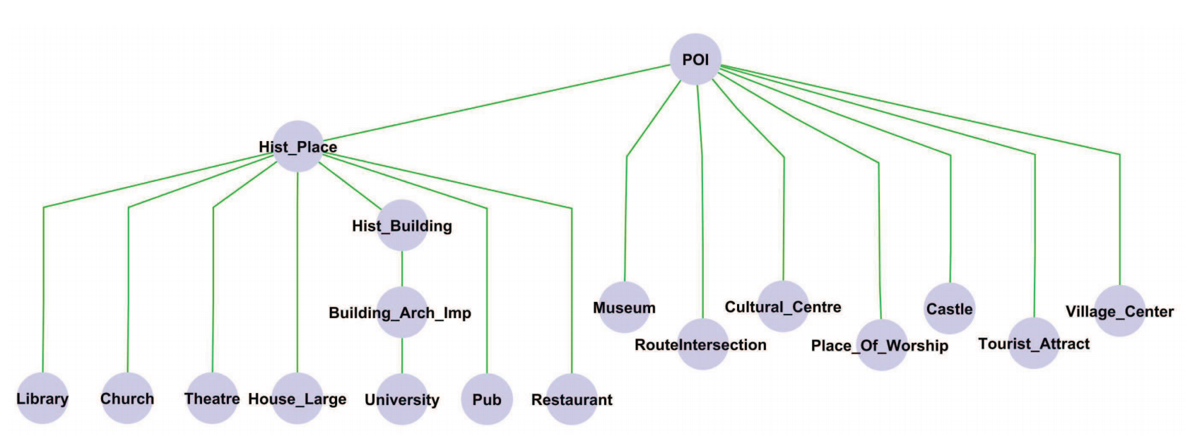
Data quality and big data challenges
Data quality
data merging
attribute merging
Naive (majority voting, coalesce – random non-null value)
Exploit data type:
Numerical (min, max, median, average…)
Textual (concatenate, shortest/longest, align-and-merge…)
Use of dynamically inferred ontologies (most general/most specific)
The Project is co-financed by the European Union from resources of the European Social Fund

Slide 63
Data quality and big data challenges
Data quality
data merging
fusion of relationships
Forward propagation
paper
authorship
author
pbid
title
journal
pages
pbid
aid
rank
aid
firstname
name
Each paper has a set of authors, that needs to be fused accordingly. Multi-valued fusers can ensure quality in relationships.
The Project is co-financed by the European Union from resources of the European Social Fund

Slide 64
Data quality and big data challenges
Data quality
data merging
soft computing
multisets
$M$ is characterized by its counting function $ω_{M}:U→IN$
cardinality $\left|M\right|=\sum_{u∈U}{ω_{M}\left(u\right)}$
operators
$$∀u∈U:ω_{A∪B}\left(u\right)=max\left(ω_{A}\left(u\right),ω_{B}\left(u\right)\right)$$
$$∀u∈U:ω_{A∩B}\left(u\right)=min\left(ω_{A}\left(u\right),ω_{B}\left(u\right)\right)$$
$$∀u∈U:ω_{A⊕B}\left(u\right)=ω_{A}\left(u\right)+ω_{B}\left(u\right)$$
k-cut
$$M_{k}=\left\{u|u∈U∧ω_{M}\left(u\right)≥k\right\}$$
The Project is co-financed by the European Union from resources of the European Social Fund

Slide 65
Data quality and big data challenges
Data quality
data merging
soft computing
merge function
$${\overline{ω}}_{O}:ℳ\left(O\right)→O$$
where $ℳ\left(O\right)$ is the set of all multisets over $O$
some desired properties
idempotency: $∀o∈O:{\overline{ω}}_{O}\left(\left\{o,…,o\right\}\right)=o$
preservation: $∀M∈ℳ\left(O\right):{\overline{ω}}_{O}\left(M\right)∈M$
majority rule: $∀M∈ℳ\left(O\right),{∃o∈O:ω_{M}\left(o\right)>\frac{\left|M\right|}{2}⇒\overline{ω}}_{O}\left(M\right)=o$
The Project is co-financed by the European Union from resources of the European Social Fund

Slide 66
Data quality and big data challenges
Data quality
data merging
merging of atomic objects
consider a multiset M of co-referent objects (detected using an evaluation function $E_{O}$)
an object u in M is compared with all objects in M using $E_{O}$, yielding a multiset ${\tilde{P}}_{u}$ of PTVs
$${\tilde{P}}_{u}=\left\{\tilde{t}|u^{′}∈M:\tilde{t}=E_{O}\left(u,u^{′}\right)\right\}$$
estimating the number of objects that are co-referent to u according to evaluator $E_{O}$
$$π_{IN}^{u}\left(k\right)=min\left(sup\left\{α∈\left[0,1\right]|\left|\left\{\tilde{t}∈{\tilde{P}}_{u}|μ_{\tilde{t}}\left(T\right)≥α\right\}\right|≥k\right\}, \right.$$
$$\left.sup\left\{α∈\left[0,1\right]|\left|\left\{\tilde{t}∈{\tilde{P}}_{u}|μ_{\tilde{t}}\left(F\right)<α\right\}\right|≥k\right\}\right)$$
The Project is co-financed by the European Union from resources of the European Social Fund

Slide 67
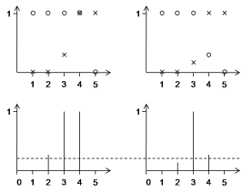
Data quality and big data challenges
Data quality
data merging
merging of atomic objects (cont’d)
in practice:
$$π_{IN}^{u}\left(k\right)=\left\{\begin{matrix}μ_{\tilde{t_{k}^{∗}}}\left(F\right),k=0 \\ μ_{\tilde{t_{k}^{∗}}}\left(T\right),k=\left|M\right| \\ min\left(μ_{\tilde{t_{k}^{∗}}}\left(T\right),μ_{\tilde{t_{k+1}^{∗}}}\left(F\right)\right), \text{else}\end{matrix}\right.$$
where $\tilde{t_{k}^{∗}}$ is the k^{th} largest PTV in ${\tilde{P}}_{u}$
set of PTVs
examples:
$$□: μ_{\tilde{t}}\left(T\right)$$
$$\text{x}: μ_{\tilde{t}}\left(F\right)$$
fuzzy integers
$$π_{IN}^{u}\left(k\right)$$
The Project is co-financed by the European Union from resources of the European Social Fund

Slide 68
Data quality and big data challenges
Data quality
data merging
merging of atomic objects (cont’d)
sup-order of fuzzy integers
$$\tilde{n}≺_{sup}\tilde{m}⇔\sup{{\tilde{n}}_{α}<}\sup{{\tilde{m}}_{α}}$$
where${ \tilde{n}}_{α}$is the α-cut of $\tilde{n}$ where α is chosen such that:
$$α=sup\left\{x|\sup{{\tilde{n}}_{x}≠}\sup{{\tilde{m}}_{x}}\right\}$$
The Project is co-financed by the European Union from resources of the European Social Fund

Slide 69
Data quality and big data challenges
Data quality
data merging
merging of atomic objects (cont’d)
evaluator driven merge function for atomic universes U
$${\overline{ω}}_{U}^{e}:ℳ\left(U\right)→U:M→\arg{\max_{u∈M}} π_{IN}^{u}$$
where$π_{IN}^{u}$ is the fuzzy number obtained from the multiset
of PTVs expressing the number of elements in M that are coreferent to u
$${\tilde{P}}_{u}=\left\{\tilde{t}|u^{′}∈M:\tilde{t}=E_{O}\left(u,u^{′}\right)\right\}$$
The Project is co-financed by the European Union from resources of the European Social Fund

Slide 70
Data quality and big data challenges
Data quality
data merging
merging of complex objects
consider a complex universe $O=U_{1}×…×U_{n}$, a composite merge function is defined by
$${\overline{ω}}_{O}^{c}:ℳ\left(O\right)→O:M→\left({\overline{ω}}_{U_{1}}\left({Proj}_{1}\left(M\right)\right),…,{\overline{ω}}_{U_{n}}\left({Proj}_{n}\left(M\right)\right)\right)$$
where ${Proj}_{i}\left(M\right)∈ℳ\left(U_{i}\right)$ such that
$$ω_{{Proj}_{i}\left(M\right)}\left(u\right)=\sum_{o∈M∧o_{i}=u}{ω_{M}\left(o\right)}$$
an example of a preservative composite merge function is
$${\overline{ω}}_{O}^{∗}:ℳ\left(O\right)→O:M→\arg{\max_{o∈M}}\left(ω_{M}\left(o\right)∙\left|\left\{i|o_{i}={\overline{ω}}_{O}^{c}{\left(M\right)}_{i}\right\}\right|\right)$$
The Project is co-financed by the European Union from resources of the European Social Fund

Slide 71
Questions?
Warsaw, June 22-26 2015
The Project is co-financed by the European Union from resources of the European Social Fund

