Slide 1
Part II: Soft computing techniques in searching and querying
Prof. Dr. Guy De Tré
Warsaw, June 22-26 2015
The Project is co-financed by the European Union from resources of the European Social Fund

Slide 2
Preliminaries
Information systems
Information systems in a company
0
Making
Decisions
End User
Increasing potential for supporting business decision making
Data Presentation
Business Analyst
Visualization techniques
Data Mining
Data Analyst
Discovery of new information
Data exploration
Statistical analyses, querying and reporting
Data Warehouses / Data Marts
OLAP, Business Intelligence
DBA
Data Sources
Files, Data Providers, Database systems, OLTP
The Project is co-financed by the European Union from resources of the European Social Fund

Slide 3
Preliminaries
Information systems
back flushing
business
intelligence


extract
data
audit
load
data
statistics

detail
summary
decision
support
transform
meta data
data mining
data sources
ETL process
data warehouse & data marts
new data
search and querying
information modelling
The Project is co-financed by the European Union from resources of the European Social Fund

Slide 4
Outline
Soft computing in searching and querying: basic techniques (2hrs.)
Soft computing in searching and querying: advanced techniques (1hr.)
Soft computing in decision support (2hrs.)
The Project is co-financed by the European Union from resources of the European Social Fund

Slide 5
Outline
Soft computing in searching and querying: basic techniques
Fuzzy querying of regular databases
Evaluation
Aggregation
Database query languages
Fuzzy querying of ‘fuzzy’ databases
Evaluation
Aggregation
Handling missing information
Database query languages
The Project is co-financed by the European Union from resources of the European Social Fund

Slide 6
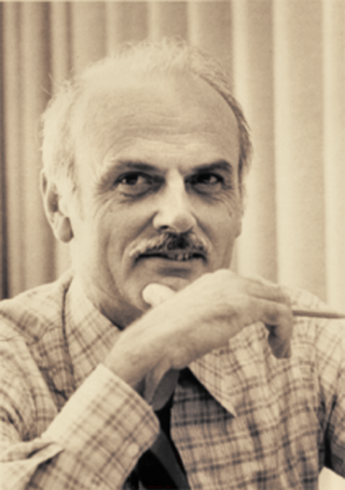
Soft computing in searching and querying: basic techniques
Fuzzy querying of
regular databases
1970: “A Relational Model for Large Shared Data Banks”, Communications of the ACM, Vol. 13, No. 6 (June 1970); reprinted in Communications of the ACM, Vol. 26, No. 1 (January 1983).
Ted Codd 1923-2003
The Project is co-financed by the European Union from resources of the European Social Fund

Slide 7
Soft computing in searching and querying: basic techniques
Fuzzy querying of
regular databases
1979: first commercial relational database system
Larry Ellison 1944-
The Project is co-financed by the European Union from resources of the European Social Fund

Slide 8
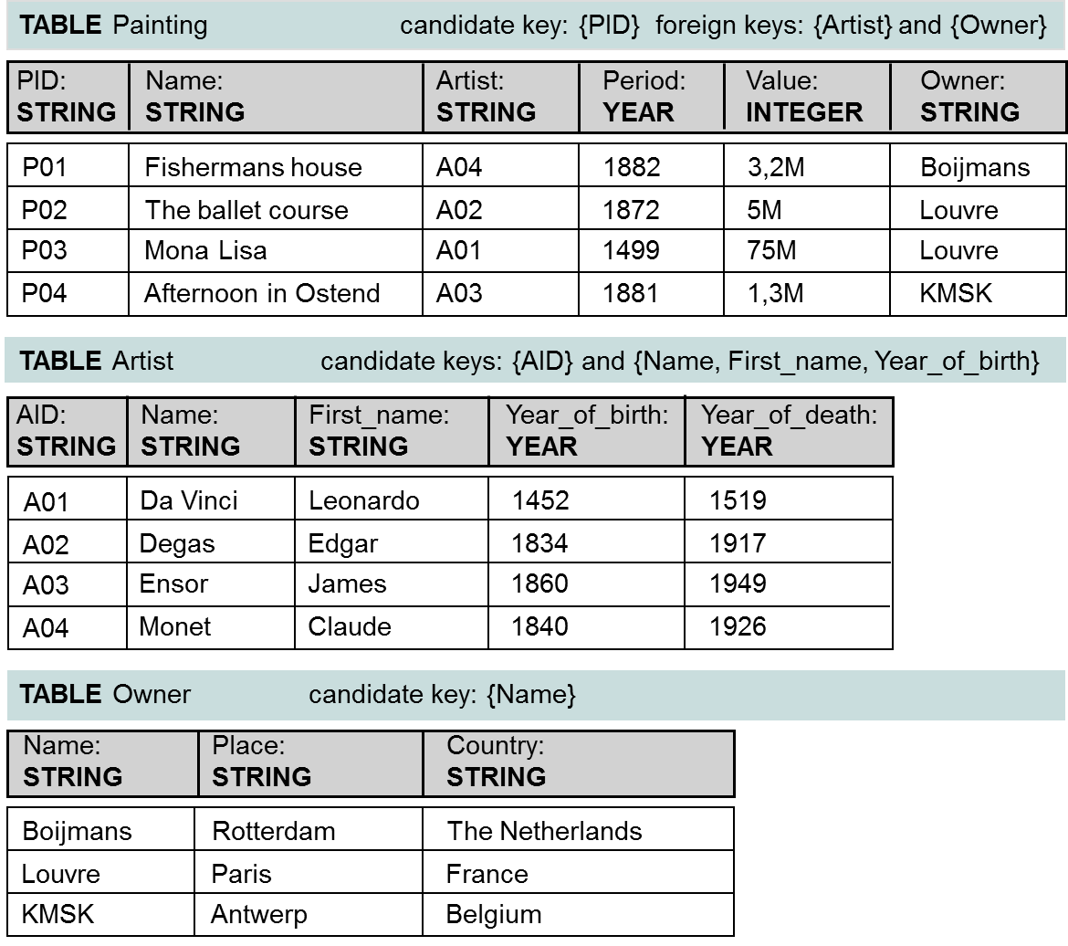
Soft computing in searching and querying: basic techniques
Fuzzy querying of
regular databases
The Project is co-financed by the European Union from resources of the European Social Fund

Slide 9
Soft computing in searching and querying: basic techniques
Fuzzy querying of
regular databases
DDL
DML
SQL/PSM
database querying SELECT [ALL|DISTINCT]{*|(column_expression [AS new_name][,…])} FROM ({name}[alias][,…]) [WHERE search_condition] [{GROUP BY column_list}[HAVING search_condition]] [ORDER BY column_list]
The Project is co-financed by the European Union from resources of the European Social Fund

Slide 10
Soft computing in searching and querying: basic techniques
Fuzzy querying of
regular databases
flexible querying
introduce flexibility in querying
auto-correct syntactic and semantic errors
intelligent database navigation
support for ‘indirect’ answers like summaries
support for conditional answers
providing background information with (empty) query results
…
support for flexible user preferences ‘fuzzy’ querying
The Project is co-financed by the European Union from resources of the European Social Fund

Slide 11
Soft computing in searching and querying: basic techniques
Fuzzy querying of
regular databases
fuzzy querying
introduce flexible preferences in querying
preferences inside query conditions
preferences between query conditions
P. Bosc, D. Kraft, and F. Petry, ``Fuzzy sets in database and information systems: status and opportunities'', Fuzzy Sets and Systems 153 3 (2005) 418--426.
The Project is co-financed by the European Union from resources of the European Social Fund

Slide 12
Soft computing in searching and querying: basic techniques
Fuzzy querying of
regular databases
fuzzy querying
preferences inside query conditions
‘inside’
preferences
users only approximately describe what they are looking for
limited knowledge e.g. was the painting painted in 1882, 1883 or in 1884?
allow some tollerance e.g. students with a high score in math
The Project is co-financed by the European Union from resources of the European Social Fund

Slide 13
Soft computing in searching and querying: basic techniques
Fuzzy querying of
regular databases
modelling
‘inside’
preferences
approach
model user preferences by labeled fuzzy sets $L$
use modification functions to deal with linguistic hedges almost, apparently, fairly, in part, nearly, relatively, somewhat, …
painted ‘around_1883’
‘high_score’ in math
1
1
0
date
0
0
10
14
16
20
score
1881
1882
1883
1884
1885
degrees of compatibility (with user preferences)
The Project is co-financed by the European Union from resources of the European Social Fund

Slide 14
Soft computing in searching and querying: basic techniques
Fuzzy querying of
regular databases
modelling
‘inside’
preferences
user preferences can depend on:
the subjectivity of the user
‘old’ for a child vs. ‘old’ for an adult vs. ‘old’ for a senior
the context
‘expensive’ for a car vs. ‘expensive’ for a book
need for user profiles
The Project is co-financed by the European Union from resources of the European Social Fund

Slide 15
Soft computing in searching and querying: basic techniques
Fuzzy querying of
regular databases
The Project is co-financed by the European Union from resources of the European Social Fund

Slide 16
Soft computing in searching and querying: basic techniques
Fuzzy querying of
regular databases
‘inside’
preferences
satisfaction degrees
$$s∈\left[0,1\right]$$
possibilistic truth values (in view of a later generalization)
$$\tilde{t}∈\tilde{2^{I}}$$
The Project is co-financed by the European Union from resources of the European Social Fund

Slide 17
Soft computing in searching and querying: basic techniques
Fuzzy querying of
regular databases
evaluation with satisfaction degrees
simple conditions for attribute $A$
‘inside’
preferences
comparison operators $=$,$≠$
transform the attribute value $r\left[A\right]$ to a fuzzy set $V=\left\{\left(r\left[A\right],1\right)\right\}$
standard equality: $e\left(A=L\right)\left(r\right)⟺\left(∀x∈U:μ_{V}\left(x\right)=μ_{L}\left(x\right)\right)$
gradual equality: $e\left(A=L\right)\left(r\right)=deg\left(V=L\right)=i\left(deg\left(V⊆L\right),deg\left(L⊆V\right)\right)$
comparison operators $op∈\left\{<,>,≤,≥\right\}$
transform the attribute value $r\left[A\right]$ to a fuzzy set $V=\left\{\left(r\left[A\right],1\right)\right\}$
apply Zadeh’s extension principle
$${e\left(A op L\right)\left(r\right)=sup}_{\left\{x|x∈U∧r\left[A\right] op x\right\}}μ_{L}\left(x\right)$$
The Project is co-financed by the European Union from resources of the European Social Fund

Slide 18
Soft computing in searching and querying: basic techniques
Fuzzy querying of
regular databases
evaluation with satisfaction degrees
simple conditions for attribute $A$ (cont’d)
‘inside’
preferences
compatibility operator $IS$
$$e\left(A IS L\right)\left(r\right)=μ_{L}\left(r\left[A\right]\right)$$
$$e\left(Period IS around_1883\right)$$
$$e\left(Score IS high_score\right)$$
1
1
0.5
0
date
0
0
10
14
16
18
20
score
1881
1883
1884
1885
$$=r\left[Score\right]$$
1882$=r\left[Period\right]$
The Project is co-financed by the European Union from resources of the European Social Fund

Slide 19
Soft computing in searching and querying: basic techniques
Fuzzy querying of
regular databases
evaluation with satisfaction degrees
simple conditions for attribute $A$ (cont’d)
‘inside’
preferences
fuzzy comparison operator $op$ characterized by $μ_{op}:U×U→\left[0,1\right]$
$$e\left(A op L\right)\left(r\right)=μ_{L∘op}\left(r\left[A\right]\right)$$
where
$$μ_{L∘op}\left(r\left[A\right]\right)=\sup_{x∈U}min\left(μ_{op}\left(r\left[A\right],x\right),μ_{L}\left(x\right)\right)$$
e.g.
$$μ_{approximately_equal}$$
$$μ_{much_larger_than}$$
The Project is co-financed by the European Union from resources of the European Social Fund

Slide 20
Soft computing in searching and querying: basic techniques
Fuzzy querying of
regular databases
evaluation with satisfaction degrees
simple conditions for attribute $A$ (cont’d)
‘inside’
preferences
the compatibility operator $IS$ is a very powerful operator
$$e\left(Score IS much_lower_than_14\right)$$
$$e\left(Score IS lower_than_14\right)$$
1
1
0
0
10
14
16
18
20
score
0
0
10
14
16
18
20
score
The Project is co-financed by the European Union from resources of the European Social Fund

Slide 21
Soft computing in searching and querying: basic techniques
Fuzzy querying of
regular databases
evaluation with satisfaction degrees
composed conditions - aggregation
‘inside’
preferences
conjunction. $μ_{p∧q}=i\left(μ_{p},μ_{q}\right)$
disjunction. $μ_{p∨q}=u\left(μ_{p},μ_{q}\right)$
negation. $μ_{¬\left(p\right)}=1−μ_{p}$
negation has precedency over conjunction and disjunction, whereas conjunction has precedency over disjunction
The Project is co-financed by the European Union from resources of the European Social Fund

Slide 22
Soft computing in searching and querying: basic techniques
Fuzzy querying of
regular databases
‘inside’
preferences
evaluation with possibilistic truth values
to be included in a query result, a record $r$ should not evaluate
to a possibilistic truth value false ($\left\{\left(F,1\right)\right\}$)
the possibilistic truth value expresses to which extent it is possible (or impossible) that the record satisfies the flexible user criteria
The Project is co-financed by the European Union from resources of the European Social Fund

Slide 23
Soft computing in searching and querying: basic techniques
Fuzzy querying of
regular databases
evaluation with possibilistic truth values
‘inside’
preferences
simple conditions for attribute $A$
comparison operators $=$,$≠$
transform the attribute value $r\left[A\right]$ to a fuzzy set $V=\left\{\left(r\left[A\right],1\right)\right\}$
standard equality: $e\left(A=L\right)\left(r\right)=\left\{\begin{matrix}\left\{\left(T,1\right)\right\}\text{,} \text{iff} \left(∀x∈U:μ_{V}\left(x\right)=μ_{L}\left(x\right)\right) \\ \left\{\left(F,1\right)\right\}, \text{else}\end{matrix}\right.$
gradual equality: $e\left(A=L\right)\left(r\right)=$
$$\left\{\left(T,\frac{deg\left(V=L\right)}{max\left(deg\left(V=L\right), 1−deg\left(V=L\right)\right)}\right),\left(F,\frac{1−deg\left(V=L\right)}{max\left(deg\left(V=L\right), 1−deg\left(V=L\right)\right)}\right)\right\}$$
The Project is co-financed by the European Union from resources of the European Social Fund

Slide 24
Soft computing in searching and querying: basic techniques
Fuzzy querying of
regular databases
evaluation with possibilistic truth values
simple conditions for attribute $A$ (cont’d)
‘inside’
preferences
comparison operators $op∈\left\{<,>,≤,≥\right\}$
transform the attribute value $r\left[A\right]$ to a fuzzy set $V=\left\{\left(r\left[A\right],1\right)\right\}$
apply Zadeh’s extension principle
$$e\left(A op L\right)\left(r\right)=\left\{\left(T,\frac{μ_{T}}{max\left(μ_{T},μ_{F}\right)}\right),\left(F,\frac{μ_{F}}{max\left(μ_{T},μ_{F}\right)}\right)\right\}$$
where
$${μ_{T}=sup}_{\left\{x|x∈U∧r\left[A\right] op x\right\}}μ_{L}\left(x\right)$$
$${μ_{F}=sup}_{\left\{x|x∈U∧ NOT\left(r\left[A\right] op x\right)\right\}}μ_{L}\left(x\right)$$
The Project is co-financed by the European Union from resources of the European Social Fund

Slide 25
Soft computing in searching and querying: basic techniques
Fuzzy querying of
regular databases
evaluation with possibilistic truth values
‘inside’
preferences
simple conditions for attribute $A$ (cont’d)
compatibility operator $IS$
$$e\left(A IS L\right)\left(r\right)=$$
$$\left\{\left(T,\frac{μ_{L}\left(r\left[A\right]\right)}{max\left(μ_{L}\left(r\left[A\right]\right),1−μ_{L}\left(r\left[A\right]\right)\right)}\right),\left(F,\frac{1−μ_{L}\left(r\left[A\right]\right)}{max\left(μ_{L}\left(r\left[A\right]\right),1−μ_{L}\left(r\left[A\right]\right)\right)}\right)\right\}$$
The Project is co-financed by the European Union from resources of the European Social Fund

Slide 26
Soft computing in searching and querying: basic techniques
Fuzzy querying of
regular databases
evaluation with possibilistic truth values
simple conditions for attribute $A$ (cont’d)
‘inside’
preferences
fuzzy comparison operator $op$ characterized by $μ_{op}:U×U→\left[0,1\right]$
$$e\left(A op L\right)\left(r\right)=\left\{\left(T,\frac{μ_{L∘op}\left(r\left[A\right]\right)}{max\left(μ_{L∘op}\left(r\left[A\right]\right),1−μ_{L∘op}\left(r\left[A\right]\right)\right)}\right),\right.$$
$$\left.\left(F,\frac{1−μ_{L∘op}\left(r\left[A\right]\right)}{max\left(μ_{L∘op}\left(r\left[A\right]\right),1−μ_{L∘op}\left(r\left[A\right]\right)\right)}\right)\right\}$$
where
$$μ_{L∘op}\left(r\left[A\right]\right)=\sup_{x∈U}min\left(μ_{op}\left(r\left[A\right],x\right),μ_{L}\left(r\left[x\right]\right)\right)$$
The Project is co-financed by the European Union from resources of the European Social Fund

Slide 27
Soft computing in searching and querying: basic techniques
Fuzzy querying of
regular databases
evaluation with possibilistic truth values
composed conditions - aggregation
‘inside’
preferences
conjunction. $∧_{i}:\tilde{2^{I}}×\tilde{2^{I}}→\tilde{2^{I}}:\left({\tilde{t}}_{1},{\tilde{t}}_{2}\right)→{\tilde{t}}_{1}∧_{i}{\tilde{t}}_{2}$
where
$$μ_{{\tilde{t}}_{1}∧_{i}{\tilde{t}}_{2}}\left(T\right)=i\left(μ_{{\tilde{t}}_{1}}\left(T\right),μ_{{\tilde{t}}_{2}}\left(T\right)\right)$$
$$μ_{{\tilde{t}}_{1}∧_{i}{\tilde{t}}_{2}}\left(F\right)=u\left(μ_{{\tilde{t}}_{1}}\left(F\right),μ_{{\tilde{t}}_{2}}\left(F\right)\right)$$
disjunction. $∨_{u}:\tilde{2^{I}}×\tilde{2^{I}}→\tilde{2^{I}}:\left({\tilde{t}}_{1},{\tilde{t}}_{2}\right)→{\tilde{t}}_{1}∨_{u}{\tilde{t}}_{2}$
where
$$μ_{{\tilde{t}}_{1}∨_{u}{\tilde{t}}_{2}}\left(T\right)=u\left(μ_{{\tilde{t}}_{1}}\left(T\right),μ_{{\tilde{t}}_{2}}\left(T\right)\right)$$
$$μ_{{\tilde{t}}_{1}∨_{u}{\tilde{t}}_{2}}\left(F\right)=i\left(μ_{{\tilde{t}}_{1}}\left(F\right),μ_{{\tilde{t}}_{2}}\left(F\right)\right)$$
negation. $¬:\tilde{2^{I}}→\tilde{2^{I}}:\left(μ_{\tilde{t}}\left(T\right),μ_{\tilde{t}}\left(F\right)\right)→\left(μ_{\tilde{t}}\left(F\right),μ_{\tilde{t}}\left(T\right)\right)$
negation has precedency over conjunction and disjunction, whereas conjunction has precedency over disjunction
The Project is co-financed by the European Union from resources of the European Social Fund

Slide 28
Soft computing in searching and querying: basic techniques
Fuzzy querying of
regular databases
fuzzy querying
preferences between query conditions
‘between’
preferences
simple conditions in a composite condition do not necessarily have to be of equal importance
e.g. paintings of Degas, painted around 1870
more
important
less
important
The Project is co-financed by the European Union from resources of the European Social Fund

Slide 29
Soft computing in searching and querying: basic techniques
Fuzzy querying of
regular databases
modelling
‘between’
preferences
weights $w_{i}∈\left[0,1\right]$
reference and scaling: ${\max_{i} w}_{i}=1$
if $w_{i}=1$ and $e\left(c_{i}\right)=false$ then the impact of $w_{i}$ should be zero
if $w_{i}=1$ and $e\left(c_{i}\right)=true$ then the impact of $w_{i}$ should be zero
if $w_{i}=0$ then the impact of $w_{i}$ must result in the neutral element
$$⇒_{f}\left(x,y\right)=¬x∨y$$
$⇒_{f}\left(0,y\right)=$1
$⇒_{f}\left(1,y\right)=$y
The Project is co-financed by the European Union from resources of the European Social Fund

Slide 30
Soft computing in searching and querying: basic techniques
Fuzzy querying of
regular databases
‘between’
preferences
satisfaction degrees
$$s∈\left[0,1\right]$$
possibilistic truth values (in view of a later generalization)
$$\tilde{t}∈\tilde{2^{I}}$$
The Project is co-financed by the European Union from resources of the European Social Fund

Slide 31
Soft computing in searching and querying: basic techniques
Fuzzy querying of
regular databases
evaluation with satisfaction degrees
‘between’
preferences
strategy
evaluate simple conditions as if there are no weights
consider implication operators ${\underset{⇒}{∧}}_{f}$ and ${\underset{⇒}{∨}}_{f}$ for conjunction and disjunction
define extended conjunction and disjunction operators $∧_{i}^{w}$ and $∨_{u}^{w}$
define an extended negation operator $¬^{w}$
evaluate the composed condition using $∧_{i}^{w}$, $∨_{u}^{w}$ and $¬^{w}$
The Project is co-financed by the European Union from resources of the European Social Fund

Slide 32
Soft computing in searching and querying: basic techniques
Fuzzy querying of
regular databases
evaluation with satisfaction degrees
‘between’
preferences
implication operators
conjunction
$${\underset{⇒}{∧}}_{f}:\left[0,1\right]×\left[0,1\right]→\left[0,1\right]$$
$$\left(w,s\right)→\left(w⇒_{f}s\right)$$
disjunction
$${\underset{⇒}{∨}}_{f}:\left[0,1\right]×\left[0,1\right]→\left[0,1\right]$$
$$\left(w,s\right)→¬\left(w⇒_{f}¬\left(s\right)\right)$$
$⇒_{f}$ : Kleene-Dienes, Reichenbach, Gödel
The Project is co-financed by the European Union from resources of the European Social Fund

Slide 33
Soft computing in searching and querying: basic techniques
Fuzzy querying of
regular databases
evaluation with satisfaction degrees
‘between’
preferences
extended operators
conjunction
$$∧_{i}^{w}:{\left(\left[0,1\right]×\left[0,1\right]\right)}^{2}→\left[0,1\right]×\left[0,1\right]$$
$$\left(\left(w_{1},s_{1}\right),\left(w_{2},s_{2}\right)\right)→\left(u\left(w_{1},w_{2}\right), i\left({\underset{⇒}{∧}}_{f}\left(w_{1},s_{1}\right),{\underset{⇒}{∧}}_{f}\left(w_{2},s_{2}\right)\right)\right)$$
disjunction
$$∨_{u}^{w}:{\left(\left[0,1\right]×\left[0,1\right]\right)}^{2}→\left[0,1\right]×\left[0,1\right]$$
$$\left(\left(w_{1},s_{1}\right),\left(w_{2},s_{2}\right)\right)→\left(u\left(w_{1},w_{2}\right),u\left({\underset{⇒}{∨}}_{f}\left(w_{1},s_{1}\right),{\underset{⇒}{∨}}_{f}\left(w_{2},s_{2}\right)\right)\right)$$
negation
$$¬^{w}:\left[0,1\right]×\left[0,1\right]→\left[0,1\right]×\left[0,1\right]$$
$$\left(w,s\right)→\left(w,1−s \right)$$
weight propagation
The Project is co-financed by the European Union from resources of the European Social Fund

Slide 34
Soft computing in searching and querying: basic techniques
Fuzzy querying of
regular databases
evaluation with possibilistic truth values
‘between’
preferences
strategy
evaluate simple conditions as if there are no weights
consider implication operators ${\underset{⇒}{∧}}_{f}$ and ${\underset{⇒}{∨}}_{f}$ for conjunction and disjunction
define extended conjunction and disjunction operators $∧_{i}^{w}$ and $∨_{u}^{w}$
define an extended negation operator $¬^{w}$
evaluate the composed condition using $∧_{i}^{w}$, $∨_{u}^{w}$ and $¬^{w}$
The Project is co-financed by the European Union from resources of the European Social Fund

Slide 35
Soft computing in searching and querying: basic techniques
Fuzzy querying of
regular databases
evaluation with possibilistic truth values
‘between’
preferences
implication operators
conjunction
$${\underset{⇒}{∧}}_{f}:\left[0,1\right]×\tilde{2^{I}}→\tilde{2^{I}}$$
$$\left(w,\tilde{t}\right)→\left\{\left(T,w⇒_{f}μ_{\tilde{t}}\left(T\right)\right),\left(F,¬\left(w⇒_{f}¬\left(μ_{\tilde{t}}\left(F\right)\right)\right)\right)\right\}$$
disjunction
$${\underset{⇒}{∨}}_{f}:\left[0,1\right]×\tilde{2^{I}}→\tilde{2^{I}}$$
$$\left(w,\tilde{t}\right)→\left\{\left(T,¬\left(w⇒_{f}¬\left(μ_{\tilde{t}}\left(T\right)\right)\right)\right),\left(F,w⇒_{f}μ_{\tilde{t}}\left(F\right)\right) \right\}$$
$⇒_{f}$ : Kleene-Dienes, Reichenbach, Gödel
The Project is co-financed by the European Union from resources of the European Social Fund

Slide 36
Soft computing in searching and querying: basic techniques
Fuzzy querying of
regular databases
evaluation with possibilistic truth values
‘between’
preferences
extended operators
conjunction
$$∧_{i}^{w}:{\left(\left[0,1\right]×\tilde{2^{I}} \right)}^{2}→\left[0,1\right]×\tilde{2^{I}}$$
$$\left(\left(w_{1},{\tilde{t}}_{1}\right),\left(w_{2},{\tilde{t}}_{2}\right)\right)→\left(u\left(w_{1},w_{2}\right),{ ∧}_{i}\left({\underset{⇒}{∧}}_{f}\left(w_{1},{\tilde{t}}_{1}\right),{\underset{⇒}{∧}}_{f}\left(w_{2},{\tilde{t}}_{2}\right)\right)\right)$$
disjunction
$$∨_{u}^{w}:{\left(\left[0,1\right]×\tilde{2^{I}} \right)}^{2}→\left[0,1\right]×\tilde{2^{I}}$$
$$\left(\left(w_{1},{\tilde{t}}_{1}\right),\left(w_{2},{\tilde{t}}_{2}\right)\right)→\left(u\left(w_{1},w_{2}\right),{ ∨}_{u}\left({\underset{⇒}{∨}}_{f}\left(w_{1},{\tilde{t}}_{1}\right),{\underset{⇒}{∨}}_{f}\left(w_{2},{\tilde{t}}_{2}\right)\right)\right)$$
negation
$$¬^{w}:\left[0,1\right]×\tilde{2^{I}}→\left[0,1\right]×\tilde{2^{I}}$$
$$\left(w,\tilde{t}\right)→\left(w,¬\left(\tilde{t}\right) \right)$$
weight propagation
The Project is co-financed by the European Union from resources of the European Social Fund

Slide 37
Soft computing in searching and querying: basic techniques
Fuzzy querying of
regular databases
evaluation with possibilistic truth values
‘between’
preferences
example
$$\left(P⇒_{Go}Q\right)=\left\{\begin{matrix}1 \text{iff} p≤q \\ q \text{else}\end{matrix}\right.$$
Gödel implicator
conjunction
$${\underset{⇒}{∧}}_{Go}:\left[0,1\right]×\tilde{2^{I}}→\tilde{2^{I}}$$
$$\left(w,\tilde{t}\right)→\left\{\left(T,\left\{\begin{matrix}1 \text{iff} w≤μ_{\tilde{t}}\left(T\right) \\ μ_{\tilde{t}}\left(T\right) \text{else}\end{matrix}\right.\right),\left(F,\left\{\begin{matrix}0 \text{iff} 1−w≥μ_{\tilde{t}}\left(F\right) \\ μ_{\tilde{t}}\left(F\right) \text{else}\end{matrix}\right.\right)\right\}$$
$${\underset{⇒}{∨}}_{Go}:\left[0,1\right]×\tilde{2^{I}}→\tilde{2^{I}}$$
weights are interpreted as thresholds
disjunction
$$\left(w,\tilde{t}\right)→\left\{\left(T,\left\{\begin{matrix}0 \text{iff} 1−w≥μ_{\tilde{t}}\left(T\right) \\ μ_{\tilde{t}}\left(T\right) \text{else}\end{matrix}\right.\right),\left(F,\left\{\begin{matrix}1 \text{iff} w≤μ_{\tilde{t}}\left(F\right) \\ μ_{\tilde{t}}\left(F\right) \text{else}\end{matrix}\right.\right) \right\}$$
The Project is co-financed by the European Union from resources of the European Social Fund

Slide 38
Soft computing in searching and querying: basic techniques
Fuzzy querying of
regular databases
evaluation with possibilistic truth values
‘between’
preferences
example (cont’d)
$$\left(ab,a+b−ab\right)$$
probabilistic t-norm and t-conorm
conjunction
$$∧_{prob}^{w}:{\left(\left[0,1\right]×\tilde{2^{I}} \right)}^{2}→\left[0,1\right]×\tilde{2^{I}}$$
$$\left(\left(w_{1},{\tilde{t}}_{1}\right),\left(w_{2},{\tilde{t}}_{2}\right)\right)→\left(w_{1}+w_{2}−w_{1}w_{2},{ ∧}_{prob}\left({\underset{⇒}{∧}}_{Go}\left(w_{1},{\tilde{t}}_{1}\right),{\underset{⇒}{∧}}_{Go}\left(w_{2},{\tilde{t}}_{2}\right)\right)\right)$$
disjunction
$$∨_{prob}^{w}:{\left(\left[0,1\right]×\tilde{2^{I}} \right)}^{2}→\left[0,1\right]×\tilde{2^{I}}$$
$$\left(\left(w_{1},{\tilde{t}}_{1}\right),\left(w_{2},{\tilde{t}}_{2}\right)\right)→\left(w_{1}+w_{2}−w_{1}w_{2},{ ∨}_{prob}\left({\underset{⇒}{∨}}_{Go}\left(w_{1},{\tilde{t}}_{1}\right),{\underset{⇒}{∨}}_{Go}\left(w_{2},{\tilde{t}}_{2}\right)\right)\right)$$
negation
$$¬^{w}:\left[0,1\right]×\tilde{2^{I}}→\left[0,1\right]×\tilde{2^{I}}$$
$$\left(w,\tilde{t}\right)→\left(w,¬\left(\tilde{t}\right) \right)$$
The Project is co-financed by the European Union from resources of the European Social Fund

Slide 39
Soft computing in searching and querying: basic techniques
Fuzzy querying of
regular databases
database query languages
extension on top of
database management system
satisfaction degrees
$$s∈\left[0,1\right]$$
possibilistic truth values
$$\tilde{t}∈\tilde{2^{I}}$$
The Project is co-financed by the European Union from resources of the European Social Fund

Slide 40
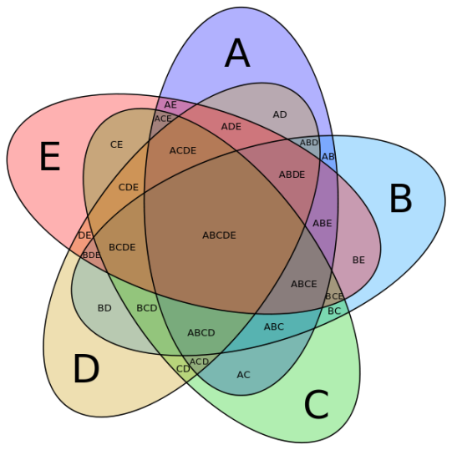
Soft computing in searching and querying: basic techniques
Fuzzy querying of
regular databases
database query languages
relational algebra
basic operators
Based on set theory
union
intersection
difference
Cartesian product
Table Artist
A_ID:
char(3)
Name:
varchar
First_name:
varchar
Birth:
integer
Death:
integer
A01
Da Vinci
Leonardo
1452
1519
A02
Degas
Edgar
1834
1917
A03
Ensor
James
1860
1949
A04
Monet
Claude
1840
1926
Based on table structure
select
project
join
division
The Project is co-financed by the European Union from resources of the European Social Fund

Slide 41
Soft computing in searching and querying: basic techniques
Fuzzy querying of
regular databases
approach with satisfaction degrees
extend relations with one extra system attribute
TABLE Artist
AID: STRING
Name: STRING
First_name: STRING
Year_of_birth: YEAR
Year_of_death: YEAR
s: REAL
Name: STRING
A01
Da Vinci
Leonardo
1452
1519
1,0000
A02
Degas
Edgar
1834
1917
1,0000
A03
Ensor
James
1860
1949
1,0000
A04
Monet
Claude
1840
1926
1,0000
threshold $0≤τ≤1$
condition $r\left[s\right]≥τ$
The Project is co-financed by the European Union from resources of the European Social Fund

Slide 42
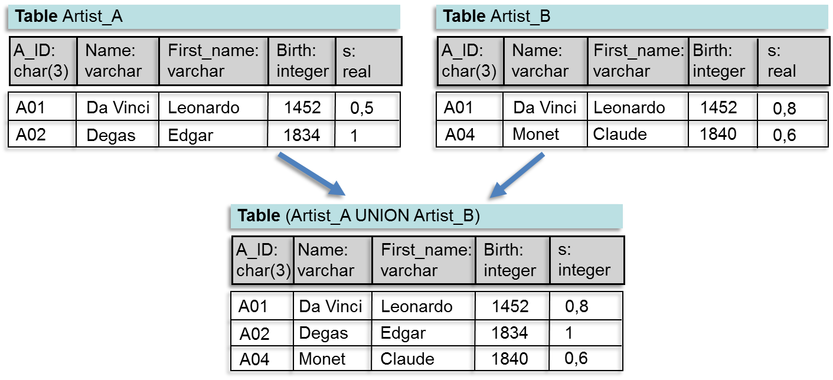
Soft computing in searching and querying: basic techniques
Fuzzy querying of
regular databases
approach with satisfaction degrees
union operator
${r\left[s\right]}_{union\left(t,t^{′}\right)}=u\left({r\left[s\right]}_{t},{r\left[s\right]}_{t^{′}}\right)$
e.g. $\left(i,u\right)=\left(min, max\right)$
The Project is co-financed by the European Union from resources of the European Social Fund

Slide 43
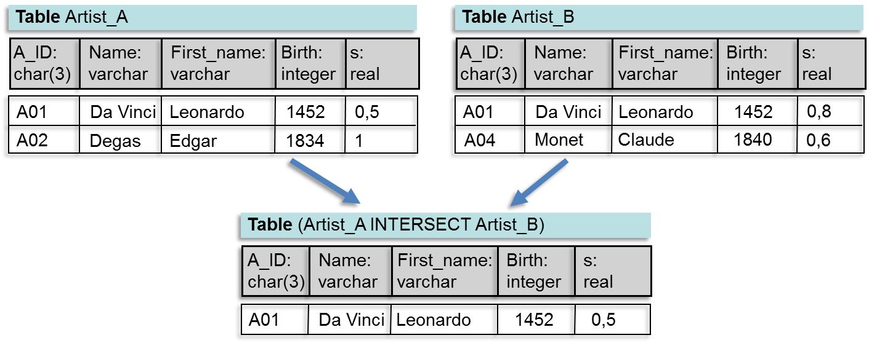
Soft computing in searching and querying: basic techniques
Fuzzy querying of
regular databases
approach with satisfaction degrees
intersection operator
${r\left[s\right]}_{intersect\left(t,t^{′}\right)}=i\left({r\left[s\right]}_{t},{r\left[s\right]}_{t^{′}}\right)$
e.g. $\left(i,u\right)=\left(min, max\right)$
The Project is co-financed by the European Union from resources of the European Social Fund

Slide 44
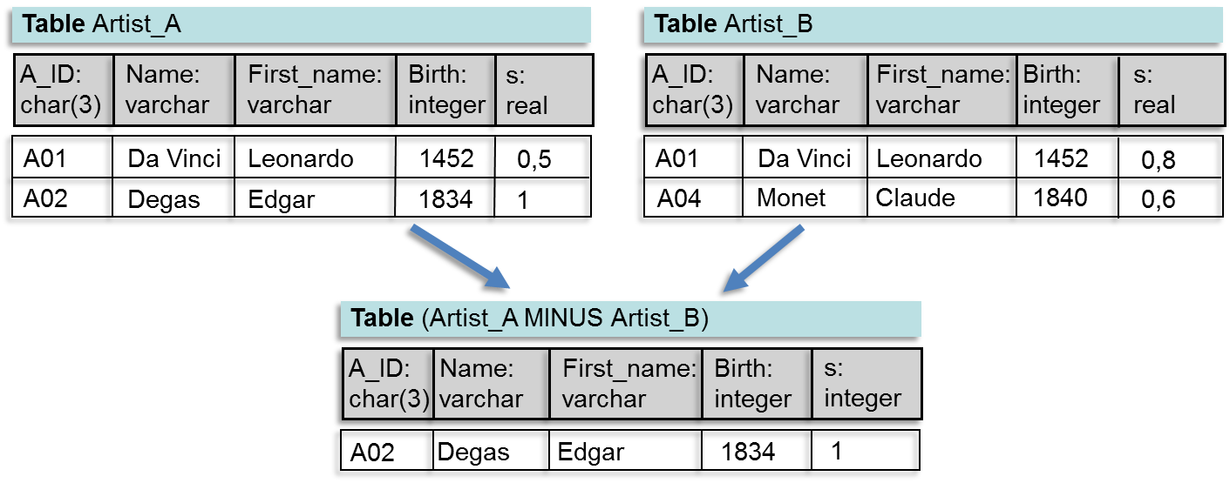
Soft computing in searching and querying: basic techniques
Fuzzy querying of
regular databases
approach with satisfaction degrees
difference operator
A01 Da Vinci Leonardo 1452 0.2
${r\left[s\right]}_{minus\left(t,t^{′}\right)}=i\left({r\left[s\right]}_{t},{1−r\left[s\right]}_{t^{′}}\right)$
e.g. $\left(i,u\right)=\left(min, max\right)$
The Project is co-financed by the European Union from resources of the European Social Fund

Slide 45
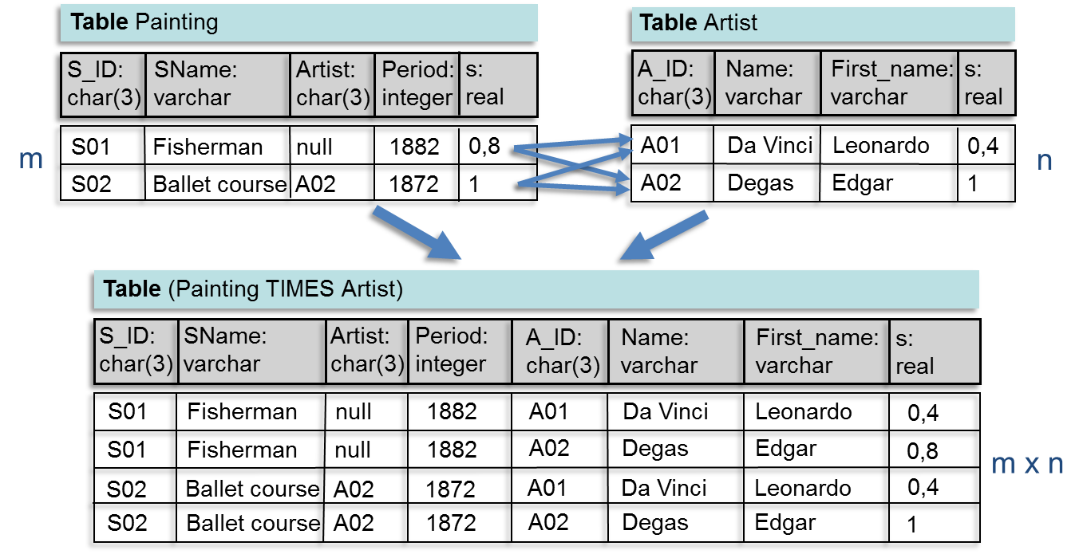
Soft computing in searching and querying: basic techniques
Fuzzy querying of
regular databases
approach with satisfaction degrees
Cartesian product operator
${rr′\left[s\right]}_{times\left(t,t^{′}\right)}=i\left({r\left[s\right]}_{t},{r′\left[s\right]}_{t^{′}}\right)$
e.g. $\left(i,u\right)=\left(min, max\right)$
The Project is co-financed by the European Union from resources of the European Social Fund

Slide 46
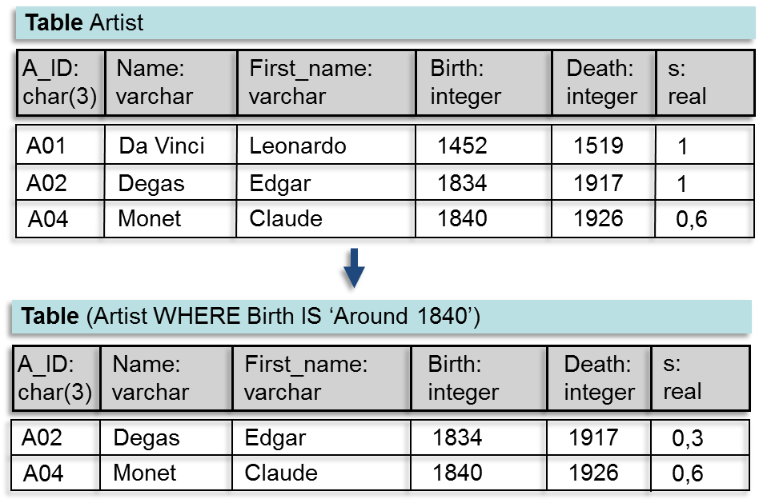
Soft computing in searching and querying: basic techniques
Fuzzy querying of
regular databases
approach with satisfaction degrees
select operator
${r\left[s\right]}_{select\left(c,t \right)}=i\left({r\left[s\right]}_{t},e\left(c\right)\left(r\right)\right)$
e.g. $\left(i,u\right)=\left(min, max\right)$
The Project is co-financed by the European Union from resources of the European Social Fund

Slide 47
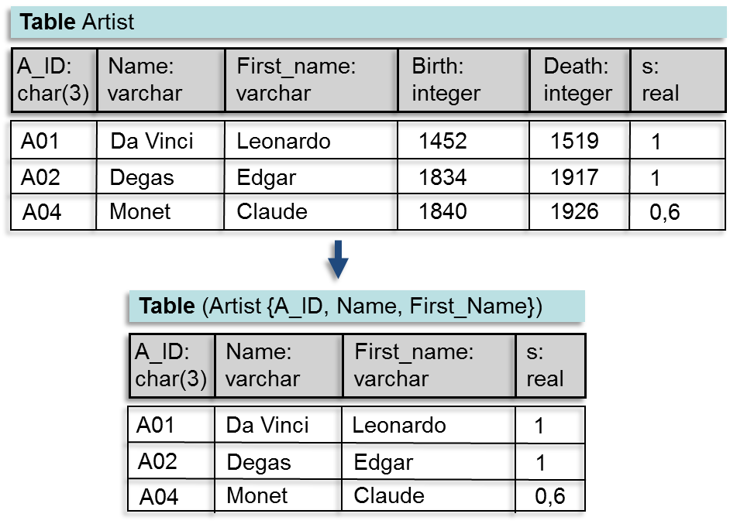
Soft computing in searching and querying: basic techniques
Fuzzy querying of
regular databases
approach with satisfaction degrees
project operator
${v\left[s\right]}_{project\left(t,V \right)}=u_{t} \left({vw\left[s\right]}_{t}\right)$
e.g. $\left(i,u\right)=\left(min, max\right)$
The Project is co-financed by the European Union from resources of the European Social Fund

Slide 48
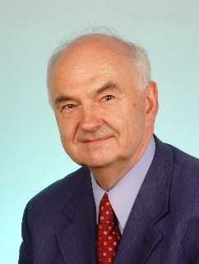
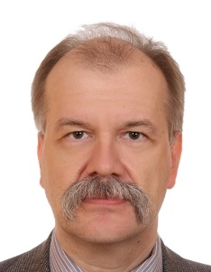
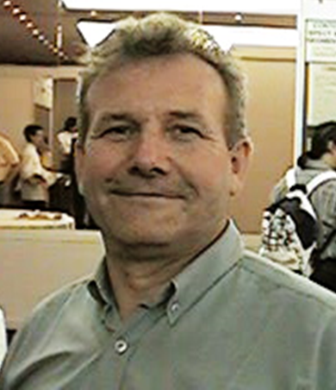
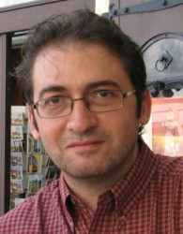
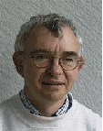
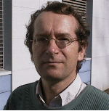
Soft computing in searching and querying: basic techniques
Fuzzy querying of
regular databases
approach with satisfaction degrees
implementations
J. Kacprzyk
S. Zadrozny
P. Bosc
O. Pivert
D. Dubois
H. Prade
FQUERY
SQLF
PRETI
The Project is co-financed by the European Union from resources of the European Social Fund

Slide 49
Soft computing in searching and querying: basic techniques
Fuzzy querying of
regular databases
approach with possibilistic truth values
extend relations with two (or three) extra system attributes
TABLE Artist
AID: STRING
Name: STRING
First_name: STRING
Year_of_birth: YEAR
Year_of_death: YEAR
F: REAL
Name: STRING
T: REAL
⊥: REAL
A01
Da Vinci
Leonardo
1452
1519
1,0000
0,0000
0,0000
A02
Degas
Edgar
1834
1917
1,0000
0,0000
1,0000
A03
Ensor
James
1860
1949
1,0000
0,0000
1,0000
A04
Monet
Claude
1840
1926
1,0000
0,0000
1,0000
condition ${\tilde{t}}_{r}=\left\{\left(T,r\left[T\right]\right),\left(F,r\left[F\right]\right),\left(⊥,r\left[⊥\right]\right)\right\}≠\left\{\left(F,1\right)\right\}$
thresholds $τ_{T},$ $τ_{F},τ_{⊥}∈\left[0,1\right]$
condition $\left\{\begin{matrix}r\left[T\right]≥τ_{T} \\ r\left[F\right]≤τ_{F} \\ r\left[⊥\right]≤τ_{⊥}\end{matrix}\right.$
The Project is co-financed by the European Union from resources of the European Social Fund

Slide 50
Soft computing in searching and querying: basic techniques
Fuzzy querying of
regular databases
approach with possibilistic truth values
ranking of PTVs
$ord:\tilde{2^{I}}→$ $IR$
$$\tilde{t}→\frac{μ_{\tilde{t}}\left(T\right)+\left(1−μ_{\tilde{t}}\left(F\right)\right)}{2}$$
threshold $0≤τ≤1$
condition $ord\left(\left\{\left(T,r\left[T\right]\right),\left(F,r\left[F\right]\right)\right\}\right) ≥τ$
The Project is co-financed by the European Union from resources of the European Social Fund

Slide 51
Soft computing in searching and querying: basic techniques
Fuzzy querying of
regular databases
approach with possibilistic truth values
algebraic operators
union: $e\left(union\left(t,t′\right)\right)\left(r\right)={\tilde{t}}_{r}∨_{u}{\tilde{t}′}_{r}$
intersection: $e\left(intersect\left(t,t′\right)\right)\left(r\right)={\tilde{t}}_{r}∧_{i}{\tilde{t}′}_{r}$
difference: $e\left(minus\left(t,t′\right)\right)\left(r\right)={\tilde{t}}_{r}∧_{i}¬\left({\tilde{t}′}_{r}\right)$
Cartesian product: $e\left(times\left(t,t′\right)\right)\left(rr′\right)={\tilde{t}}_{r}∧_{i}{\tilde{t}′}_{r^{′}}$
select: $e\left(select\left(t,c\right)\right)\left(r\right)={\tilde{t}}_{r}∧_{i}e\left(c\right)\left(r\right)$
project: $e\left(project\left(t,V\right)\right)\left(v\right)={\left(∨_{u}\right)}_{t}{\tilde{t}}_{vw}$
e.g. $\left(i,u\right)=\left(min, max\right)$
The Project is co-financed by the European Union from resources of the European Social Fund

Slide 52
Soft computing in searching and querying: basic techniques
Fuzzy querying of
regular databases
approach with possibilistic truth values
example
‘Give the name of the painting and the name of the artist of all very expensive painting (less important: 60%) of which the artist died at the beginning of the 20th century (very important: 100%).’
‘very expensive’
‘beginning 20th century’
1
1
0
price
0
date
1M
2M
3M
4M
5M
1900
1910
1920
1930
1940
The Project is co-financed by the European Union from resources of the European Social Fund

Slide 53
Soft computing in searching and querying: basic techniques
Fuzzy querying of
regular databases
approach with possibilistic truth values
example (cont’d)
‘Give the name of the painting and the name of the artist of all very expensive painting (less important: 60%) of which the artist died at the beginning of the 20th century (very important: 100%).’
algebraic expression
project(select(times(Painting,Artist), (Painting.Artist=Artist.AID, weight 1) AND
(Painting.Value IS ‘very expensive’, weight 0,6) AND
(Artist.Year_of_death IS ‘beginning 20th century’, weight 1)),
{Painting.Name, Artist.Name})
The Project is co-financed by the European Union from resources of the European Social Fund

Slide 54
Soft computing in searching and querying: basic techniques
Fuzzy querying of
regular databases
approach with possibilistic truth values
example (cont’d)
project(select(times(Painting,Artist), (Painting.Artist=Artist.AID, weight 1) AND
(Painting.Value IS ‘very expensive’, weight 0,6) AND
(Artist.Year_of_death IS ‘beginning 20th century’, weight 1)),
{Painting.Name, Artist.Name})


intermediate results


The Project is co-financed by the European Union from resources of the European Social Fund

Slide 55
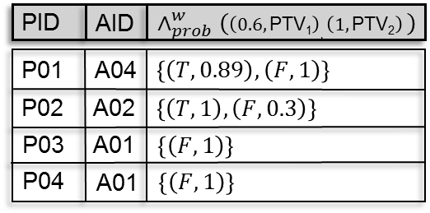
Soft computing in searching and querying: basic techniques
Fuzzy querying of
regular databases
approach with possibilistic truth values
example (cont’d)
aggregation
project(select(times(Painting,Artist), (Painting.Artist=Artist.AID, weight 1) AND
(Painting.Value IS ‘very expensive’, weight 0,6) AND
(Artist.Year_of_death IS ‘beginning 20th century’, weight 1)),
{Painting.Name, Artist.Name})
The Project is co-financed by the European Union from resources of the European Social Fund

Slide 56
Soft computing in searching and querying: basic techniques
Fuzzy querying of
regular databases
approach with possibilistic truth values
example (cont’d)
‘Give the name of the painting and the name of the artist of all very expensive painting (less important: 60%) of which the artist died at the beginning of the 20th century (very important: 100%).’
result
project(select(times(Painting,Artist), (Painting.Artist=Artist.AID, weight 1) AND
(Painting.Value IS ‘very expensive’, weight 0,6) AND
(Artist.Year_of_death IS ‘beginning 20th century’, weight 1)),
{Painting.Name, Artist.Name})
The Project is co-financed by the European Union from resources of the European Social Fund

Slide 57
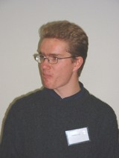
Soft computing in searching and querying: basic techniques
Fuzzy querying of
regular databases
approach with possibilistic truth values
implementations
G. De Tré
T. Matthé
FlexQL
The Project is co-financed by the European Union from resources of the European Social Fund

Slide 58
Soft computing in searching and querying: basic techniques
Fuzzy querying of
regular databases
database query languages
The Project is co-financed by the European Union from resources of the European Social Fund

Slide 59
Soft computing in searching and querying: basic techniques
Fuzzy querying of
regular databases
user metadata
catalog
system metadata
data
The Project is co-financed by the European Union from resources of the European Social Fund

Slide 60
Soft computing in searching and querying: basic techniques
Fuzzy querying of
‘fuzzy’ databases
what if the data are imperfect?
The Project is co-financed by the European Union from resources of the European Social Fund

Slide 61
Soft computing in searching and querying: basic techniques
Fuzzy querying of
‘fuzzy’ databases
sources of imperfections
data(base) integration
predictive data
information loss or damage in data sources
automatically retrieved data
…
The Project is co-financed by the European Union from resources of the European Social Fund

Slide 62
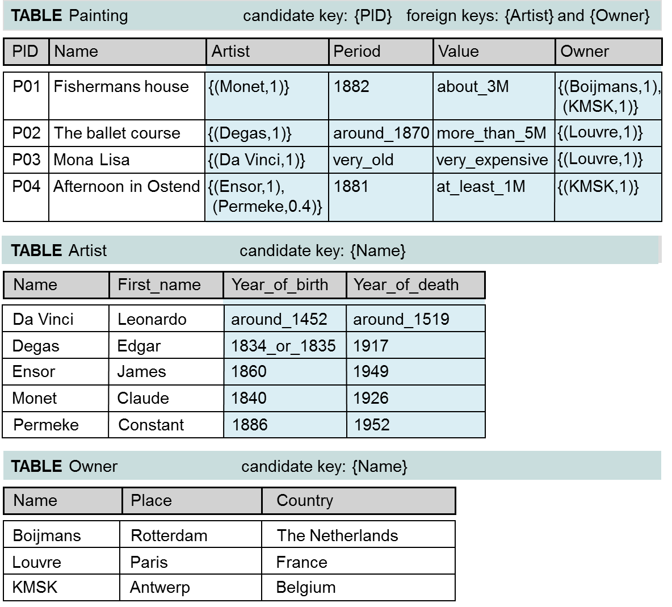
Soft computing in searching and querying: basic techniques
Fuzzy querying of
‘fuzzy’ databases
degrees of uncertainty
The Project is co-financed by the European Union from resources of the European Social Fund

Slide 63
Soft computing in searching and querying: basic techniques
Fuzzy querying of
‘fuzzy’ databases
fuzzy querying
introduce flexible preferences in querying
preferences inside query conditions
preferences between query conditions
P. Bosc, D. Kraft, and F. Petry, ``Fuzzy sets in database and information systems: status and opportunities'', Fuzzy Sets and Systems 153 3 (2005) 418--426.
The Project is co-financed by the European Union from resources of the European Social Fund

Slide 64
Soft computing in searching and querying: basic techniques
Fuzzy querying of
‘fuzzy’ databases
fuzzy querying
preferences inside query conditions
‘inside’
preferences
users only approximately describe what they are looking for
limited knowledge e.g. was the painting painted in 1882, 1883 or in 1884?
allow some tollerance e.g. students with a high score in math
still the same… but the data can now be uncertain
The Project is co-financed by the European Union from resources of the European Social Fund

Slide 65
Soft computing in searching and querying: basic techniques
Fuzzy querying of
‘fuzzy’ databases
modelling
‘inside’
preferences
approach
model user preferences by labeled fuzzy sets $L$
use modification functions to deal with linguistic hedges almost, apparently, fairly, in part, nearly, relatively, somewhat, …
painted ‘around_1883’
‘high_score’ in math
1
1
0
date
0
0
10
14
16
20
score
1881
1882
1883
1884
1885
degrees of compatibility (with user preferences)
still the same… but the data can now be uncertain
The Project is co-financed by the European Union from resources of the European Social Fund

Slide 66
Soft computing in searching and querying: basic techniques
Fuzzy querying of
‘fuzzy’ databases
‘inside’
preferences
possibility and necessity
$$Pos, Nec∈\left[0,1\right]×\left[0,1\right]$$
possibilistic truth values
$$\tilde{t}∈\tilde{2^{I}}$$
uncertainty in the data cannot disappear
The Project is co-financed by the European Union from resources of the European Social Fund

Slide 67
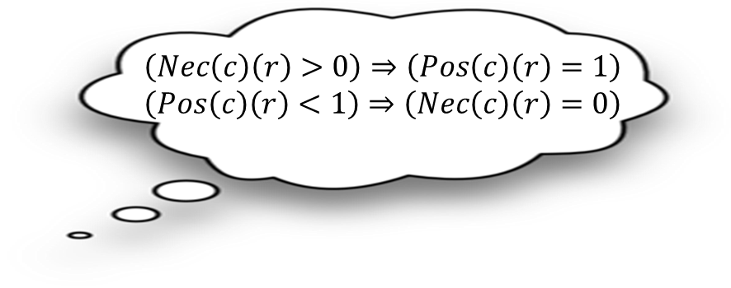
Soft computing in searching and querying: basic techniques
Fuzzy querying of
‘fuzzy’ databases
evaluation with possibility and necessity
‘inside’
preferences
$$e\left(c\right)\left(r\right)=\left(Pos\left(c\right)\left(r\right),Nec\left(c\right)\left(r\right)\right)$$
necessity that the values of r satisfy c
possibility that the values of r satisfy c
The Project is co-financed by the European Union from resources of the European Social Fund

Slide 68
Soft computing in searching and querying: basic techniques
Fuzzy querying of
‘fuzzy’ databases
evaluation with possibility and necessity
simple conditions of the form $A θ L$
‘inside’
preferences
(‘fuzzy’) comparison operators $op$
linguistic term
e.g. ‘age is much lower than middle-aged’ ‘value is approximately equal to 3.000 Euro’
$$e\left(A op L\right)\left(r\right)=\left(Pos\left(A op L\right)\left(r\right),Nec\left(A op L\right)\left(r\right)\right)$$
where
$Pos\left(A op L\right)\left(r\right)=\sup_{x∈U} min\left(μ_{L∘op}\left(x\right),π_{r\left[A\right]}\left(x\right)\right)$
$Nec\left(A op L\right)\left(r\right)=\inf_{x∈U} max\left(μ_{L∘op}\left(x\right),1−π_{r\left[A\right]}\left(x\right)\right)$
with
$$μ_{L∘op}\left(x\right)=\sup_{x^{′}∈U}min\left(μ_{op}\left(x,x′\right),μ_{L}\left(x′\right)\right)$$
The Project is co-financed by the European Union from resources of the European Social Fund

Slide 69
Soft computing in searching and querying: basic techniques
Fuzzy querying of
‘fuzzy’ databases
evaluation with possibility and necessity
simple conditions of the form $A θ L$ (cont’d)
‘inside’
preferences
compatibility operator $IS$
e.g. ‘value IS expensive’ ‘period IS old’
$$e\left(A IS L\right)\left(r\right)=\left(Pos\left(A IS L\right)\left(r\right),Nec\left(A IS L\right)\left(r\right)\right)$$
where
$Pos\left(A IS L\right)\left(r\right)=\sup_{x∈U} min\left(μ_{L}\left(x\right),π_{r\left[A\right]}\left(x\right)\right)$
$Nec\left(A IS L\right)\left(r\right)=\inf_{x∈U} max\left(μ_{L}\left(x\right),1−π_{r\left[A\right]}\left(x\right)\right)$
The Project is co-financed by the European Union from resources of the European Social Fund

Slide 70
Soft computing in searching and querying: basic techniques
Fuzzy querying of
‘fuzzy’ databases
evaluation with possibility and necessity
simple conditions of the form $A θ B$
‘inside’
preferences
(‘fuzzy’) comparison operators $op$
attribute
e.g. ‘score for math exam is much different from score for physics exam’ ‘sale price is approximately equal to purchase price’
$$e\left(A op B\right)\left(r\right)=\left(Pos\left(A op L\right)\left(r\right),Nec\left(A op L\right)\left(r\right)\right)$$
where
$Pos\left(A op B\right)\left(r\right)=\sup_{\left(x,x^{′}\right)∈U_{A}×U_{B}} min\left(μ_{op}\left(x,x′\right),π_{r\left[A\right]}\left(x\right),π_{r\left[B\right]}\left(x′\right)\right)$
$Nec\left(A op L\right)\left(r\right)=\inf_{\left(x,x^{′}\right)∈U_{A}×U_{B}} max\left(μ_{op}\left(x,x′\right),{1−π}_{r\left[A\right]}\left(x\right),1−π_{r\left[B\right]}\left(x′\right)\right)$
The Project is co-financed by the European Union from resources of the European Social Fund

Slide 71
Soft computing in searching and querying: basic techniques
Fuzzy querying of
‘fuzzy’ databases
evaluation with possibility and necessity
composed conditions - aggregation
‘inside’
preferences
conjunction
if $e\left(c_{i}\right)\left(r\right)=\left(Pos\left(c_{i}\right)\left(r\right),Nec\left(c_{i}\right)\left(r\right)\right)$, $i=1,2$
then $e\left(c_{1}∧c_{2}\right)\left(r\right)=\left(i\left(Pos\left(c_{1}\right)\left(r\right),Pos\left(c_{2}\right)\left(r\right)\right),i\left(Nec\left(c_{1}\right)\left(r\right),Nec\left(c_{2}\right)\left(r\right)\right)\right)$
disjunction
if $e\left(c_{i}\right)\left(r\right)=\left(Pos\left(c_{i}\right)\left(r\right),Nec\left(c_{i}\right)\left(r\right)\right)$, $i=1,2$
then $e\left(c_{1}∨c_{2}\right)\left(r\right)=\left(u\left(Pos\left(c_{1}\right)\left(r\right),Pos\left(c_{2}\right)\left(r\right)\right),u\left(Nec\left(c_{1}\right)\left(r\right),Nec\left(c_{2}\right)\left(r\right)\right)\right)$
The Project is co-financed by the European Union from resources of the European Social Fund

Slide 72
Soft computing in searching and querying: basic techniques
Fuzzy querying of
‘fuzzy’ databases
evaluation with possibility and necessity
composed conditions – aggregation (cont’d)
‘inside’
preferences
negation
if $e\left(c\right)\left(r\right)=\left(Pos\left(c\right)\left(r\right),Nec\left(c\right)\left(r\right)\right)$
then $e\left(¬\left(c\right)\right)\left(r\right)=\left(1−Pos\left(c\right)\left(r\right),1−Nec\left(c\right)\left(r\right)\right)$
negation has precedency over conjunction and disjunction, whereas conjunction has precedency over disjunction
The Project is co-financed by the European Union from resources of the European Social Fund

Slide 73
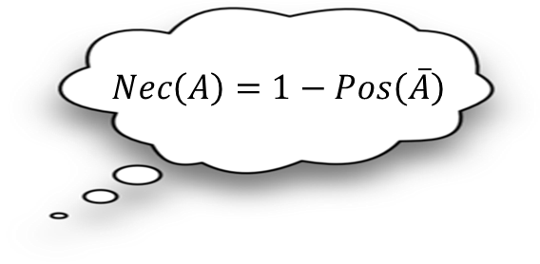
Soft computing in searching and querying: basic techniques
Fuzzy querying of
‘fuzzy’ databases
evaluation with possibilistic truth values
‘inside’
preferences
$$e\left(c\right)\left(r\right)=\left\{\left(T,μ_{e\left(c\right)\left(r\right)}\left(T\right)\right),\left(F,μ_{e\left(c\right)\left(r\right)}\left(F\right)\right),\left(⊥,μ_{e\left(c\right)\left(r\right)}\left(⊥\right)\right)\right\}$$
possibility that c is not applicable for r
possibility that the values of r do not satisfy c
possibility that the values of r satisfy c
relationship with possibility and necessity
$μ_{e\left(c\right)\left(r\right)}\left(T\right)=Pos\left(e\left(c\right)\left(r\right)=T\right)=Pos\left(c\right)\left(r\right)$
$μ_{e\left(c\right)\left(r\right)}\left(F\right)=Pos\left(e\left(c\right)\left(r\right)=F\right)=Pos\left(\overline{c}\right)\left(r\right)=1−Nec\left(c\right)\left(r\right)$
The Project is co-financed by the European Union from resources of the European Social Fund

Slide 74
Soft computing in searching and querying: basic techniques
Fuzzy querying of
‘fuzzy’ databases
evaluation with possibilistic truth values
simple conditions of the form $A θ L$
‘inside’
preferences
(‘fuzzy’) comparison operators $op$
linguistic term
e.g. ‘age is much lower than middle-aged’ ‘value is approximately equal to 3.000 Euro’
$$e\left(A op L\right)\left(r\right)=\left\{\left(T,μ_{e\left(A op L\right)\left(r\right)}\left(T\right)\right),\left(F,μ_{e\left(A op L\right)\left(r\right)}\left(F\right)\right),\left(⊥,μ_{e\left(A op L\right)\left(r\right)}\left(⊥\right)\right)\right\}$$
where
$μ_{e\left(A op L\right)\left(r\right)}\left(T\right)=\sup_{x∈U\backslash \left\{⊥\right\}} min\left(μ_{L∘op}\left(x\right),π_{r\left[A\right]}\left(x\right)\right)$
$μ_{e\left(A op L\right)\left(r\right)}\left(F\right)={1−inf}_{x∈U\backslash \left\{⊥\right\}} max\left(μ_{L∘op}\left(x\right),1−π_{r\left[A\right]}\left(x\right)\right)$
$μ_{e\left(A op L\right)\left(r\right)}\left(⊥\right)= max\left(μ_{L}\left(⊥\right), π_{r\left[A\right]}\left(⊥\right)\right)$
with
$$μ_{L∘op}\left(x\right)=\sup_{x^{′}∈U}min\left(μ_{op}\left(x,x′\right),μ_{L}\left(x′\right)\right)$$
The Project is co-financed by the European Union from resources of the European Social Fund

Slide 75
Soft computing in searching and querying: basic techniques
Fuzzy querying of
‘fuzzy’ databases
evaluation with possibilistic truth values
simple conditions of the form $A θ L$ (cont’d)
‘inside’
preferences
compatibility operator $IS$
e.g. ‘value IS expensive’ ‘period IS old’
$$e\left(A IS L\right)\left(r\right)=\left\{\left(T,μ_{e\left(A IS L\right)\left(r\right)}\left(T\right)\right),\left(F,μ_{e\left(A IS L\right)\left(r\right)}\left(F\right)\right),\left(⊥,μ_{e\left(A IS L\right)\left(r\right)}\left(⊥\right)\right)\right\}$$
where
$μ_{e\left(A IS L\right)\left(r\right)}\left(T\right)=\sup_{x∈U} min\left(μ_{L}\left(x\right),π_{r\left[A\right]}\left(x\right)\right)$
$μ_{e\left(A IS L\right)\left(r\right)}\left(F\right)=\sup_{x∈U\backslash \left\{⊥\right\}} min\left({1−μ}_{L}\left(x\right),π_{r\left[A\right]}\left(x\right)\right)$
$μ_{e\left(A IS L\right)\left(r\right)}\left(⊥\right)= min\left({1−μ}_{L}\left(⊥\right),π_{r\left[A\right]}\left(⊥\right)\right)$
The Project is co-financed by the European Union from resources of the European Social Fund

Slide 76
Soft computing in searching and querying: basic techniques
Fuzzy querying of
‘fuzzy’ databases
evaluation with possibilistic truth values
simple conditions of the form $A θ L$ (cont’d)
‘inside’
preferences
example
evaluation of ‘around_30K IS cheap’
1
μ_{cheap}
π_{around_30K}
$$μ_{e\left(Price IS Cheap\right)\left(r\right)}\left(F\right)$$
1-μ_{cheap}
$$μ_{e\left(Price IS Cheap\right)\left(r\right)}\left(T\right)$$
0
10K
20K
30K
40K
50K
60K
70K
80K
⊥_{Price}
Prices for paintings
$$\left\{\left(T,μ_{e\left(Price IS Cheap\right)\left(r\right)}\left(T\right)\right),\left(F,μ_{e\left(Price IS Cheap\right)\left(r\right)}\left(F\right)\right),\left(⊥,μ_{e\left(Price IS Cheap\right)\left(r\right)}\left(⊥\right)\right)\right\}$$
The Project is co-financed by the European Union from resources of the European Social Fund

Slide 77
Soft computing in searching and querying: basic techniques
Fuzzy querying of
‘fuzzy’ databases
evaluation with possibilistic truth values
simple conditions of the form $A θ B$
‘inside’
preferences
(‘fuzzy’) comparison operators $op$
attribute
e.g. ‘score for math exam is much different from score for physics exam’ ‘sale price is approximately equal to purchase price’
$$e\left(A op B\right)\left(r\right)=\left\{\left(T,μ_{e\left(A op B\right)\left(r\right)}\left(T\right)\right),\left(F,μ_{e\left(A op B\right)\left(r\right)}\left(F\right)\right),\left(⊥,μ_{e\left(A op B\right)\left(r\right)}\left(⊥\right)\right)\right\}$$
where
$μ_{e\left(A op B\right)\left(r\right)}\left(T\right)=\sup_{\left(x,x^{′}\right)∈U_{A}\backslash \left\{⊥_{A}\right\}×U_{B}\backslash \left\{⊥_{B}\right\}} min\left(μ_{op}\left(x,x′\right),π_{r\left[A\right]}\left(x\right),π_{r\left[B\right]}\left(x\right)\right)$
$μ_{e\left(A op B\right)\left(r\right)}\left(F\right)={1−inf}_{\left(x,x^{′}\right)∈U_{A}\backslash \left\{⊥_{A}\right\}×U_{B}\backslash \left\{⊥_{B}\right\}} max\left(μ_{op}\left(x,x′\right),{1−π}_{r\left[A\right]}\left(x\right),{1−π}_{r\left[B\right]}\left(x\right)\right)$
$μ_{e\left(A op B\right)\left(r\right)}\left(⊥\right)= max\left(π_{r\left[A\right]}\left(⊥_{A}\right),π_{r\left[B\right]}\left(⊥_{B}\right)\right)$
The Project is co-financed by the European Union from resources of the European Social Fund

Slide 78
Soft computing in searching and querying: basic techniques
Fuzzy querying of
‘fuzzy’ databases
evaluation with possibilistic truth values
composed conditions - aggregation
‘inside’
preferences
the same as with fuzzy querying of regular databases
The Project is co-financed by the European Union from resources of the European Social Fund

Slide 79
Soft computing in searching and querying: basic techniques
Fuzzy querying of
‘fuzzy’ databases
database query languages
integration in
database management system
possibility and necessity
$$\left(Pos,Nec\right)∈{\left[0,1\right]}^{2}$$
possibilistic truth values
$$\tilde{t}∈\tilde{2^{I}}$$
The Project is co-financed by the European Union from resources of the European Social Fund

Slide 80
Soft computing in searching and querying: basic techniques
Fuzzy querying of
‘fuzzy’ databases
database query languages
relational algebra
basic operators
Based on set theory
union
intersection
difference
Cartesian product
Table Artist
A_ID:
char(3)
Name:
varchar
First_name:
varchar
Birth:
integer
Death:
integer
A01
Da Vinci
Leonardo
1452
1519
A02
Degas
Edgar
1834
1917
A03
Ensor
James
1860
1949
A04
Monet
Claude
1840
1926
Based on table structure
select
project
join
division
The Project is co-financed by the European Union from resources of the European Social Fund

Slide 81
Soft computing in searching and querying: basic techniques
Fuzzy querying of
‘fuzzy’ databases
approach with possibility and necessity
extend relations with two extra system attributes
TABLE Artist
AID: STRING
Name: STRING
First_name: STRING
Year_of_birth: YEAR
Year_of_death: YEAR
Pos: REAL
Name: STRING
Nec: REAL
A01
Da Vinci
Leonardo
around_1452
around_1519
1,0000
1,0000
A02
Degas
Edgar
1834_or_1835
1917
0,8530
0
A03
Ensor
James
1860
1949
0,2000
0
A04
Monet
Claude
1840
1926
1,0000
0,6000
thresholds $0≤τ_{Pos}≤1$ and $0≤τ_{Nec}≤1$
condition $\left\{\begin{matrix}r\left[Pos\right]≥τ_{Pos} \\ r\left[Nec\right]≥τ_{Nec}\end{matrix}\right.$
The Project is co-financed by the European Union from resources of the European Social Fund

Slide 82
Soft computing in searching and querying: basic techniques
Fuzzy querying of
‘fuzzy’ databases
approach with possibility and necessity
algebraic operators
union
$r{\left[Pos\right]}_{union\left(t,t^{′}\right)}=u\left(r{\left[Pos\right]}_{t},r{\left[Pos\right]}_{t^{′}}\right)$
$r{\left[Nec\right]}_{union\left(t,t^{′}\right)}=u\left(r{\left[Nec\right]}_{t},r{\left[Nec\right]}_{t^{′}}\right)$
intersection
$r{\left[Pos\right]}_{intersect\left(t,t^{′}\right)}=i\left(r{\left[Pos\right]}_{t},r{\left[Pos\right]}_{t^{′}}\right)$
$r{\left[Nec\right]}_{intersect\left(t,t^{′}\right)}=i\left(r{\left[Nec\right]}_{t},r{\left[Nec\right]}_{t^{′}}\right)$
difference
$r{\left[Pos\right]}_{minus\left(t,t^{′}\right)}=i\left(r{\left[Pos\right]}_{t},1−r{\left[Pos\right]}_{t^{′}}\right)$
$r{\left[Nec\right]}_{minus\left(t,t^{′}\right)}=i\left(r{\left[Nec\right]}_{t},1−r{\left[Nec\right]}_{t^{′}}\right)$
e.g. $\left(i,u\right)=\left(min, max\right)$
The Project is co-financed by the European Union from resources of the European Social Fund

Slide 83
Soft computing in searching and querying: basic techniques
Fuzzy querying of
‘fuzzy’ databases
approach with possibility and necessity
algebraic operators (cont’d)
Cartesian product
$rr′{\left[Pos\right]}_{times\left(t,t^{′}\right)}=i\left(r{\left[Pos\right]}_{t},r′{\left[Pos\right]}_{t^{′}}\right)$
$rr′{\left[Nec\right]}_{times\left(t,t^{′}\right)}=i\left(r{\left[Nec\right]}_{t},r{′\left[Nec\right]}_{t^{′}}\right)$
select
$r{\left[Pos\right]}_{select\left(c,t\right)}=i\left(r{\left[Pos\right]}_{t},Pos\left(c\right)\left(r\right)\right)$
$r{\left[Nec\right]}_{select\left(c,t\right)}=i\left(r{\left[Nec\right]}_{t},Nec\left(c\right)\left(r\right)\right)$
project
$v{\left[Pos\right]}_{project\left(t,V\right)}=u_{t} \left(vw{\left[Pos\right]}_{t}\right)$
$v{\left[Nec\right]}_{project\left(t,V\right)}=u_{t} \left(vw{\left[Nec\right]}_{t}\right)$
e.g. $\left(i,u\right)=\left(min, max\right)$
The Project is co-financed by the European Union from resources of the European Social Fund

Slide 84
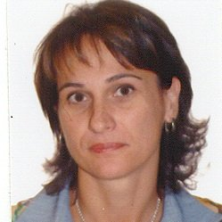
Soft computing in searching and querying: basic techniques
Fuzzy querying of
‘fuzzy’ databases
approach with possibility and necessity
implementations
D. Dubois
H. Prade
J.M. Medina
O. Pons
M.A. Vila
PRETI
Gefred
The Project is co-financed by the European Union from resources of the European Social Fund

Slide 85
Soft computing in searching and querying: basic techniques
Fuzzy querying of
‘fuzzy’ databases
approach with possibilistic truth values
‘inside’
preferences
TABLE Artist
AID: STRING
Name: STRING
First_name: STRING
Year_of_birth: YEAR
Year_of_death: YEAR
F: REAL
Name: STRING
T: REAL
⊥: REAL
A01
Da Vinci
Leonardo
around_1452
around_1519
1,0000
0,0000
0,0000
A02
Degas
Edgar
1834_or_1835
1917
1,0000
0,0000
1,0000
A03
Ensor
James
1860
1949
1,0000
0,0000
1,0000
A04
Monet
Claude
1840
1926
1,0000
0,0000
1,0000
condition ${\tilde{t}}_{r}=\left\{\left(T,r\left[T\right]\right),\left(F,r\left[F\right]\right),\left(⊥,r\left[⊥\right]\right)\right\}≠\left\{\left(F,1\right)\right\}$
thresholds $τ_{T},$ $τ_{F},τ_{⊥}∈\left[0,1\right]$
the same as with fuzzy querying
of regular databases
condition $\left\{\begin{matrix}r\left[T\right]≥τ_{T} \\ r\left[F\right]≤τ_{F} \\ r\left[⊥\right]≤τ_{⊥}\end{matrix}\right.$
The Project is co-financed by the European Union from resources of the European Social Fund

Slide 86
Soft computing in searching and querying: basic techniques
Fuzzy querying of
‘fuzzy’ databases
approach with possibilistic truth values
example
‘Give the name of the painting and the name of the artist of all very expensive painting (less important: 60%) of which the artist died at the beginning of the 20th century (very important: 100%).’
‘very expensive’
‘beginning 20th century’
1
1
0
price
0
date
1M
2M
3M
4M
5M
1900
1910
1920
1930
1940
The Project is co-financed by the European Union from resources of the European Social Fund

Slide 87
Soft computing in searching and querying: basic techniques
Fuzzy querying of
‘fuzzy’ databases
approach with possibilistic truth values
example (cont’d)
‘Give the name of the painting and the name of the artist of all very expensive painting (less important: 60%) of which the artist died at the beginning of the 20th century (very important: 100%).’
algebraic expression
project(select(times(Painting,Artist), (Painting.Artist=Artist.Name, weight 1) AND
(Painting.Value IS ‘very expensive’, weight 0,6) AND
(Artist.Year_of_death IS ‘beginning 20th century’, weight 1)),
{Painting.Name, Artist.Name})
The Project is co-financed by the European Union from resources of the European Social Fund

Slide 88
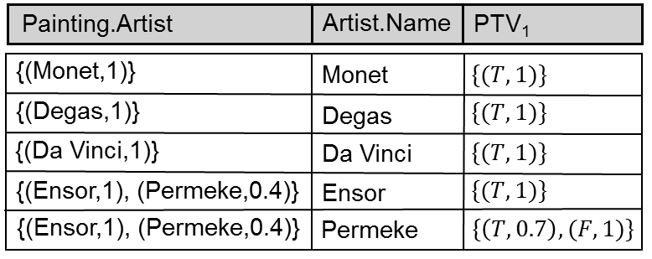
Soft computing in searching and querying: basic techniques
Fuzzy querying of
‘fuzzy’ databases
approach with possibilistic truth values
example (cont’d)
project(select(times(Painting,Artist), (Painting.Artist=Artist.Name, weight 1) AND
(Painting.Value IS ‘very expensive’, weight 0,6) AND
(Artist.Year_of_death IS ‘beginning 20th century’, weight 1)),
{Painting.Name, Artist.Name})


●
intermediate results

The Project is co-financed by the European Union from resources of the European Social Fund

Slide 89
Soft computing in searching and querying: basic techniques
Fuzzy querying of
‘fuzzy’ databases
approach with possibilistic truth values
example (cont’d)
project(select(times(Painting,Artist), (Painting.Artist=Artist.Name, weight 1) AND
(Painting.Value IS ‘very expensive’, weight 0,6) AND
(Artist.Year_of_death IS ‘beginning 20th century’, weight 1)),
{Painting.Name, Artist.Name})


●
intermediate results (cont’d)

●
The Project is co-financed by the European Union from resources of the European Social Fund

Slide 90
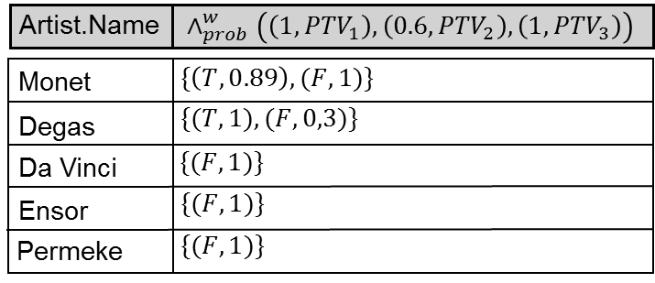
Soft computing in searching and querying: basic techniques
Fuzzy querying of
‘fuzzy’ databases
approach with possibilistic truth values
example (cont’d)
aggregation
project(select(times(Painting,Artist), (Painting.Artist=Artist.Name, weight 1) AND
(Painting.Value IS ‘very expensive’, weight 0,6) AND
(Artist.Year_of_death IS ‘beginning 20th century’, weight 1)),
{Painting.Name, Artist.Name})
The Project is co-financed by the European Union from resources of the European Social Fund

Slide 91
Soft computing in searching and querying: basic techniques
Fuzzy querying of
‘fuzzy’ databases
approach with possibilistic truth values
example (cont’d)
‘Give the name of the painting and the name of the artist of all very expensive painting (less important: 60%) of which the artist died at the beginning of the 20th century (very important: 100%).’
result
project(select(times(Painting,Artist), (Painting.Artist=Artist.Name, weight 1) AND
(Painting.Value IS ‘very expensive’, weight 0,6) AND
(Artist.Year_of_death IS ‘beginning 20th century’, weight 1)),
{Painting.Name, Artist.Name})
The Project is co-financed by the European Union from resources of the European Social Fund

Slide 92
Soft computing in searching and querying: basic techniques
Fuzzy querying of
‘fuzzy’ databases
handling missing information
approach with possibility and necessity
modelling unknown and inapplicable data
evaluation is as explained before
no explicit reflection of inapplicability in evaluation results as we only have $\left(Pos,Nec\right)$
The Project is co-financed by the European Union from resources of the European Social Fund

Slide 93
Soft computing in searching and querying: basic techniques
Fuzzy querying of
‘fuzzy’ databases
handling missing information
approach with possibilistic truth values
modelling unknown and inapplicable data
evaluation is as explained before
explicit reflection of inapplicability in evaluation results as we only have $\left\{\left(T,μ_{T}\right),\left(F,μ_{F}\right),\left(⊥,μ_{⊥}\right)\right\}$
The Project is co-financed by the European Union from resources of the European Social Fund

Slide 94
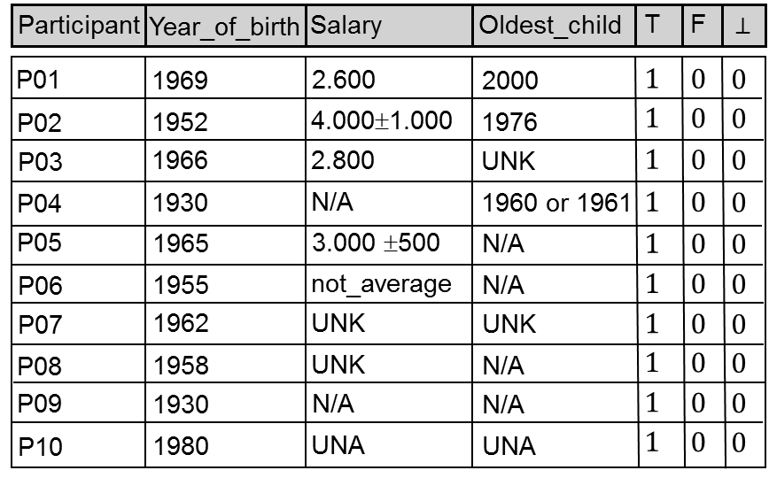
Soft computing in searching and querying: basic techniques
Fuzzy querying of
‘fuzzy’ databases
handling missing information
example: table Inquiry
The Project is co-financed by the European Union from resources of the European Social Fund

Slide 95
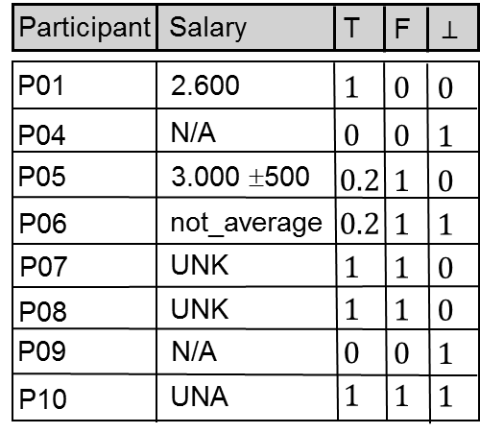
Soft computing in searching and querying: basic techniques
Fuzzy querying of
‘fuzzy’ databases
handling missing information
example (cont’d)
query 1: SELECT PID, Salary FROM Inquiry WHERE Salary IS 2.600
The Project is co-financed by the European Union from resources of the European Social Fund

Slide 96
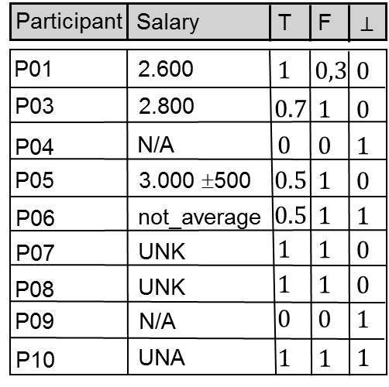
Soft computing in searching and querying: basic techniques
Fuzzy querying of
‘fuzzy’ databases
handling missing information
example (cont’d)
query 2: SELECT PID, Salary FROM Inquiry WHERE Salary IS average
The Project is co-financed by the European Union from resources of the European Social Fund

Slide 97
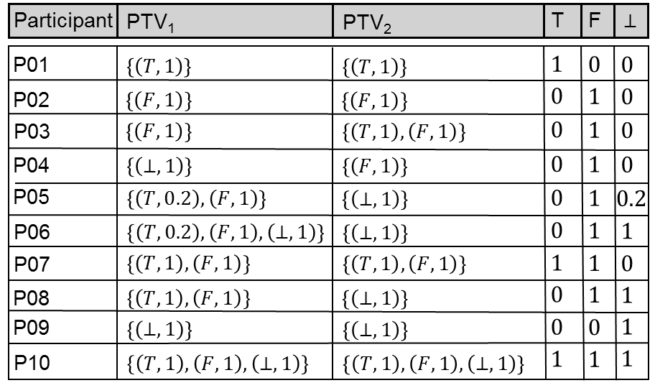
Soft computing in searching and querying: basic techniques
Fuzzy querying of
‘fuzzy’ databases
handling missing information
example (cont’d)
query 3: SELECT PID, Salary, Oldest_child FROM Inquiry WHERE (Salary IS average) AND (Oldest_child IS 2000)
The Project is co-financed by the European Union from resources of the European Social Fund

Slide 98
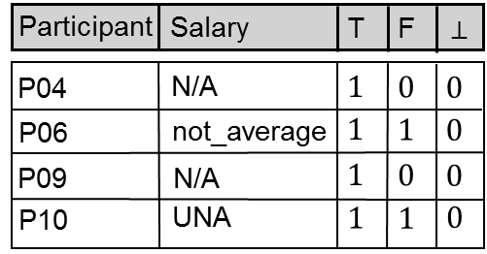
Soft computing in searching and querying: basic techniques
Fuzzy querying of
‘fuzzy’ databases
handling missing information
example (cont’d)
query 4: SELECT PID, Salary
FROM Inquiry WHERE Salary IS N/A
The Project is co-financed by the European Union from resources of the European Social Fund

Slide 99
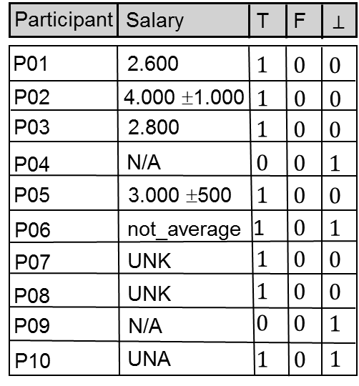
Soft computing in searching and querying: basic techniques
Fuzzy querying of
‘fuzzy’ databases
handling missing information
example (cont’d)
query 5: SELECT PID, Salary
FROM Inquiry WHERE Salary IS UNK
The Project is co-financed by the European Union from resources of the European Social Fund

Slide 100
Soft computing in searching and querying: basic techniques
Fuzzy querying of
‘fuzzy’ databases
handling missing information
example (cont’d)
query 6: SELECT PID, Salary
FROM Inquiry WHERE Salary IS UNA
The Project is co-financed by the European Union from resources of the European Social Fund

Slide 101
Questions?
Warsaw, June 22-26 2015
The Project is co-financed by the European Union from resources of the European Social Fund

