Slide 1


Outline
Soft computing in decision support
LSP
  The different components of LSP
  Suitability vs. affordability
What can we learn from decision support?
Applications
The Project is co-financed by the European Union from resources of the European Social Fund

Slide 2
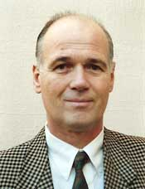
Soft computing in decision support
LSP
Logic Scoring of Preferences
J.J. Dujmović
“Preference Logic for System Evaluation”
IEEE Transactions on Fuzzy Systems 15 6
(2007) 1082-1099.
The Project is co-financed by the European Union from resources of the European Social Fund

Slide 3
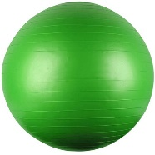

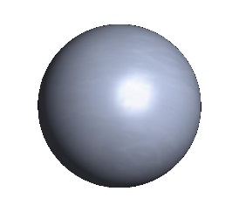



Soft computing in decision support
LSP
Logic Scoring of Preferences
mulitiple criteria decision making
?
score
select
the best
user
preferences
cases
(multiple criteria)
The Project is co-financed by the European Union from resources of the European Social Fund

Slide 4

Soft computing in decision support
LSP
Logic Scoring of Preferences
scoring: overall degree of suitability
the overall degree of suitability E is a soft computing logical function of n attributes of which it is assumed that its range is normalized
$$E=G\left(a_{1},…,a_{n}\right)∈\left[0,1\right]$$
the value 0 denotes an unsuitable case and the value 1 (or 100%) denotes the maximum level of suitability
The Project is co-financed by the European Union from resources of the European Social Fund

Slide 5
Soft computing in decision support
LSP
Logic Scoring of Preferences
main steps of the LSP method
create the system attribute tree
define an elementary criterion for each attribute
for each competitive system, compute elementary degrees of suitability of elementary criteria
use logic aggregators developed to aggregate all elementary degrees of suitability and compute the overall suitability (of all user requirements)
if the overall degree of suitability E corresponds to the overall cost C, perform a cost/suitability analysis to find the best value
The Project is co-financed by the European Union from resources of the European Social Fund

Slide 6
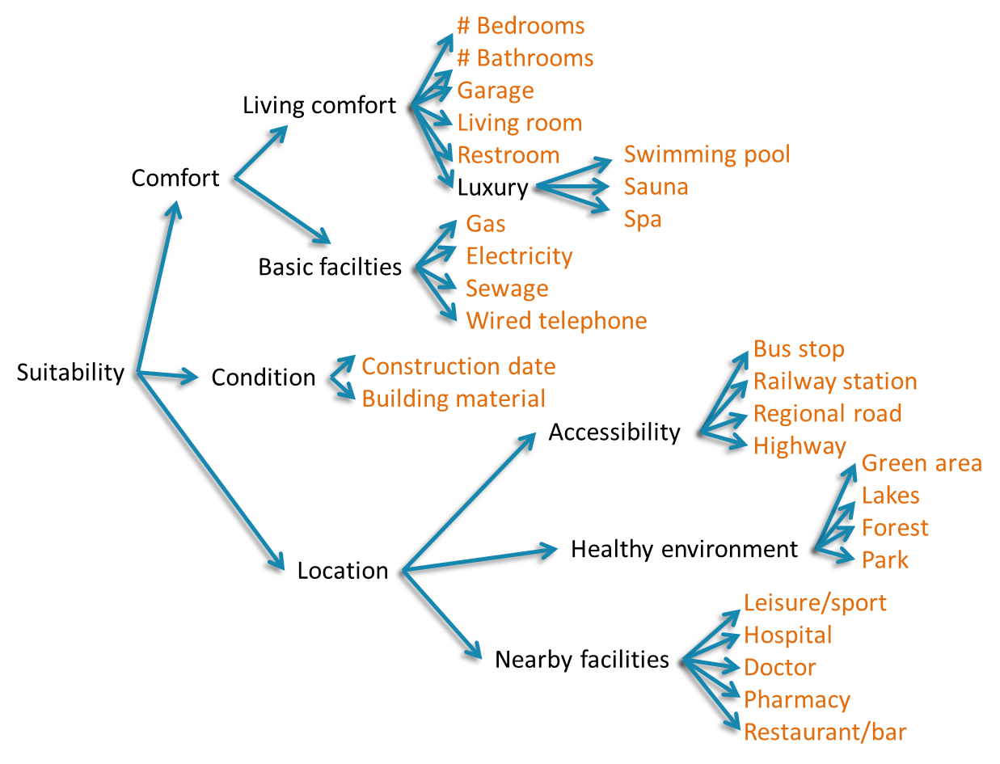


Soft computing in decision support
LSP
Logic Scoring of Preferences
step 1: creation of the system attribute tree
array of elementary attributes $\left[a_{1},…,a_{n}\right]$
The Project is co-financed by the European Union from resources of the European Social Fund

Slide 7


Soft computing in decision support
LSP
Logic Scoring of Preferences
step 2: definition of elementary criteria
array of elementary attributes $\left[a_{1},…,a_{n}\right]$
array of elementary criteria $\left[g_{1},…,g_{n}\right]$
The Project is co-financed by the European Union from resources of the European Social Fund

Slide 8
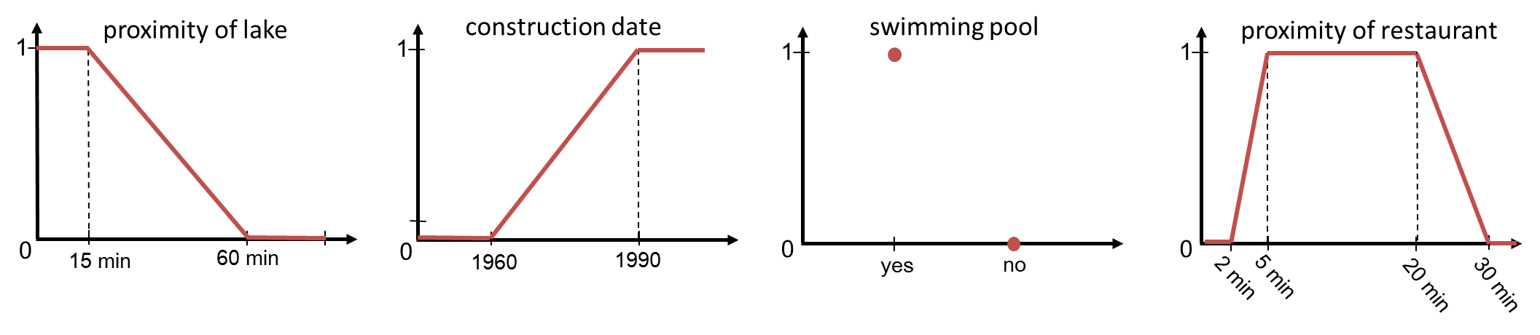
Soft computing in decision support
LSP
Logic Scoring of Preferences
step 2: definition of elementary criteria (cont’d)
examples
The Project is co-financed by the European Union from resources of the European Social Fund

Slide 9



Soft computing in decision support
LSP
Logic Scoring of Preferences
step 3: evaluation of elementary criteria
array of elementary criteria $\left[g_{1},…,g_{n}\right]$
array of elementary suitability degrees $\left[e_{1},…,e_{n}\right]$
for case C, attribute $a_{i}$
$$g_{i}:{dom}_{a_{i}}→\left[0,1\right]$$
$$a_{i}\left[C\right]→g_{i}\left(a_{i}\left[C\right]\right)$$
The Project is co-financed by the European Union from resources of the European Social Fund

Slide 10
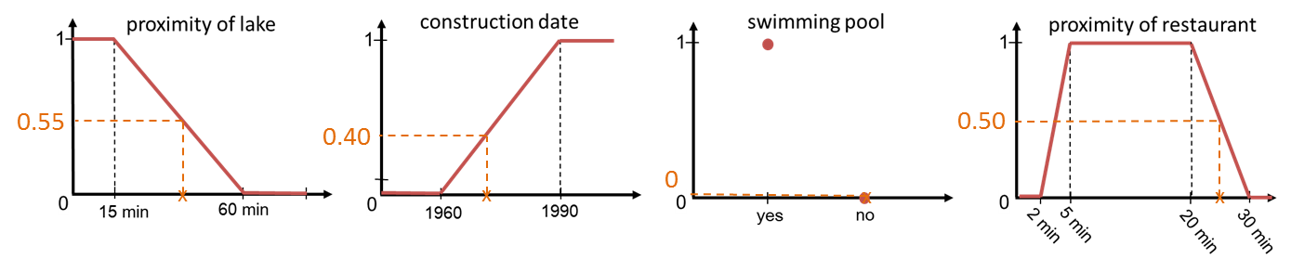
Soft computing in decision support
LSP
Logic Scoring of Preferences
step 3: evaluation of elementary criteria (cont’d)
examples
The Project is co-financed by the European Union from resources of the European Social Fund

Slide 11
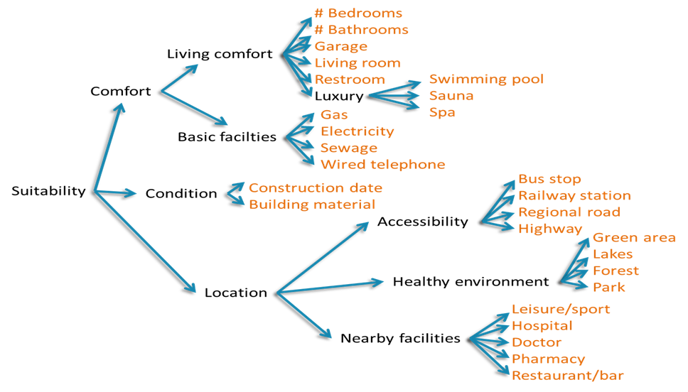
Soft computing in decision support
LSP
Logic Scoring of Preferences
step 4: aggregation of elementary degrees of suitability
construction of a hierarchic preference aggregation structure
that reflects the semantics of the attribute tree
The Project is co-financed by the European Union from resources of the European Social Fund

Slide 12

Soft computing in decision support
LSP
Logic Scoring of Preferences
step 4: aggregation of elementary degrees of suitability (cont’d)
building blocks
simple aggregators
compound aggregators
The Project is co-financed by the European Union from resources of the European Social Fund

Slide 13

Soft computing in decision support
LSP
Logic Scoring of Preferences
step 4: aggregation of elementary degrees of suitability (cont’d)
simple aggregators
Based on superposition of the fundamental Generalized Conjunction/Disjunction (GCD) function (basic LSP aggregator)
Continuous transition from conjunction to disjunction
Adjustable degrees of andness/orness (r)
Adjustable relative importance of inputs (w_{i})
The Project is co-financed by the European Union from resources of the European Social Fund

Slide 14
Soft computing in decision support
LSP
Logic Scoring of Preferences
step 4: aggregation of elementary degrees of suitability (cont’d)
generalized conjunction/disjunction (GCD)
GCD is implemented as a mean
frequently used implementations
  weighted power mean (WPM)
  exponential mean
  quasi-arithmetic mean
  OWA
WPM is used for practical purposes
The Project is co-financed by the European Union from resources of the European Social Fund

Slide 15
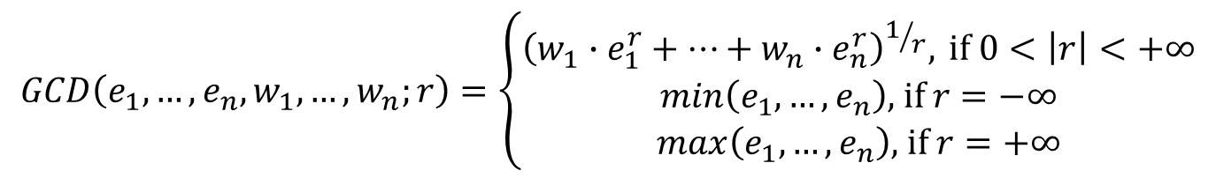
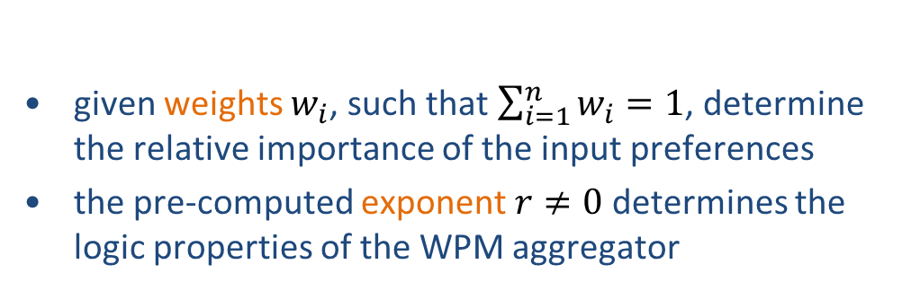
Soft computing in decision support
LSP
Logic Scoring of Preferences
step 4: aggregation of elementary degrees of suitability (cont’d)
weighted power mean (WPM)
$$GCD\left(e_{1},…,e_{n},w_{1},…,w_{n};r\right)=\left\{\begin{matrix}{\left(w_{1}∙e_{1}^{r}+…+w_{n}∙e_{n}^{r}\right)}^{1/r}, \text{if} 0<\left|r\right|<+∞ \\ min\left(e_{1},…,e_{n}\right)\text{, }\text{if} r=−∞ \\ max\left(e_{1},…,e_{n}\right)\text{, }\text{if} r=+∞\end{matrix}\right.$$
given weights $w_{i}$, such that $\sum_{i=1}^{n}{w_{i}=1}$, determine the relative importance of the input preferences
the pre-computed exponent $r≠0$ determines the logic properties of the WPM aggregator
The Project is co-financed by the European Union from resources of the European Social Fund

Slide 16
Soft computing in decision support
LSP
Logic Scoring of Preferences
step 4: aggregation of elementary degrees of suitability (cont’d)
in practice: discrete levels of andness/orness
discrete levels of andness/orness associate aggregators with linguistic interpretations
the use of linguistic labels (weak, medium, strong, etc.) simplifies the process of selecting the most appropriate aggregator
LSP basically uses a system with 17 discrete levels
The Project is co-financed by the European Union from resources of the European Social Fund

Slide 17
Soft computing in decision support
LSP
Logic Scoring of Preferences
17 discrete levels and their symbols
GCD
The Project is co-financed by the European Union from resources of the European Social Fund

Slide 18
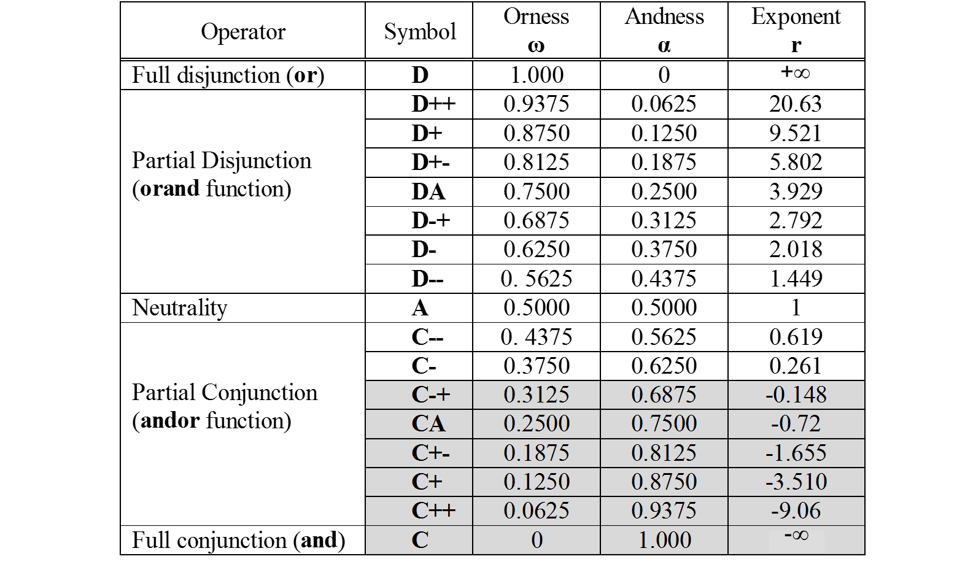
Soft computing in decision support
LSP
Logic Scoring of Preferences
GCD implemented as a weighted power mean
mandatory (all inputs must be satisfied)
The Project is co-financed by the European Union from resources of the European Social Fund

Slide 19

Soft computing in decision support
LSP
Logic Scoring of Preferences
step 4: aggregation of elementary degrees of suitability (cont’d)
compound aggregators
combining a mandatory with a desired input
  conjunctive partial absorption
combining a sufficient with a desired input
  disjunctive partial absorption
The Project is co-financed by the European Union from resources of the European Social Fund

Slide 20
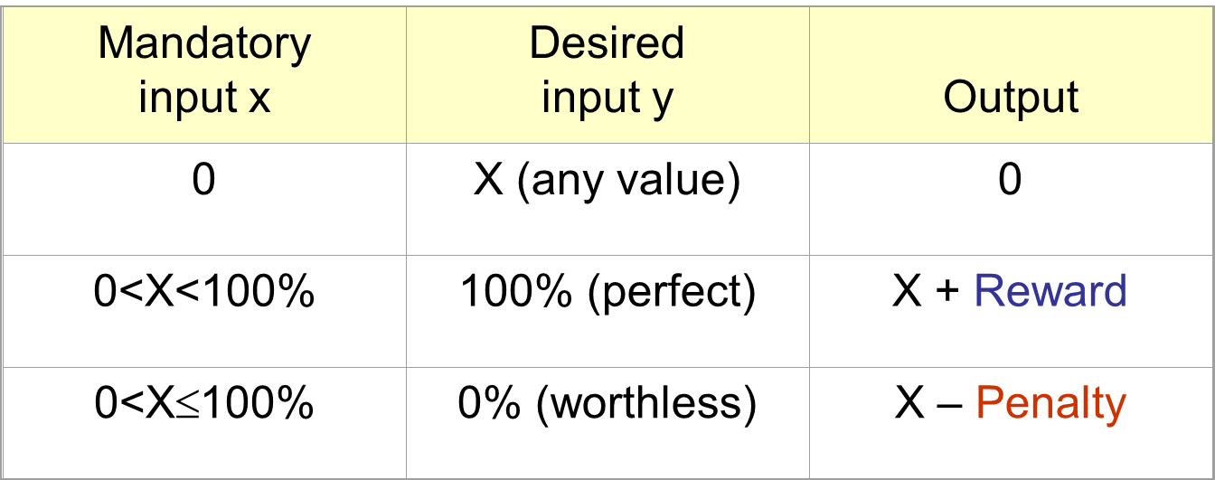
Soft computing in decision support
LSP
Logic Scoring of Preferences
step 4: aggregation of elementary degrees of suitability (cont’d)
conjunctive partial absorption
The Project is co-financed by the European Union from resources of the European Social Fund

Slide 21
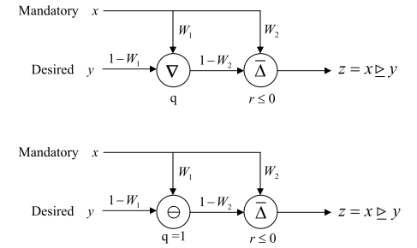
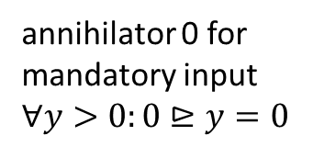

Soft computing in decision support
LSP
Logic Scoring of Preferences
step 4: aggregation of elementary degrees of suitability (cont’d)
conjunctive partial absorption ($⊵$)
P(enalty); R(eward)
annihilator 0 for
mandatory input
$$∀y>0:0⊵y=0$$
D+
C+
HPFdd
P(enalty); R(eward)
A
C+
The Project is co-financed by the European Union from resources of the European Social Fund

Slide 22

Soft computing in decision support
LSP
Logic Scoring of Preferences
step 4: aggregation of elementary degrees of suitability (cont’d)
conjunctive partial absorption ($⊵$)
$$x⊵y=w_{2}∙x\overset{̿}{∆}\left(1−w_{2}\right)∙\left(w_{1}∙x\tilde{∇}\left(1−w_{1}\right)∙y\right)$$
where $\overset{̿}{∆}∈\left\{\text{C},\text{C}\text{+}\right\}$ and $\tilde{∇}∈\left\{\text{D}\text{,}\text{D}\text{+,}\text{D}\text{−,}\text{A}\right\}$
The Project is co-financed by the European Union from resources of the European Social Fund

Slide 23
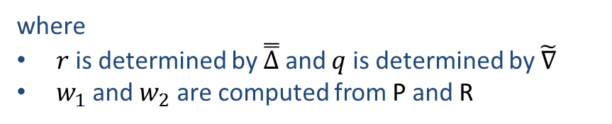
Soft computing in decision support
LSP
Logic Scoring of Preferences
step 4: aggregation of elementary degrees of suitability (cont’d)
conjunctive partial absorption ($⊵$)
in practice
$$x⊵y={\left(\left(1−w_{2}\right)∙{\left(w_{1}∙x^{q}+\left(1−w_{1}\right)∙y^{q}\right)}^{r/q}+w_{2}∙x^{r}\right)}^{1/r}$$
where
$r$ is determined by $\overset{̿}{∆}$ and $q$is determined by $\tilde{∇}$
$w_{1}$ and $w_{2}$ are computed from P and R
The Project is co-financed by the European Union from resources of the European Social Fund

Slide 24
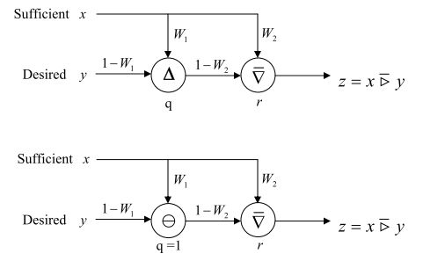
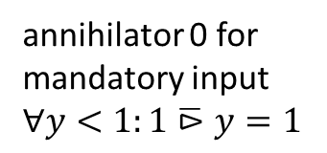
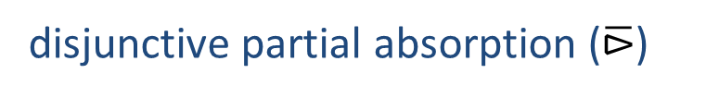
Soft computing in decision support
LSP
Logic Scoring of Preferences
step 4: aggregation of elementary degrees of suitability (cont’d)
disjunctive partial absorption ($\overline{⊳}$)
P(enalty); R(eward)
annihilator 0 for
mandatory input
$$∀y<1:1\overline{⊳}y=1$$
C+
D+
P(enalty); R(eward)
A
D+
The Project is co-financed by the European Union from resources of the European Social Fund

Slide 25

Soft computing in decision support
LSP
Logic Scoring of Preferences
step 4: aggregation of elementary degrees of suitability (cont’d)
disjunctive partial absorption ($\overline{⊳}$)
$$x\overline{⊳}y=w_{2}∙x\overset{̿}{∇}\left(1−w_{2}\right)∙\left(w_{1}∙x\tilde{∆}\left(1−w_{1}\right)∙y\right)$$
where $\overset{̿}{∇}∈\left\{\text{D},\text{D}\text{+}\right\}$ and $\tilde{∆}∈\left\{\text{C}\text{,}\text{C}\text{+,}\text{C}\text{−,}\text{A}\right\}$
The Project is co-financed by the European Union from resources of the European Social Fund

Slide 26
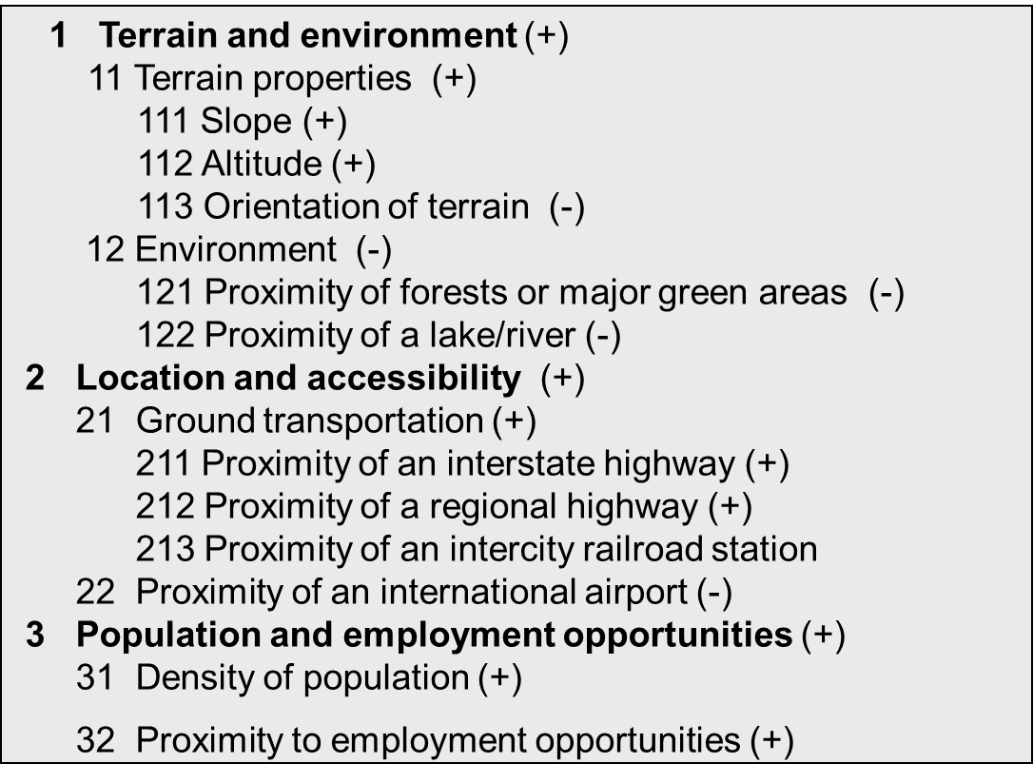
Soft computing in decision support
LSP
Logic Scoring of Preferences
step 4: aggregation of elementary degrees of suitability (cont’d)
example
The Project is co-financed by the European Union from resources of the European Social Fund

Slide 27
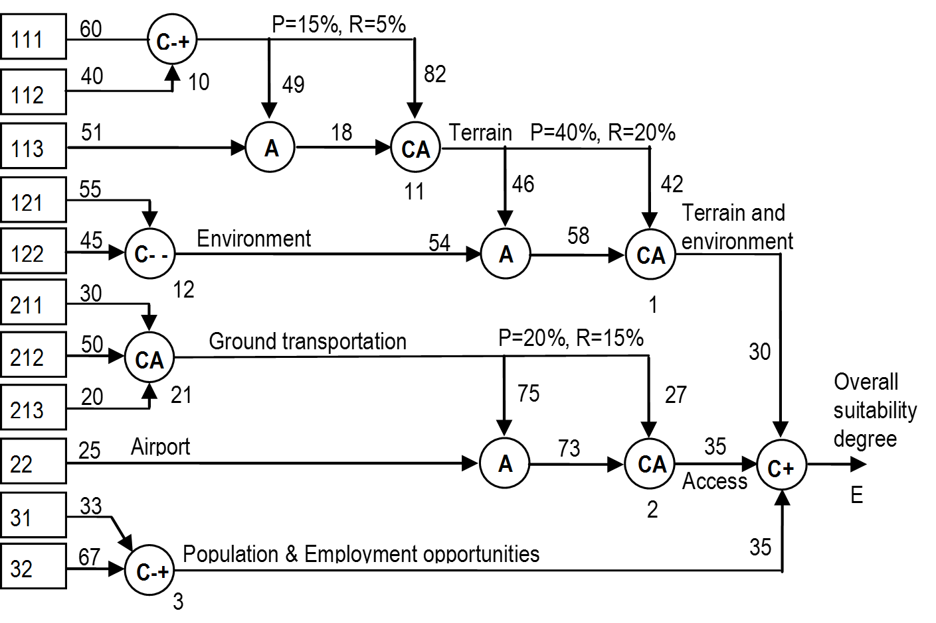
Soft computing in decision support
LSP
Logic Scoring of Preferences
step 4: aggregation of elementary degrees of suitability (cont’d)
The Project is co-financed by the European Union from resources of the European Social Fund

Slide 28

Soft computing in decision support
LSP
Logic Scoring of Preferences
step 5: perform a cost/suitability analysis to find the best value
suitability and affordability are orthogonal concepts
both have a hierarchic structure
but aggregation is different as values are different
  suitability: logical aggregation (and, or, not, etc.)
  cost: arithmetic aggregation (add, multiply, etc.)
decision makers usually need a tradeoff between both
The Project is co-financed by the European Union from resources of the European Social Fund

Slide 29

Soft computing in decision support
LSP
Logic Scoring of Preferences
step 5: perform a cost/suitability analysis to find the best value
The Project is co-financed by the European Union from resources of the European Social Fund

Slide 30



Soft computing in decision support
LSP
Logic Scoring of Preferences
step 5: perform a cost/suitability analysis to find the best value
overall suitability E vs. global cost C
minimal suitability $E^{MIN}$ and maximal cost $C^{MAX}$
reject if $E<E^{MIN}$ or $C>C^{MAX}$
global quality Q
$$Q=E/C$$
best suitability-cost tradeoff
The Project is co-financed by the European Union from resources of the European Social Fund

Slide 31
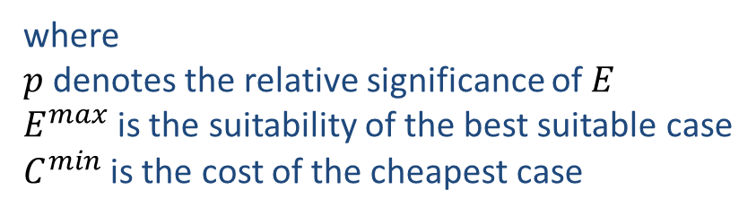
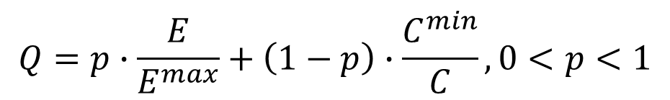
Soft computing in decision support
LSP
Logic Scoring of Preferences
step 5: perform a cost/suitability analysis to find the best value
$$Q=p∙\frac{E}{E^{max}}+\left(1−p\right)∙\frac{C^{min}}{C},0<p<1$$
where
$p$ denotes the relative significance of $E$
$E^{max}$is the suitability of the best suitable case
$C^{min}$is the cost of the cheapest case
The Project is co-financed by the European Union from resources of the European Social Fund

Slide 32
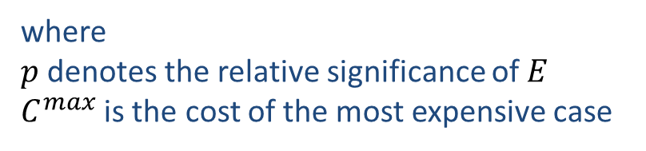
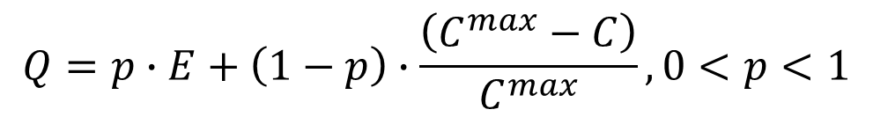
Soft computing in decision support
LSP
Logic Scoring of Preferences
step 5: perform a cost/suitability analysis to find the best value
$$Q=p∙E+\left(1−p\right)∙\frac{\left(C^{max}−C\right)}{C^{max}},0<p<1$$
where
$p$ denotes the relative significance of $E$
$C^{max}$is the cost of the most expensive case
The Project is co-financed by the European Union from resources of the European Social Fund

Slide 33

Soft computing in decision support
What can we learn from
decision support?
what can we learn from decision support?
The Project is co-financed by the European Union from resources of the European Social Fund

Slide 34

Soft computing in decision support
What can we learn from
decision support?
Bipolarity in ‘fuzzy’ querying
$$c \text{and} \text{if} \text{possible} w=min\left(c,k∙c+\left(1−k\right)⋅w\right), k∈\left]0,1\right[$$
‘and if possible’ is a special case of
Conjunctive Partial Absorption
$$x⊵y=w_{2}∙x\overset{̿}{∆}\left(1−w_{2}\right)∙\left(w_{1}∙x\tilde{∇}\left(1−w_{1}\right)∙y\right)$$
where $\overset{̿}{∆}∈\left\{\text{C},\text{C}\text{+}\right\}$ and $\tilde{∇}∈\left\{\text{D}\text{,}\text{D}\text{+,}\text{D}\text{−,}\text{A}\right\}$
J.J. Dujmović
“Partial Absorption Function”
Journal of the University of Belgrade 659
(1979) 156-163.
The Project is co-financed by the European Union from resources of the European Social Fund

Slide 35

Soft computing in decision support
What can we learn from
decision support?
Bipolarity in ‘fuzzy’ querying
$$c \text{or} \text{else} w=max\left(c,k∙c+\left(1−k\right)⋅w\right), k∈\left]0,1\right[$$
‘or else’ is a special case of
Disjunctive Partial Absorption
$$x\overline{⊳}y=w_{2}∙x\overset{̿}{∇}\left(1−w_{2}\right)∙\left(w_{1}∙x\tilde{∆}\left(1−w_{1}\right)∙y\right)$$
where $\overset{̿}{∇}∈\left\{\text{D},\text{D}\text{+}\right\}$ and $\tilde{∆}∈\left\{\text{C}\text{,}\text{C}\text{+,}\text{C}\text{−,}\text{A}\right\}$
J.J. Dujmović
“Partial Absorption Function”
Journal of the University of Belgrade 659
(1979) 156-163.
The Project is co-financed by the European Union from resources of the European Social Fund

Slide 36

Soft computing in decision support
What can we learn from
decision support?
there is a need for querying facilities to
handle mandatory and optional criteria
The Project is co-financed by the European Union from resources of the European Social Fund

Slide 37
Soft computing in decision support
What can we learn from
decision support?
current querying facilities do not
efficiently support complex data searches
The Project is co-financed by the European Union from resources of the European Social Fund

Slide 38

Soft computing in decision support
What can we learn from
decision support?
query expressivity
  need for grouping and structuring preferences
  need for generalizing and specializing preferences
criterion trees
The Project is co-financed by the European Union from resources of the European Social Fund

Slide 39

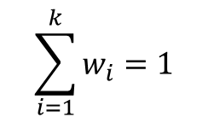
Soft computing in decision support
What can we learn from
decision support?
query expressivity
  tree structure
  leaf node: elementary criterion c_{i} on a single attribute a_{i}
  internal node: specification of an aggregation operator A
  edge: relative weight (importance) of the criterion
A
$$\sum_{i=1}^{k}{w_{i}=1}$$
w₁
w₂
w_{k}
c₁
c₂
…
c_{k}
The Project is co-financed by the European Union from resources of the European Social Fund

Slide 40
Soft computing in decision support
What can we learn from
decision support?
query expressivity
  aggregators
Generalised
Conjunction
Disjunction
(GCD)
Ordered
Weighted
Average
(OWA)
C D
HPC HPD
SPC SPD
A
Dujmović
Yager
The Project is co-financed by the European Union from resources of the European Social Fund

Slide 41

Soft computing in decision support
What can we learn from
decision support?
query expressivity
  weighted aggregators
  no more need for weight propagation!
  (because internal nodes have associated weights)
The Project is co-financed by the European Union from resources of the European Social Fund

Slide 42
Soft computing in decision support
What can we learn from
decision support?
query expressivity
  evaluation
  leaf node: evaluation of elementary criterion c_{i}
  internal node: aggregation of evaluation results of all leaf nodes
  criterion tree: evaluation of the root node
The Project is co-financed by the European Union from resources of the European Social Fund

Slide 43



Soft computing in decision support
What can we learn from
decision support?
query expressivity
  example
…
The Project is co-financed by the European Union from resources of the European Social Fund

Slide 44
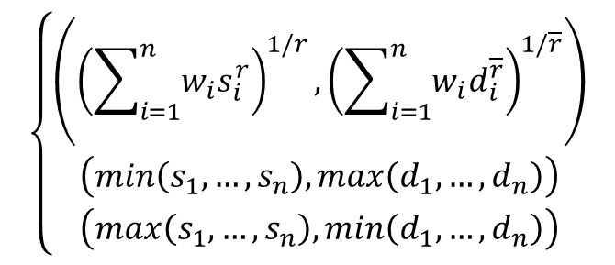
Soft computing in decision support
What can we learn from
decision support?
query expressivity
  advanced GCD aggregation for BSDs
$$GCD\left(\left(s_{1},d_{1}\right),…,\left(s_{n},d_{n}\right),w_{1},…,w_{n};r\right)=$$
$$\left\{\begin{matrix}\left({\left(\sum_{i=1}^{n}{w_{i}s_{i}^{r}}\right)}^{1/r},{\left(\sum_{i=1}^{n}{w_{i}d_{i}^{\overline{r}}}\right)}^{1/\overline{r}}\right) \\ \left(min\left(s_{1},…,s_{n}\right),max\left(d_{1},…,d_{n}\right)\right) \\ \left(max\left(s_{1},…,s_{n}\right),min\left(d_{1},…,d_{n}\right)\right)\end{matrix}\right.$$
, if 0<|r|<+∞
, if r= -∞
, if r= +∞
⎯
where r models the logical counterpart of the operator modelled by r
(e.g., if r models HPC, then r models HPD)
⎯
The Project is co-financed by the European Union from resources of the European Social Fund

Slide 45
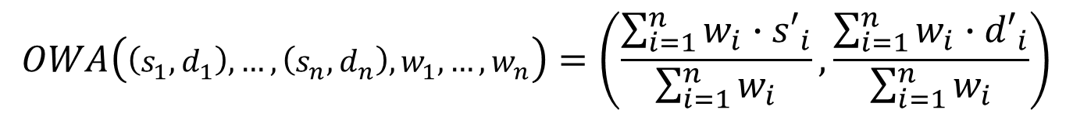
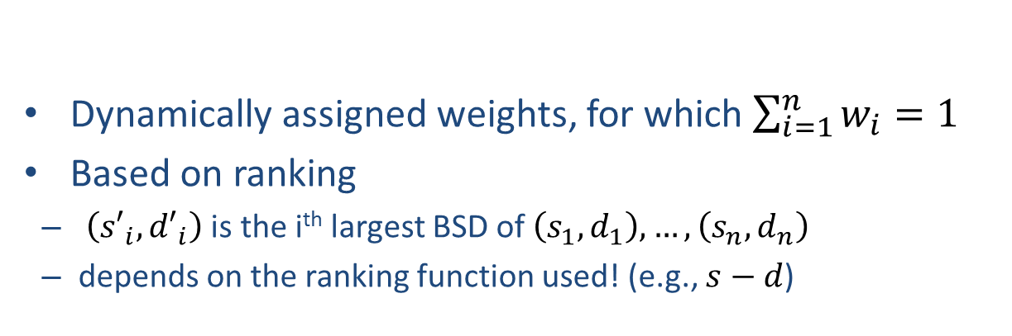
Soft computing in decision support
What can we learn from
decision support?
query expressivity
  advanced OWA aggregation for BSDs
Dynamically assigned weights, for which $\sum_{i=1}^{n}{w_{i}=1}$
Based on ranking
  $\left({s′}_{i},{d′}_{i}\right)$ is the i^{th} largest BSD of $\left(s_{1},d_{1}\right),…,\left(s_{n},d_{n}\right)$
  depends on the ranking function used! (e.g., $s−d$)
$$OWA\left(\left(s_{1},d_{1}\right),…,\left(s_{n},d_{n}\right),w_{1},…,w_{n}\right)=\left(\frac{\sum_{i=1}^{n}{{w_{i}∙s′}_{i}}}{\sum_{i=1}^{n}{w_{i}}},\frac{\sum_{i=1}^{n}{{w_{i}∙d′}_{i}}}{\sum_{i=1}^{n}{w_{i}}}\right)$$
The Project is co-financed by the European Union from resources of the European Social Fund

Slide 46

Soft computing in decision support
Applications
some applications
The Project is co-financed by the European Union from resources of the European Social Fund

Slide 47
Soft computing in decision support
Applications
LSP suitability maps
logically aggregated geographical suitability maps (S-maps)
provide specialized maps of the suitability degree of a selected geographic region for a specific purpose
  construction of industrial objects, airports, entertainment centers, shopping malls, sport facilities
  land/sea exploitation
  agriculture
  etc.
for the purpose of evaluating and comparing locations, areas or regions
suitability degrees are computed using the LSP method
The Project is co-financed by the European Union from resources of the European Social Fund

Slide 48
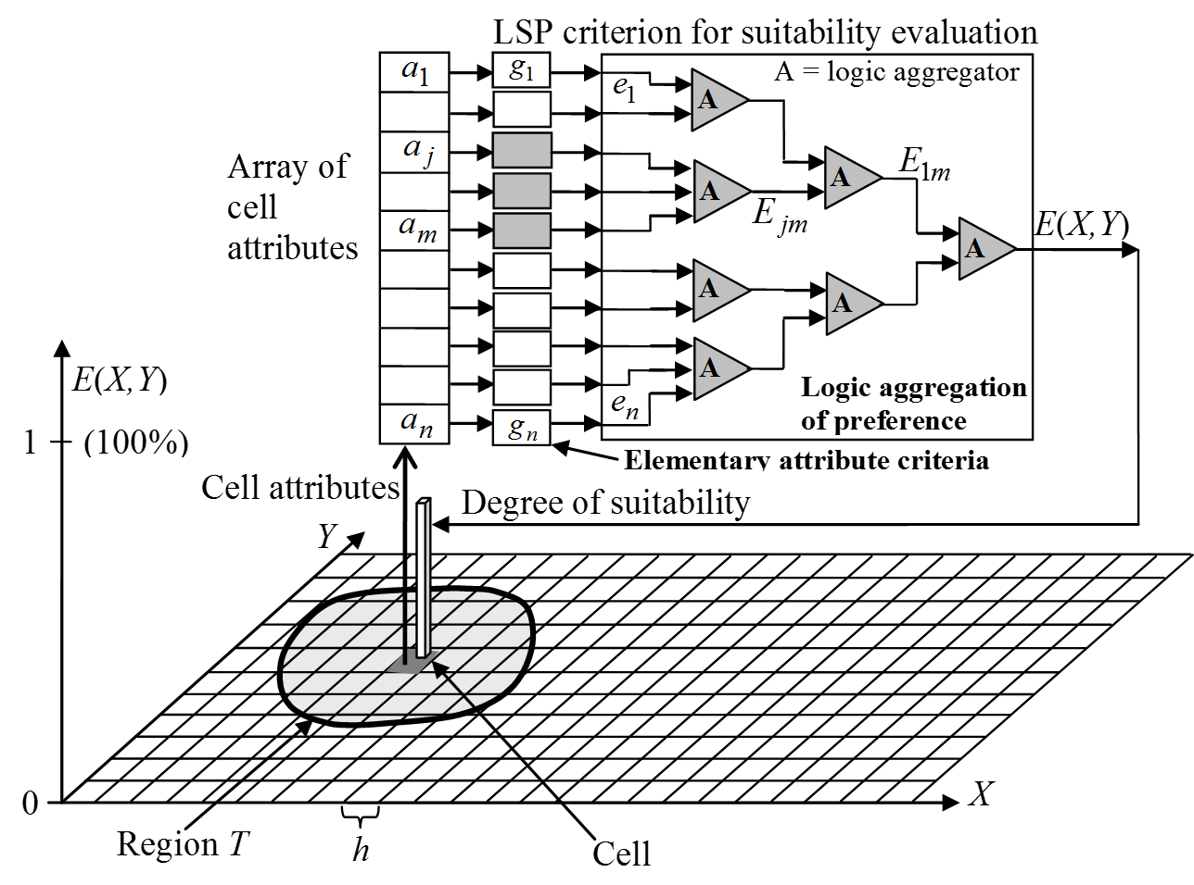
Soft computing in decision support
Applications
LSP suitability maps
regular approach
The Project is co-financed by the European Union from resources of the European Social Fund

Slide 49
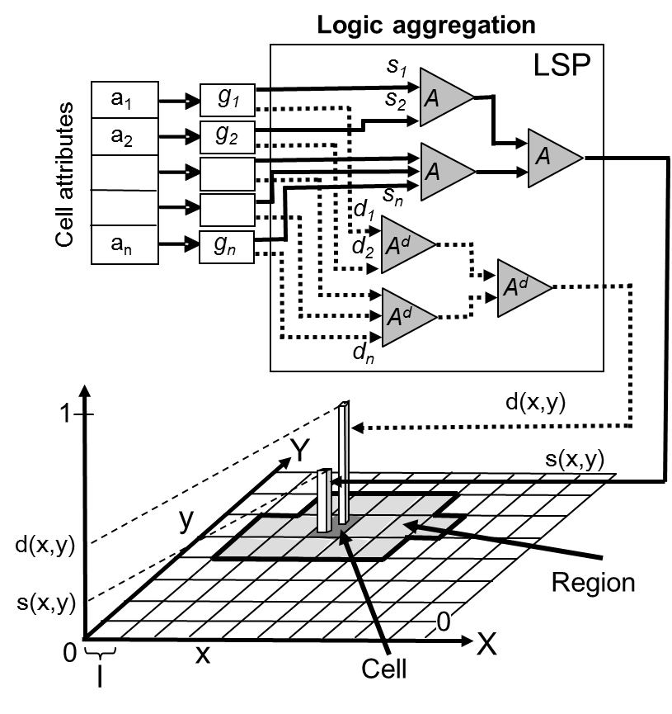
Soft computing in decision support
Applications
LSP suitability maps
bipolar approach
The Project is co-financed by the European Union from resources of the European Social Fund

Slide 50

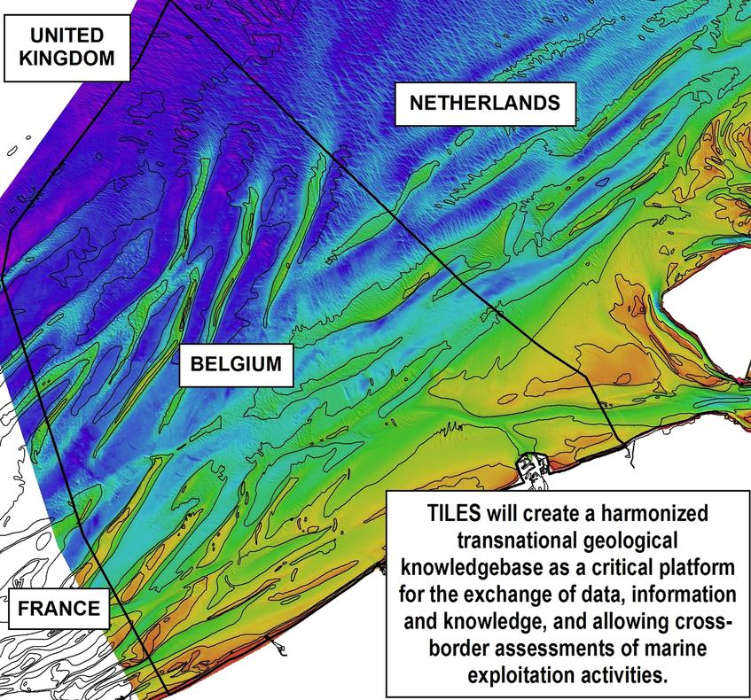
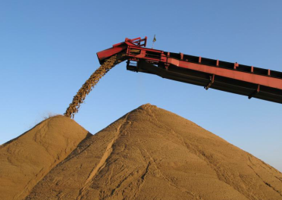
Soft computing in decision support
Applications
the TILES project
Transnational and Integrated Long-term Marine Exploitation Strategies
The Project is co-financed by the European Union from resources of the European Social Fund

Slide 51
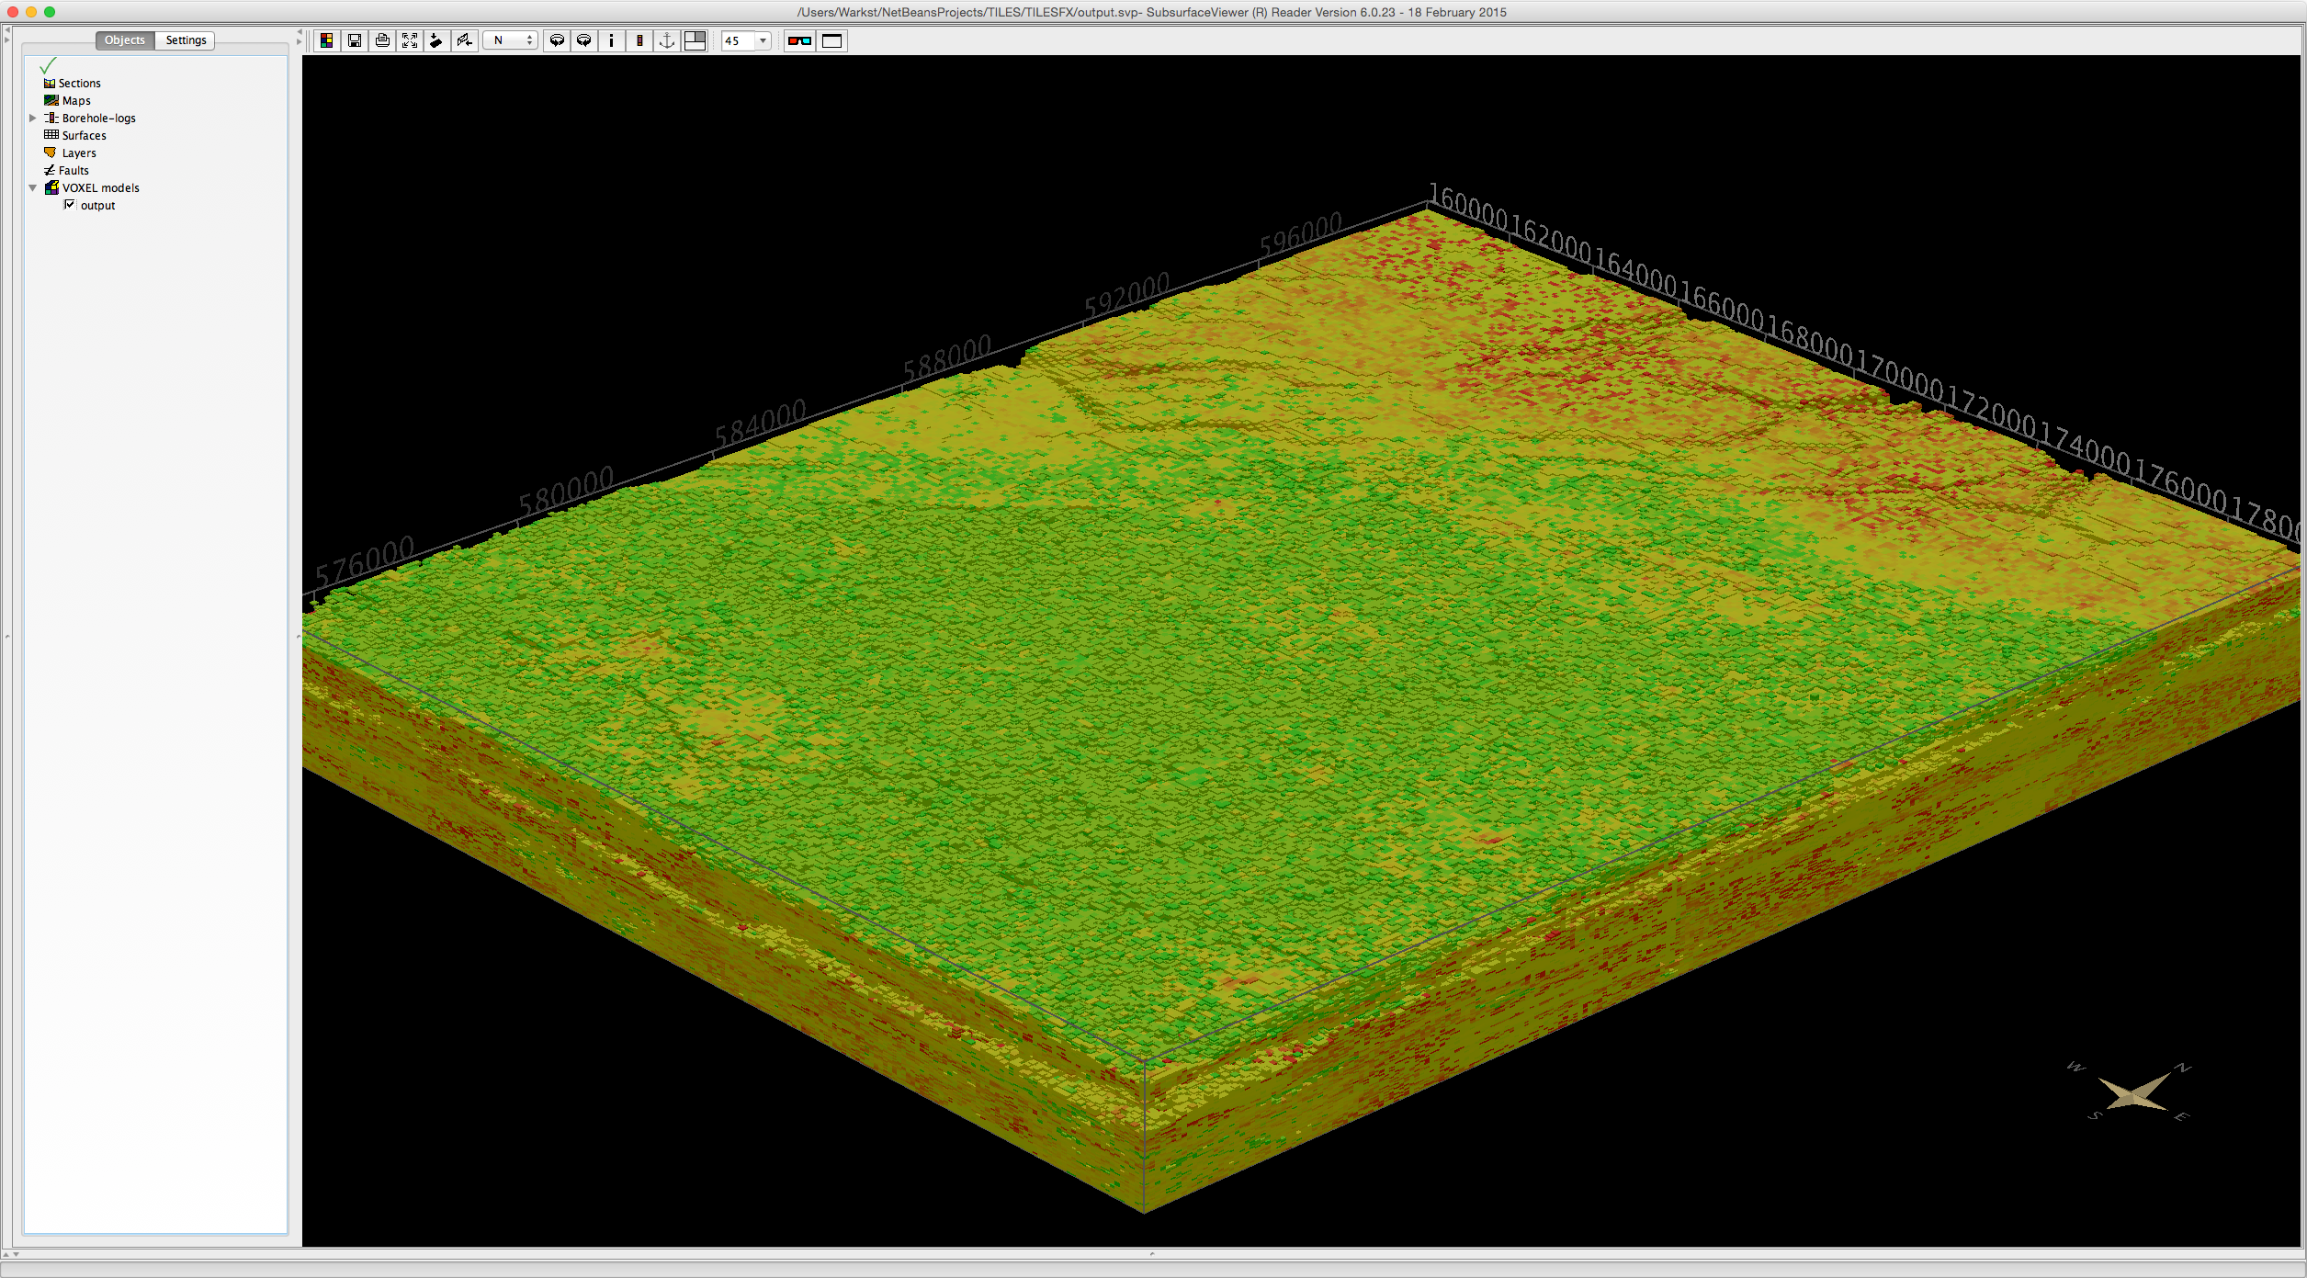
Soft computing in decision support
Applications
the TILES project
The Project is co-financed by the European Union from resources of the European Social Fund

Slide 52

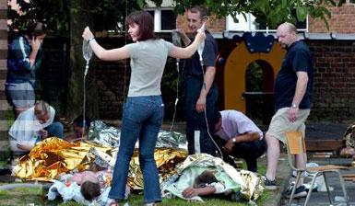

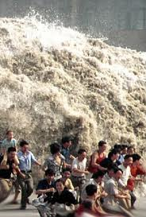

Soft computing in decision support
Applications
ear identification
Disaster Victim Identification
identification of human bodies
large scale disasters
The Project is co-financed by the European Union from resources of the European Social Fund

Slide 53
Soft computing in decision support
Applications
ear identification
strategy
collect as many data as possible about:
  victims
  missing persons
data examples
  biometrical (DNA, dental records, ear photographs...)
  general data (gender, name...)
  descriptive data (clothes, tattoo’s, piercings...)
The Project is co-financed by the European Union from resources of the European Social Fund

Slide 54
Soft computing in decision support
Applications
ear identification
issues
  fast data collection
  intelligent combination of all information
  final decision by a committee of experts
  uncertainty in early stage
  charitable approach is preferred
The Project is co-financed by the European Union from resources of the European Social Fund

Slide 55
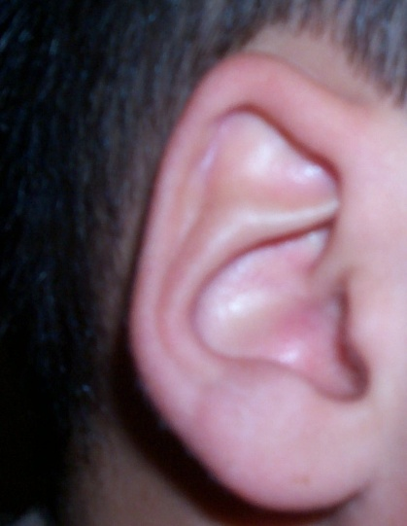
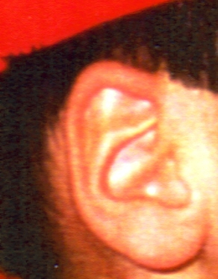
Soft computing in decision support
Applications
ear identification
data
?
=
  victim: post mortem (PM) 3D ear picture
  missing person: ante mortem (AM) 2D pictures
The Project is co-financed by the European Union from resources of the European Social Fund

Slide 56
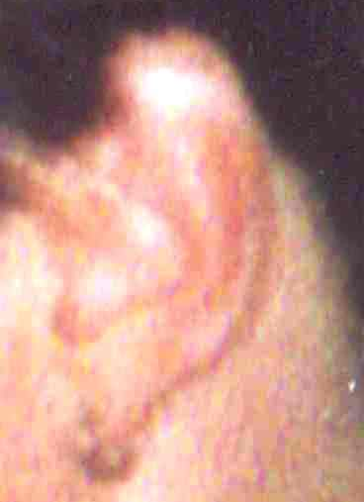
Soft computing in decision support
Applications
ear identification
challenge
  cope with poor picture quality of AM pictures
The Project is co-financed by the European Union from resources of the European Social Fund

Slide 57
Soft computing in decision support
Applications
ear identification
approach
    Ear detection
    Positioning and extraction
    Ear normalisation and enhancement
    Transform to a 3D ear model using geometrical and photometric corrections
    Feature extraction
    Ear recognition
    Compare feature sets and compute matching score
    Decision
The Project is co-financed by the European Union from resources of the European Social Fund

Slide 58
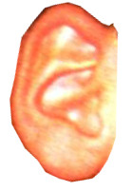
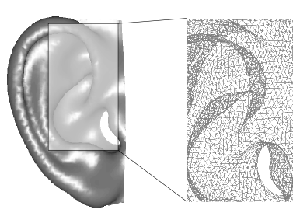

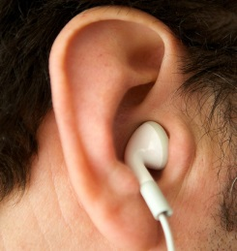

Soft computing in decision support
Applications
ear identification
approach
AM ear
ear detection
①
②
①
ear normalisation
and enhancement
normalized 3D ear
…
…
The Project is co-financed by the European Union from resources of the European Social Fund

Slide 59
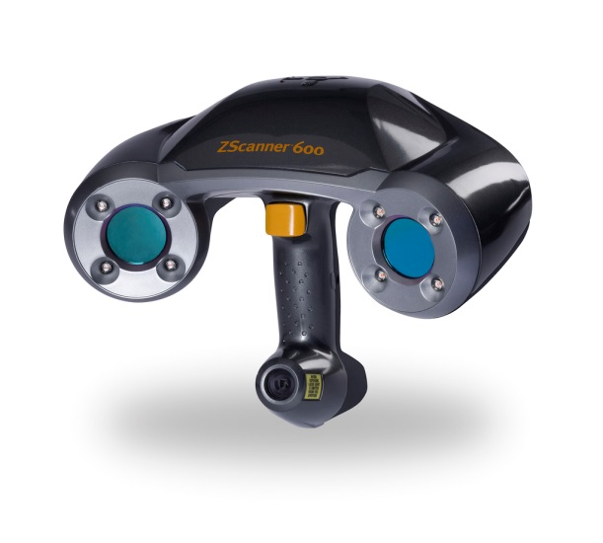
Soft computing in decision support
Applications
ear identification
approach
PM ear
②
ear normalisation
and enhancement
3D camera / 3D scanner
normalized 3D ear
The Project is co-financed by the European Union from resources of the European Social Fund

Slide 60
Soft computing in decision support
Applications
ear identification
approach
●
feature
extraction
selecting n representative points
L_{A}=[p₁^{A},…,p_{n}^{A}]
The Project is co-financed by the European Union from resources of the European Social Fund

Slide 61

Soft computing in decision support
Applications
ear identification
approach
AM ear
PM ear
❍
ear
recognition
comparing feature sets om 3D AM and PM ear models
L_{A}=[p₁^{A},…,p_{n}^{A}]
L_{P}=[p₁^{P},…,p_{n}^{P}]
The Project is co-financed by the European Union from resources of the European Social Fund

Slide 62


Soft computing in decision support
Applications
ear identification
approach
❍
ear
recognition
comparing feature sets om 3D AM and PM ear models
match
+ coping with imperfect data
The Project is co-financed by the European Union from resources of the European Social Fund

Slide 63
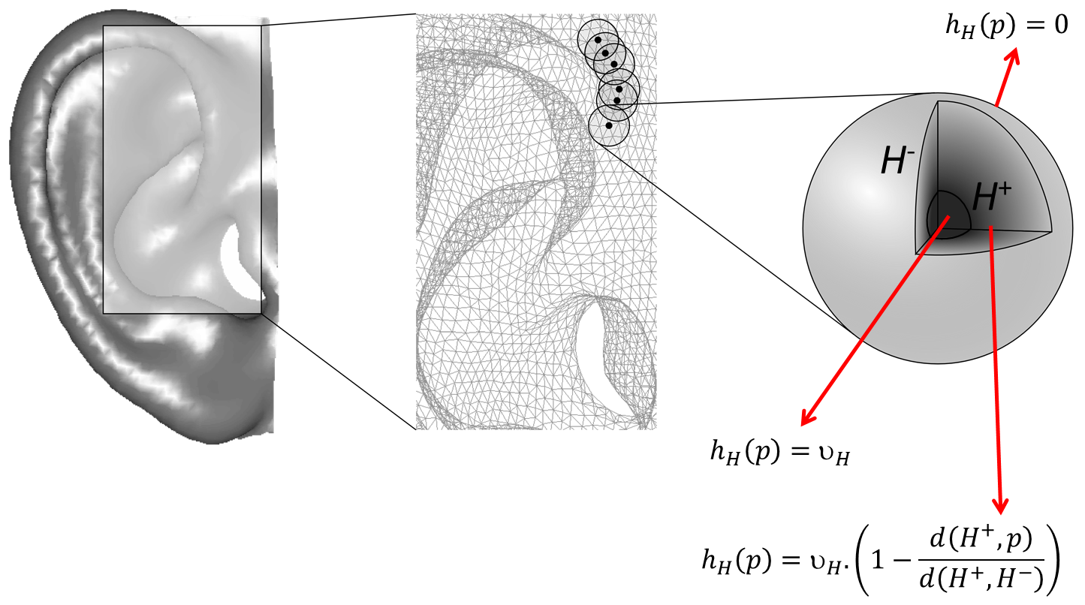
Soft computing in decision support
Applications
ear identification
hesitation spheres
The Project is co-financed by the European Union from resources of the European Social Fund

Slide 64
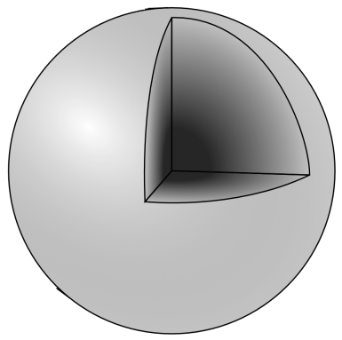

Soft computing in decision support
Applications
ear identification
hesitation spheres
  handle unreliable parts
  manually assigned by forensic experts
  overall hesitation of point p covered by
  multiple hesitation spheres
$$h\left(p\right)={\max_{k}h}_{H_{k}}\left(p\right)$$
The Project is co-financed by the European Union from resources of the European Social Fund

Slide 65
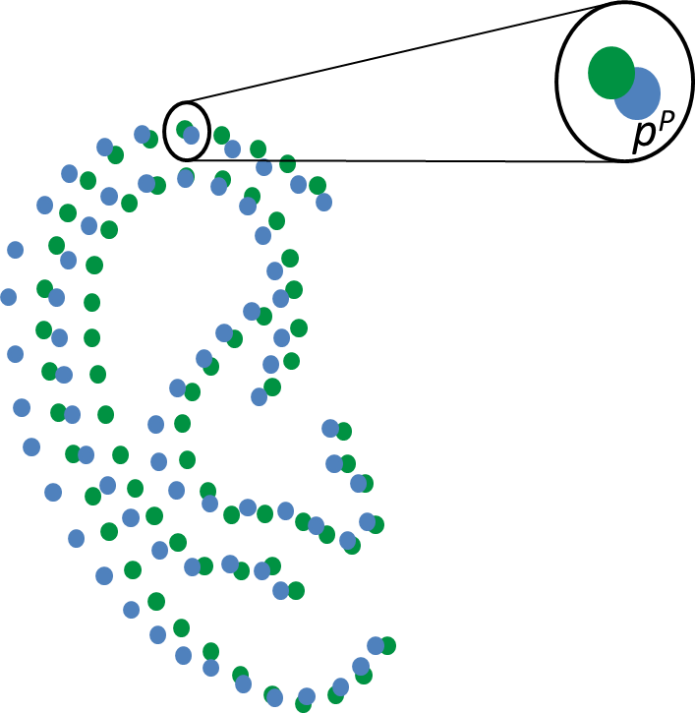
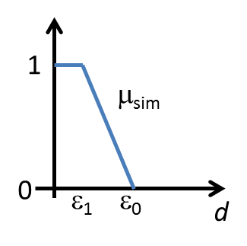
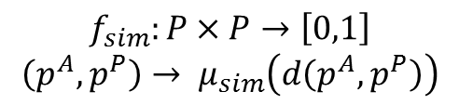
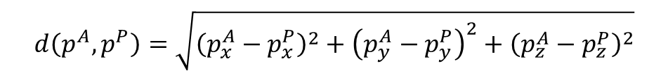
Soft computing in decision support
Applications
ear identification
traditional approach
p^{A}
1. distance d(p^{A},p^{P})
$$d\left(p^{A},p^{P}\right)=\sqrt{{\left(p_{x}^{A}−p_{x}^{P}\right)}^{2}+{\left(p_{y}^{A}−p_{y}^{P}\right)}^{2}+{\left(p_{z}^{A}−p_{z}^{P}\right)}^{2}}$$
2. similarity f_{sim}(p^{A},p^{P})
$$f_{sim}:P×P→\left[0,1\right]$$
$$\left(p^{A},p^{P}\right)→ μ_{sim}\left(d\left(p^{A},p^{P}\right)\right)$$
The Project is co-financed by the European Union from resources of the European Social Fund

Slide 66
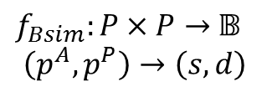
Soft computing in decision support
Applications
ear identification
bipolar approach
p^{A}
local similarity f_{Bsim}(p^{A},p^{P})
$f_{Bsim}:P×P→$ $𝔹$
$$\left(p^{A},p^{P}\right)→\left(s,d\right)$$
$$s=\left(1−max\left(h\left(p^{A}\right),h\left(p^{P}\right)\right)\right).μ_{sim}\left(d\left(p^{A},p^{P}\right)\right)$$
$$d=\left(1−max\left(h\left(p^{A}\right),h\left(p^{P}\right)\right)\right).\left(1−μ_{sim}\left(d\left(p^{A},p^{P}\right)\right)\right)$$
$$h=1−s−d=max\left(h\left(p^{A}\right),h\left(p^{P}\right)\right)$$
The Project is co-financed by the European Union from resources of the European Social Fund

Slide 67


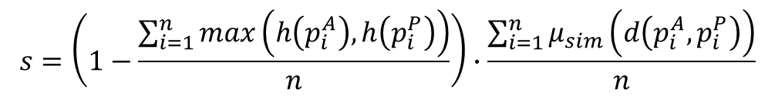
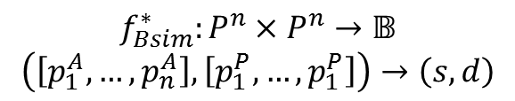



Soft computing in decision support
Applications
ear identification
bipolar approach
overall similarity $f_{Bsim}^{∗}\left(p^{A},p^{P}\right)$
$$f_{Bsim}^{∗}:P^{n}×P^{n}→𝔹$$
$$\left(\left[p_{1}^{A},…,p_{n}^{A}\right],\left[p_{1}^{P},…,p_{1}^{P}\right]\right)→\left(s,d\right)$$
$$s=\left(1−\frac{\sum_{i=1}^{n}{max\left(h\left(p_{i}^{A}\right),h\left(p_{i}^{P}\right)\right)}}{n}\right)∙\frac{\sum_{i=1}^{n}{μ_{sim}\left(d\left(p_{i}^{A},p_{i}^{P}\right)\right)}}{n}$$
$$d=\left(1−\frac{\sum_{i=1}^{n}{max\left(h\left(p_{i}^{A}\right),h\left(p_{i}^{P}\right)\right)}}{n}\right)∙\left(1−\frac{\sum_{i=1}^{n}{μ_{sim}\left(d\left(p_{i}^{A},p_{i}^{P}\right)\right)}}{n}\right)$$
$$h=1−s−d=\frac{\sum_{i=1}^{n}{max\left(h\left(p_{i}^{A}\right),h\left(p_{i}^{P}\right)\right)}}{n}$$
match
The Project is co-financed by the European Union from resources of the European Social Fund

Slide 68


Soft computing in decision support
Applications
ear identification
approach
❍
interpretation
of results
each comparison i :
(s_{i},d_{i})
ranking of the results:
$$r:𝔹→\left[0,1\right]$$
$$\left(s_{i},d_{i} \right)→\frac{s_{i}+\left(1−d_{i}\right)}{2}$$
satisfaction about matching
dissatisfaction about matching
top-k matching results
h_{i} = 1-s_{i}-d_{i} : overall hesitation about matching
The Project is co-financed by the European Union from resources of the European Social Fund

Slide 69





Questions?
Warsaw, June 22-26 2015
The Project is co-financed by the European Union from resources of the European Social Fund

Slide 70

Warsaw, June 22-26 2015
The Project is co-financed by the European Union from resources of the European Social Fund

