Slide 1

ACHIEVE-ITN PROGRESS PRESENTATION
Patrick Heyer
TELIN-Image Processing and Interpretation Ghent University
WASC
July 1-2 2019, Rennes

Slide 2
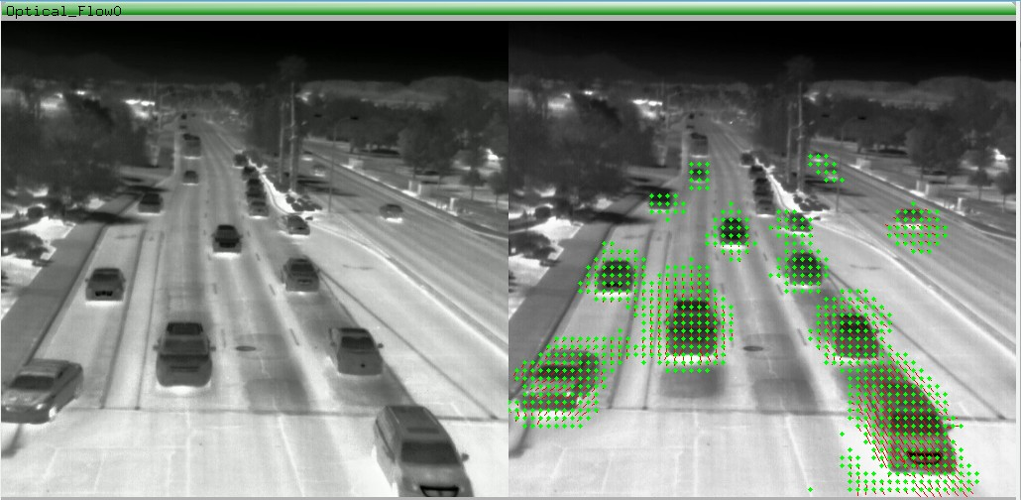
Software architecture for cooperative sensing
P. Heyer (Ghent University)
ACHIEVE-ITN PROGRESS PRESENTATION
Project Check Meeting
<number> / 14

Slide 3
ACHIEVE-ITN The main scientific objective of the research program will be the development of a distributed vision platform composed of networked, smart and efficient vision systems.
P. Heyer (Ghent University)
ACHIEVE-ITN PROGRESS PRESENTATION
Project Check Meeting
<number> / 14

Slide 4
Requirements for cooperation
Multiple simultaneous information sources
Different sensor types (RGB, Thermal, Traffic controller) Ability to communicate and coordinate
Fast deployment of new algorithms
P. Heyer (Ghent University)
ACHIEVE-ITN PROGRESS PRESENTATION
Project Check Meeting
<number> / 14

Slide 5
Proposed solution
Plugin based system for modularity
Shared memory data communication for speed Common logging system for debugging Custom GUI to prevent threading problems
P. Heyer (Ghent University)
ACHIEVE-ITN PROGRESS PRESENTATION
Project Check Meeting
<number> / 14

Slide 6
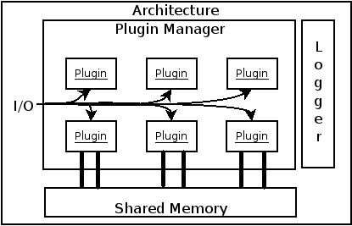
Long explanation, bare with me
P. Heyer (Ghent University)
ACHIEVE-ITN PROGRESS PRESENTATION
Project Check Meeting
<number> / 14

Slide 7
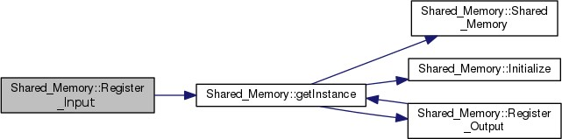
Shared Memory Structure
P. Heyer (Ghent University)
ACHIEVE-ITN PROGRESS PRESENTATION
Project Check Meeting
<number> / 14

Slide 8
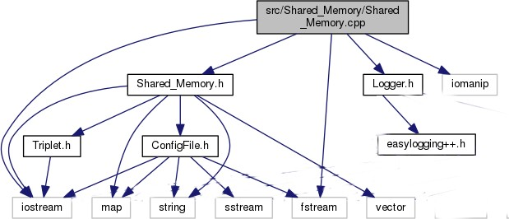
Shared Memory dependency
P. Heyer (Ghent University)
ACHIEVE-ITN PROGRESS PRESENTATION
Project Check Meeting
<number> / 14

Slide 9
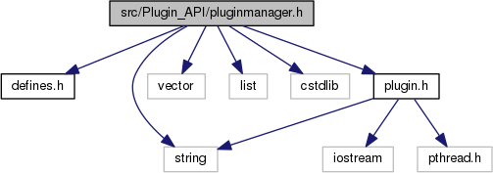
Plugin Manager dependency
P. Heyer (Ghent University)
ACHIEVE-ITN PROGRESS PRESENTATION
Project Check Meeting
<number> / 14

Slide 10
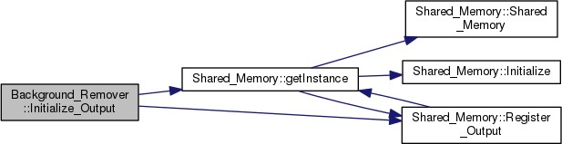
Plugin Sample call graph
P. Heyer (Ghent University)
ACHIEVE-ITN PROGRESS PRESENTATION
Project Check Meeting
<number> / 14

Slide 11

Existing plugins
(not all up to date)
Background remover
Optical flow
Network server/client Python interpreter
Camera reader
IP Camera checker IP Camera reader Video file reader
Video RTSP streamer Camshift tracker
Joystick reader/writer Keyboard reader/writer
(Some other plugins protected by IP)
P. Heyer (Ghent University)
ACHIEVE-ITN PROGRESS PRESENTATION
Project Check Meeting
<number> / 14

Slide 12
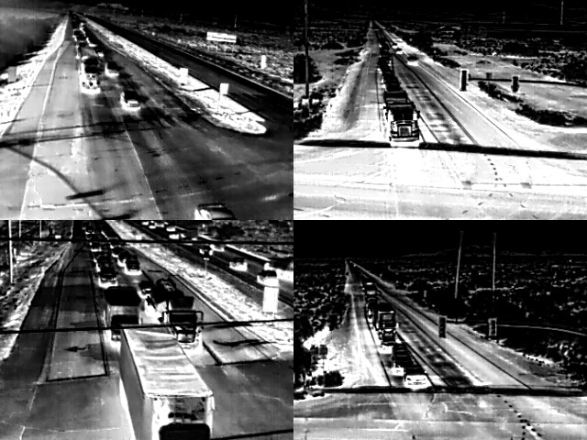
P. Heyer (Ghent University)
ACHIEVE-ITN PROGRESS PRESENTATION
Project Check Meeting
<number> / 14

Slide 13
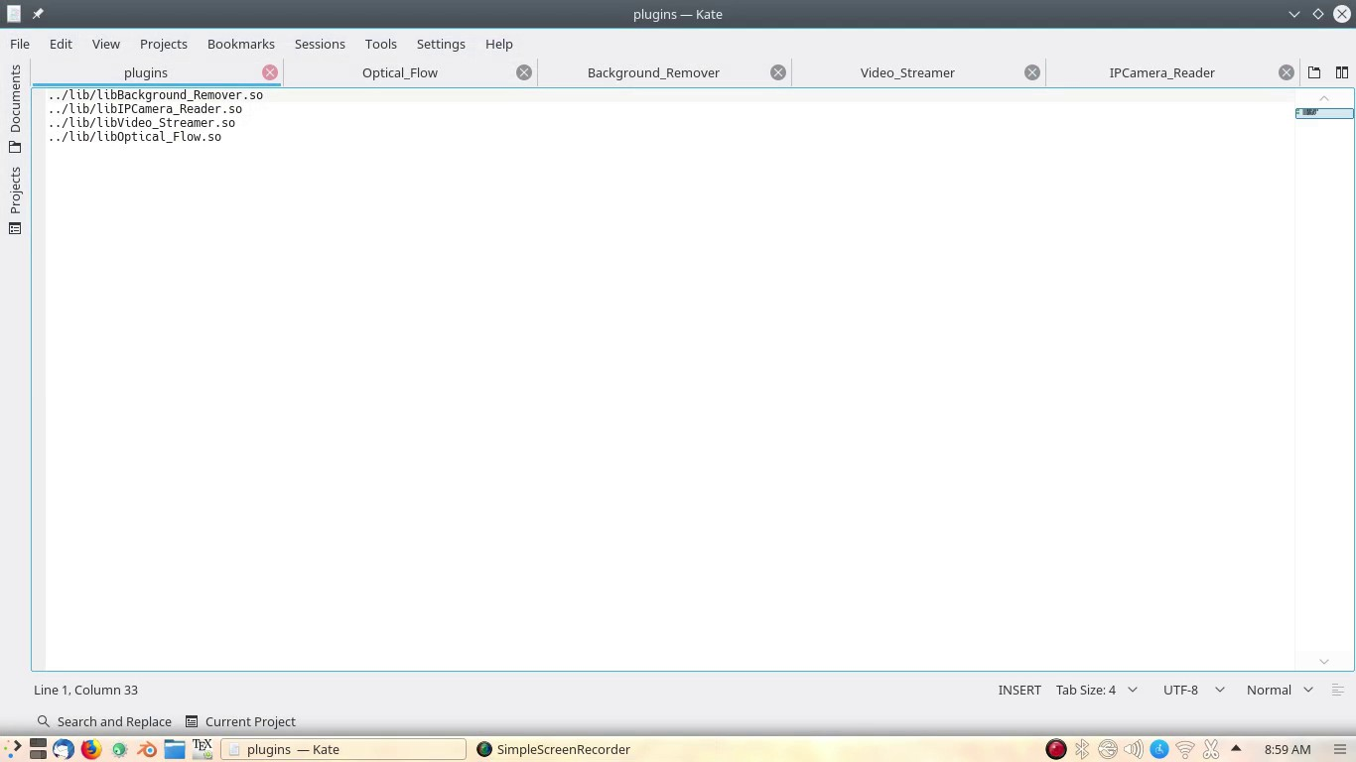
Start the demo, If it fails show this video
P. Heyer (Ghent University)
ACHIEVE-ITN PROGRESS PRESENTATION
Project Check Meeting
<number> / 14

Slide 14
Thanks Questions?
P. Heyer (Ghent University)
ACHIEVE-ITN PROGRESS PRESENTATION
Project Check Meeting
<number> / 14

