Slide 1

Cooperative camera scene modeling using metadata
Patrick Heyer
TELIN-Image Processing and Interpretation Ghent University
Project Check Meeting March 5–6 2019, Sevilla

Slide 2
Outline
1 Background
Experience Past Projects
2
Research project
Motivation and problematic Research proposal
Research problems
Progress
P. Heyer (Ghent University)
Cooperative camera scene modeling using metadata
Project Check Meeting
<number> / 11

Slide 3
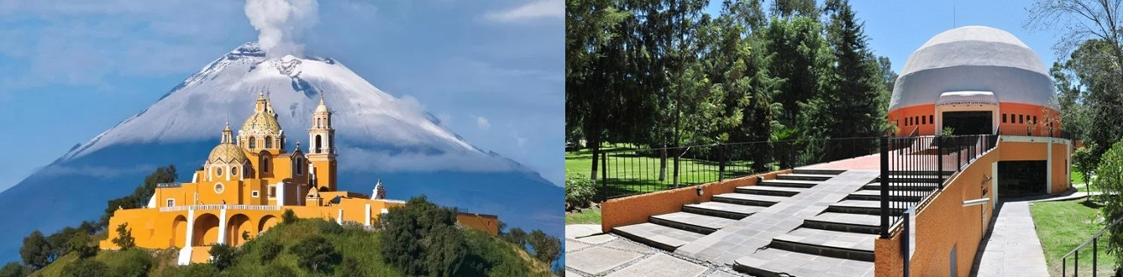
Experience
Education:
MSc in Computer Sciences. National Institute of Astrophysics, Optics and Electronics (INAOE) Mexico. 2017
BSc in Computer Sciences. Instituto de Estudios Universitarios (IEU) Mexico, 2014
Research groups:
Image Processing and Interpretation (2018-ongoing) Gent University (UGent)
Biosignal processing and medical computing lab (2014-2018) INAOE) Computer sensing and robotics (2011-2015 INAOE)
P. Heyer (Ghent University)
Cooperative camera scene modeling using metadata
Project Check Meeting
<number> / 11

Slide 4
Past Projects
Gesture Therapy: Serious game development, sensing architecture, and automatic assessment development (2011-2018)
SmartSDK: Cloud based health monitoring app development (FiHEALTH), support in multi-camera security system using cloud-services (FiWARE) (2017-2018)
UBI-HEALTH: Testing and development of accelerometer based motion analysis (2012-2016)
ICON: Research and develop probabilistic cloud resources allocation schemes (2015)
Markovito: Development of plugin based shared memory architecture, adaptation and integration of service robot AI (2011-2014)
P. Heyer (Ghent University)
Cooperative camera scene modeling using metadata
Project Check Meeting
<number> / 11

Slide 5
Research Project
Cooperative camera scene modeling using metadata
P. Heyer (Ghent University)
Cooperative camera scene modeling using metadata
Project Check Meeting
<number> / 11

Slide 6
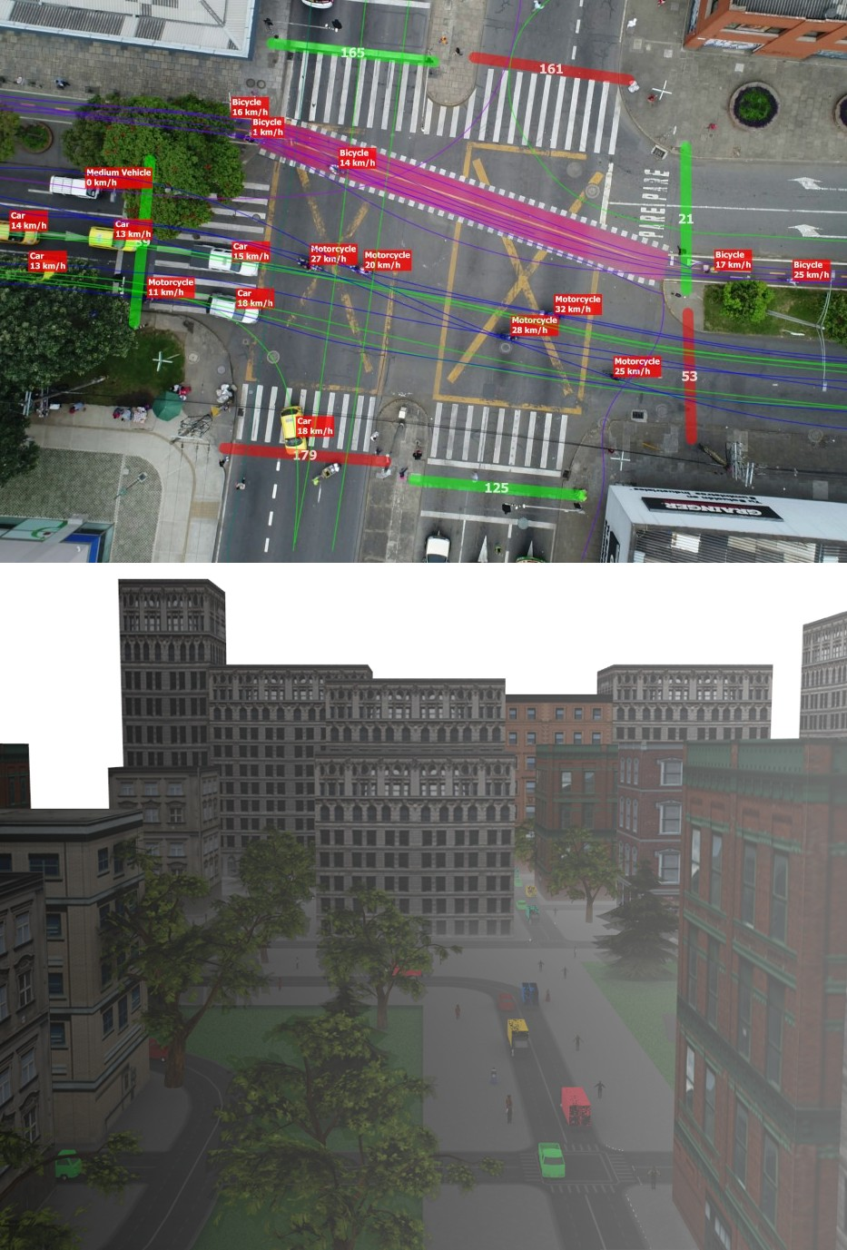
Motivation and problematic
Motivation: Intersection monitoring allows to react to different traffic conditions, this enables decision making that improve general traffic flow
Problematic: Environmental conditions, occlusion, and noise reduce the general overview of the environment limiting the certainty to make decisions
P. Heyer (Ghent University)
Cooperative camera scene modeling using metadata
Project Check Meeting
<number> / 11

Slide 7
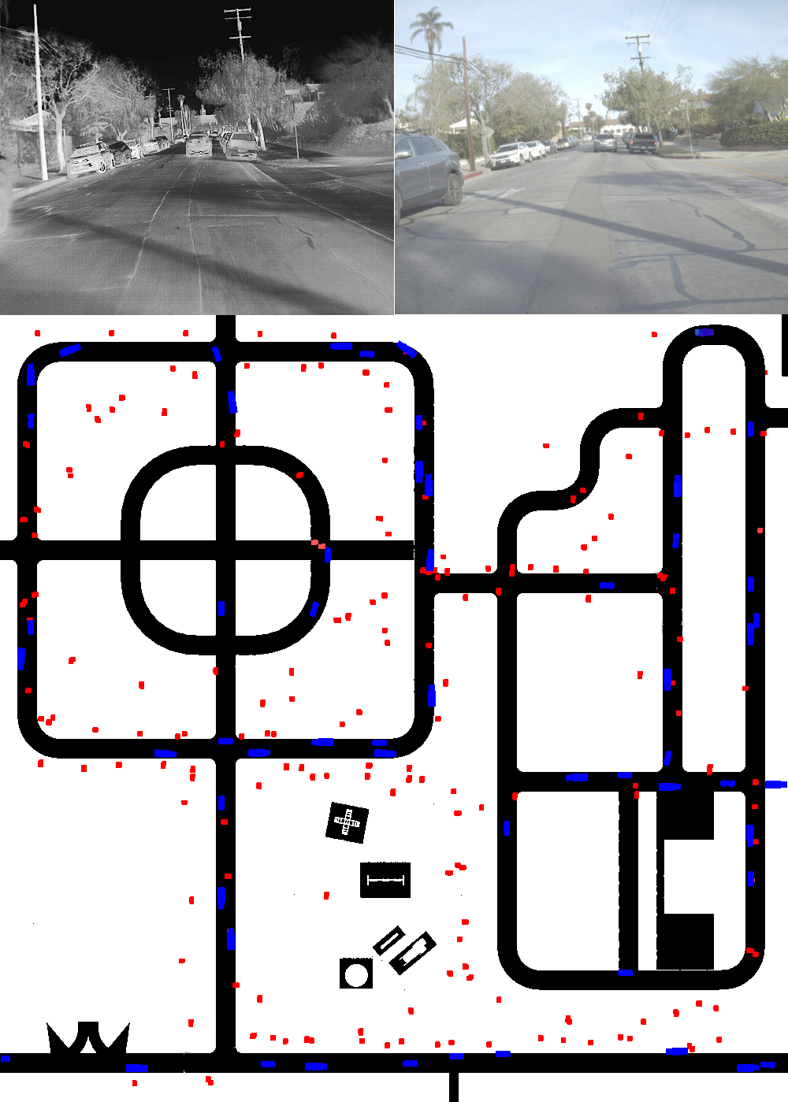
Research proposal
Obtain information from multiple sensors (thermal & RGB), to increase the certainty of the observations
Generate a representation that uses combined information to obtain a clearer idea of the observed scenario
Map the generated representation to a human readable format (Map with overlaying information)
P. Heyer (Ghent University)
Cooperative camera scene modeling using metadata
Project Check Meeting
<number> / 11

Slide 8
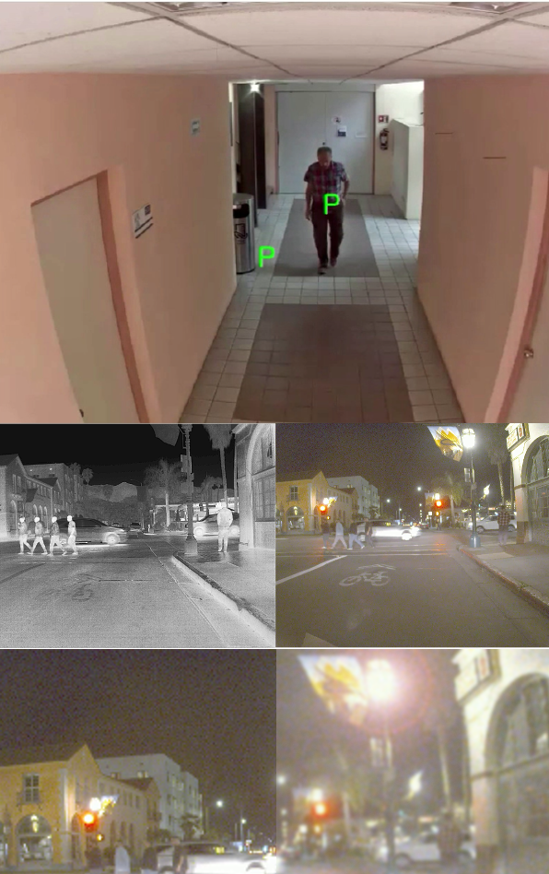
Research problems
Detection of entities, partial and total occlusion,
re-identification of entities
Merging of information from different sensors
Asses accuracy of a sensor reduce cross contamination when merging
Define best features to reliably represent the sensed scenario
P. Heyer (Ghent University)
Cooperative camera scene modeling using metadata
Project Check Meeting
<number> / 11

Slide 9
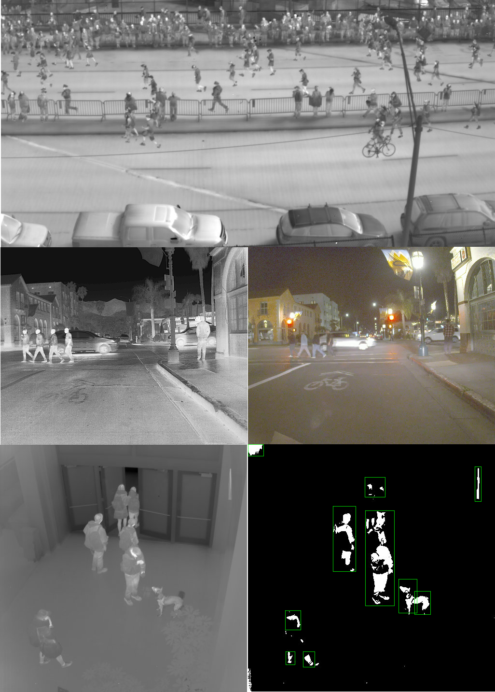
Progress
Implementation of visualization algorithm, using Quasar Preprocessed data-sets
5 RGB-thermal datasets
23 thermal datasets
Normalization of annotations (labels, meta-data)
P. Heyer (Ghent University)
Cooperative camera scene modeling using metadata
Project Check Meeting
<number> / 11

Slide 10
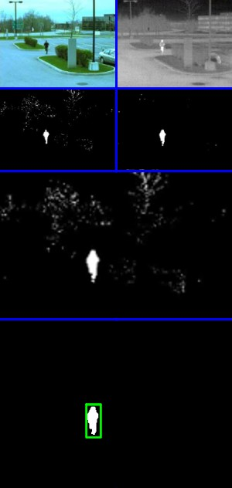
Progress
Preliminary segmentation of pedestrians and vehicles (Gaussian Mixture-based Segmentation Algorithm)
Merge and cleanup of segmented images
Improved segmentation when using combined sensor data
P. Heyer (Ghent University)
Cooperative camera scene modeling using metadata
Project Check Meeting
<number> / 11

Slide 11
Thanks Questions?
P. Heyer (Ghent University)
Cooperative camera scene modeling using metadata
Project Check Meeting
<number> / 11

