Slide 1
An Overview of State-of-the-art Denoising and Demosaicking Techniques: Toward A Unified Framework for Handling Artifacts during Image Reconstruction
Bart Goossens, Hiep Luong, Jan Aelterman, Aleksandra Pizurica and Wilfried Philips
Ghent University, TELIN-IPI-iMinds
June 11, 2015
Notes:
Abstract:

Slide 2
Overview
Introduction
Image denoising
Image demosaicking
A unified reconstruction framework
Results
Conclusion

Slide 3
Overview
Introduction
Image denoising
Image demosaicking
A unified reconstruction framework
Results
Conclusion

Slide 4
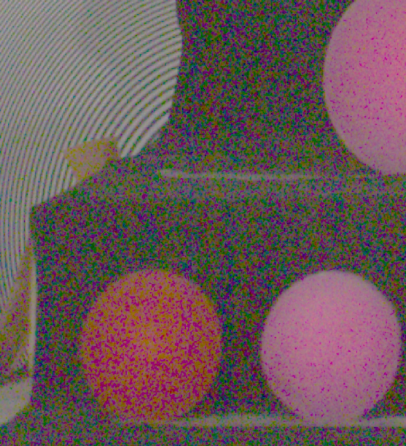
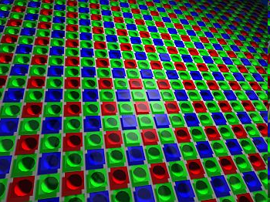
Introduction
Digital photography: more MP
=
More noise: area of a sensor element (pixel) becomes smaller
Demosaicking: interpolation of missing color pixel intensities
→ noise becomes correlated
Blur (optics, motion) becomes more apparent.
Notes:
Tendency to push the physical limits of acquisition

Slide 5
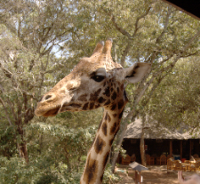
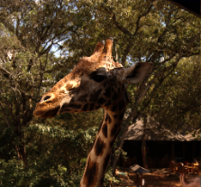
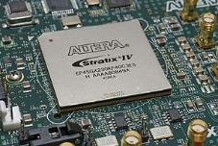
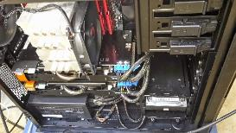
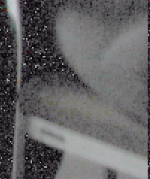
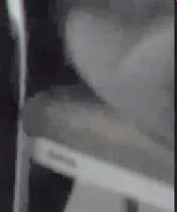
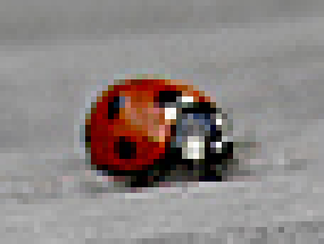
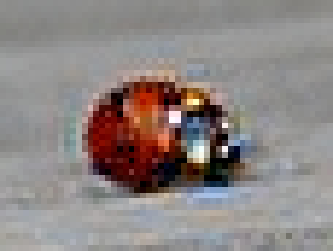
Introduction
Goal: “solve” artifacts (noise, blur) using digital image processing techniques.
Criteria (see also [Hirakawa, 2008]):
Geforce GTX 980
vs
vs
Geforce GTX 980
Quality of the reconstruction
Complexity of the implementation
vs
vs
Quantum efficiency/noise
Robustness to color prior assumptions
Notes:
Quantum efficiency: measurement of a device’s electrical sensitivity to light

Slide 6
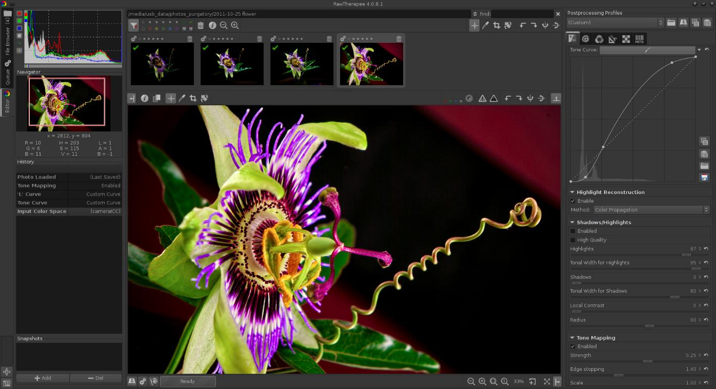
Introduction
On-line: within the camera
Off-line: desktop PC software (RawTherapee, Adobe Lightroom)

Slide 7
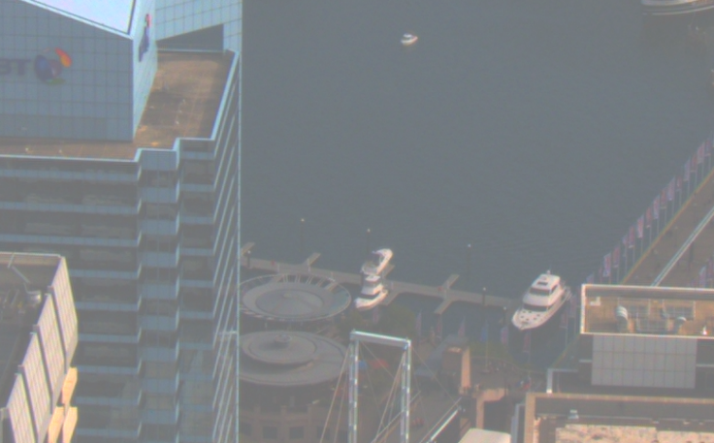
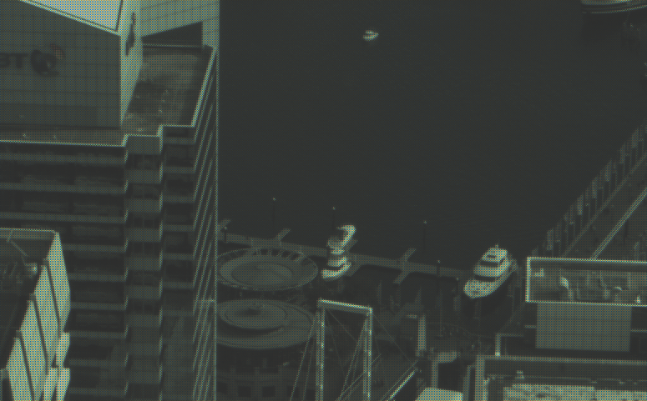
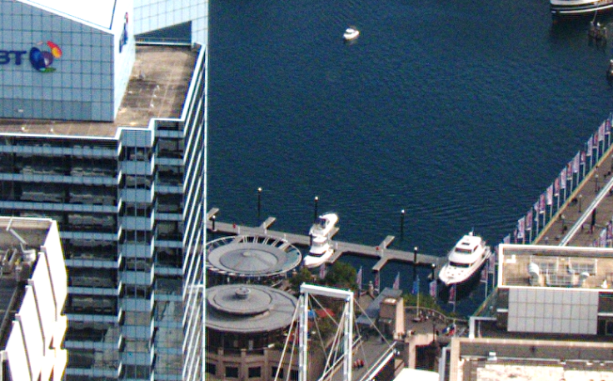
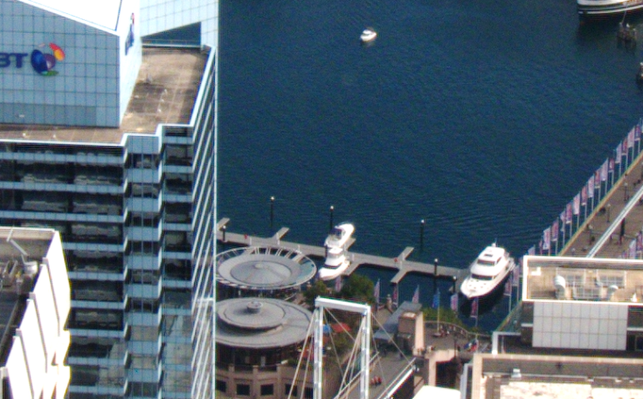
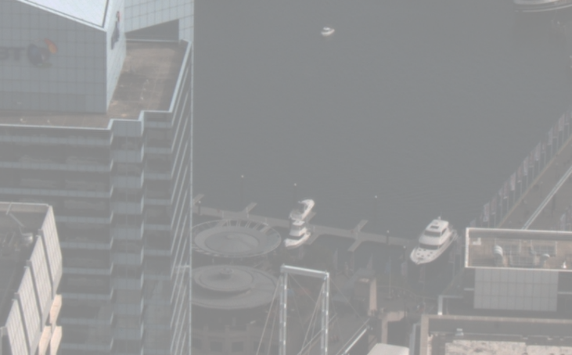
Introduction
Image processing chain (simplified):
Chromatic
aberration correction
RAW
Exposure correction
Denoising
demosaicking
Color
correction
HDR synthesis (optional effect)
Gamma
correction
Output image
Deblurring
Gamma correction
Color correction
RAW image
Deblurring
Output image
demosaicking
Notes:
Add example images?
Split the slide in two?

Slide 8
Introduction
Image processing chain (simplified):
Problems:
Sequential processing (denoising, deblurring and demosaicking) leads to poor image quality due to incorrect interpolation of color intensities and noise.
Pushing acquisition limits (e.g. resolution, noise) => effect becomes more pronounced
Research:
Joint denoising and demosaicking [Hirakawa, 2006], [Condat, 2010], [Chatterjee, 2011]
Joint demosaicking and deconvolution [Paliy, 2008], [Soulez, 2009]
High dynamic range synthesis and denoising [Goossens, 2011b]
Declipping (de-saturation) and denoising [Foi, 2008]
Chromatic
aberration correction
RAW
Exposure correction
Denoising
demosaicking
Color
correction
HDR synthesis (optional effect)
Deblurring
Gamma
correction
Output image
Notes:
Add example images?
Split the slide in two?

Slide 9
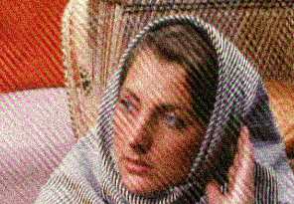
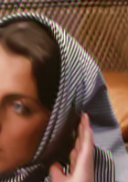
Overview
Introduction
Image denoising
Image demosaicking
A unified reconstruction framework
Results
Conclusion

Slide 10
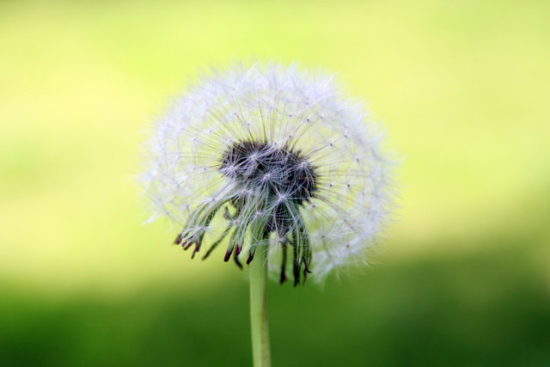
Image denoising techniques
Main principle:
Images consist of smooth areas with discontinuities near edges, textures
Pre-knowledge for image reconstruction method, exploited by
Either a cost criterion (penalty)
Or a statistical model
Smooth area
Texture
Edge
Notes:
Dandelion

Slide 11
Image denoising techniques – wavelets, shearlets
Complex wavelets [Selesnick, 2005]
Shearlets [Kutyniok, 2007], [Goossens, 2011a]
Scale 3
Scale 2
Scale 1
Scaling function
Scale 1
Scale 2
Scale 3
Write images as sum of different wavelets/shearlets (with coefficients)
Transform domain: denoising & demosaicking becomes easier!!!

Slide 12
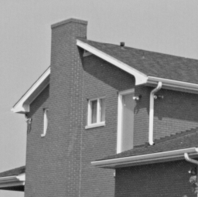
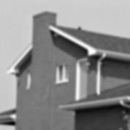
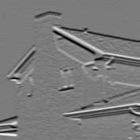
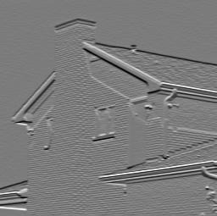
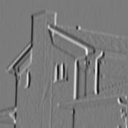
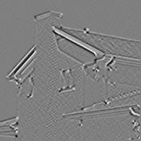
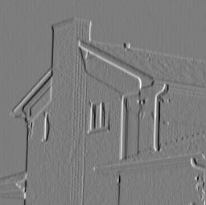
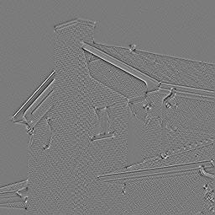
Image denoising techniques
Waveletcoefficients
0
Peaks correspond to edges

Slide 13
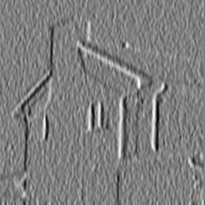
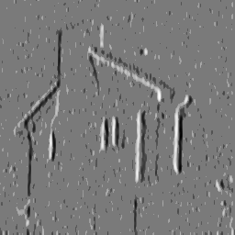
Image denoising techniques
Example: wavelet-domain soft-thresholding
Wavelet coefficients
T
0
-T
After “hard thresholding”
0

Slide 14
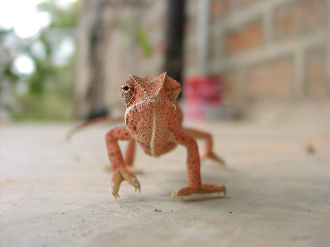
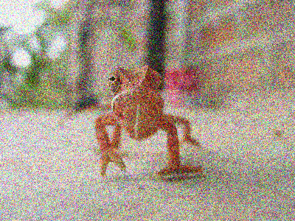
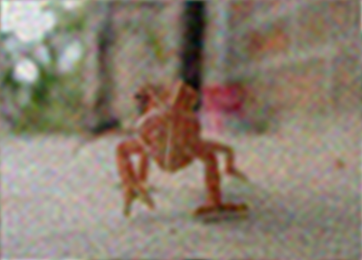
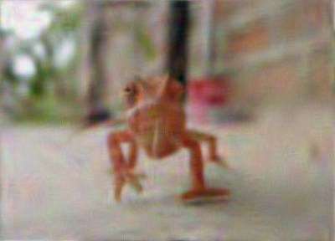
Image denoising techniques: wavelet-domain techniques
Original
Original+Gaussian Noise (s=50)
CPU: 2.6 s | GPU: 0.701 s
CPU: 2.8 s | GPU: 0.733 s
Shearlet thresholding
[Goossens, 2011a]+[Chang, 2000]
BLS-GSM + shearlets
[Goossens, 2011a]+[Portilla, 2003]
Notes:
Lizard
Image size: 400x300, RGB
Shearlet thresholding: 10 s (CPU), 700 ms (GPU)
BLS-GSM: 733 msec (GPU), 2.8 sec (CPU)

Slide 15
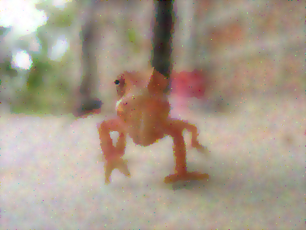
Image denoising techniques: image domain techniques
Original
Original+Gaussian Noise (s=50)
CPU: 0.093 s | GPU: 0.007 s
CPU: 2.180 s | GPU: 0.080 s
Bilateral filter
[Tomasi, 1998]
Anisotropic diffusion
[Weickert, 1998]
Notes:
Bilateral filter: 7 ms (GPU), 93 ms (CPU) – 10 iterations
Anisotropic diffusion: 80 ms (GPU), ms (CPU) – 150 iterations (NOTE: calculation time depends on the parameters – step size, number of iterations)

Slide 16
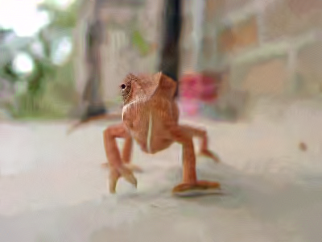
Image denoising techniques: image domain techniques
Original
Original+Gaussian Noise (s=50)
CPU: 3.3 s | GPU: 0.398 s
CPU: 49 s | GPU: N/A
Non-local means
[Goossens, 2008]
BM3D
[Dabov, 2007]
Notes:
Non-local means: (CPU) 3.343 s (GPU) 398 ms
BM3D: (CPU) 49 s

Slide 17
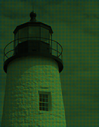
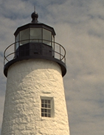
Overview
Introduction
Image denoising
Image demosaicking
A unified reconstruction framework
Results
Conclusion

Slide 18
Image demosaicking: principle
Main principle: unmixing of the measured color channels!
Grid mosaic:
Alternative interpretation:
=
+
+
=
+
(
)
(
)
+
-
-
β_{s}
α_{s}
g
~fully sampled luminance
~subsampled chrominances

Slide 19
Image demosaicking: principle
Main principle: unmixing of the measured color channels!
Assumption 1:
luminance bandlimited
Assumption 2:
chrominance bandlimited
0
3π/4
π
0
π/4
π
Frequency spectrum
Frequency spectrum

Slide 20
Image demosaicking: principle
Main principle: unmixing of the measured color channels!
0
π
Bandlimitedness assumptions: exact recovery possible!!!

Slide 21
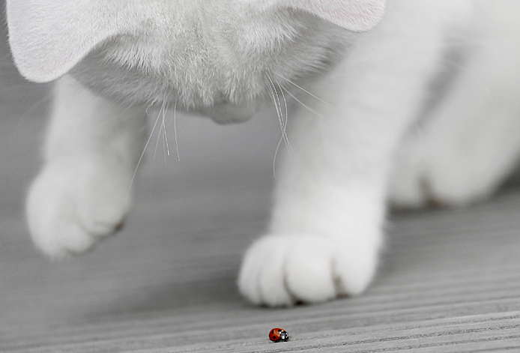
Image demosaicking: artifacts
Sudden color transition: difficult for demosaicking!

Slide 22
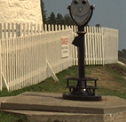
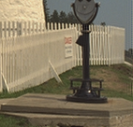
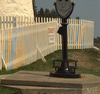
Image demosaicking: artifacts
Blur
Ground truth
Discolorations
Zipper

Slide 23
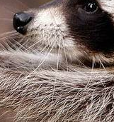
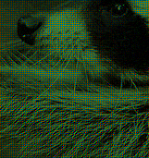
Image demosaicking: results
DLMMSE
[Zhang, 2005]
Complex wavelet
[Goossens, 2013]
Reference image
CFA image
Difference
DLMMSE - ref
Difference
Complex wavelet - ref
DLMMSE
[Zhang, 2005]
Complex wavelet
[Goossens, 2013]

Slide 24
Image denoising+demosaicking
Denoising-after-demosaicking: noise is highly correlated due to the interpolation
Demosaicking-after-denoising: denoising may destroy high-frequency components necessary for demosaicking
Better: joint denoising and demosaicking: take uncertainty in the edge direction estimation into account
Demos.
Denoise
Denoise
Demos.
Denoise
Demos.

Slide 25
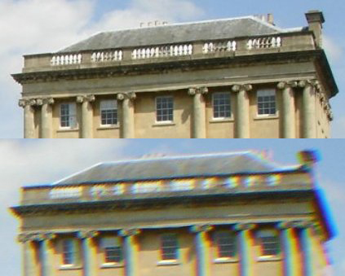
A unified reconstruction framework: overview
Unified reconstruction framework
More sophisticated processing (higher complexity?)
Optimally solving the noise and demosaicking problems
Other sensor/lens deficiencies (chromatic aberration, cross-talk, fixed pattern noise, …)
Notes:
TODO: add pictures

Slide 26
A unified reconstruction framework: overview
RAW
Exposure correction
Chromatic
aberration correction
Denoising
demosaicking
Color
correction
RAW
input image
Updated
RAW image
Output image
Deblurring
Gamma
correction
In the loop
Degradation model
(blur, signal-dependent noise,
demosaicking…)
Impose prior knowledge
w.r.t. undegraded image
(e.g., wavelets, shearlets)
Iterative
solver
Reconstructed
image

Slide 27
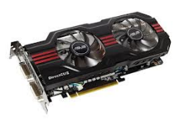
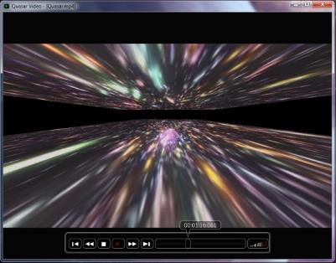
Quasar: new programming language for CPU and GPU
http://quasar.ugent.be [Goossens, 2014]
…
Block 1 Warps
…
Block 2 Warps
…
Block 1 Warps
…
…
…
Video input
t0 t1 t2 … t31
t0 t1 t2 … t31
t0 t1 t2 … t31
FFMPEG / DirectShow
Nvidia CUDA
Streaming Multiprocessor
Instruction L1
Instruction Fetch/Dispatch
Shared Memory
OpenGL / DirectX
SP
SP
Quasar
Real-time
visualization
SP
SP
SP
SFU
SP
SFU
SP
SP
GPU
OpenCL
Core 1
Core 2
Core 3
Core 4
CPU
GCC

Slide 28
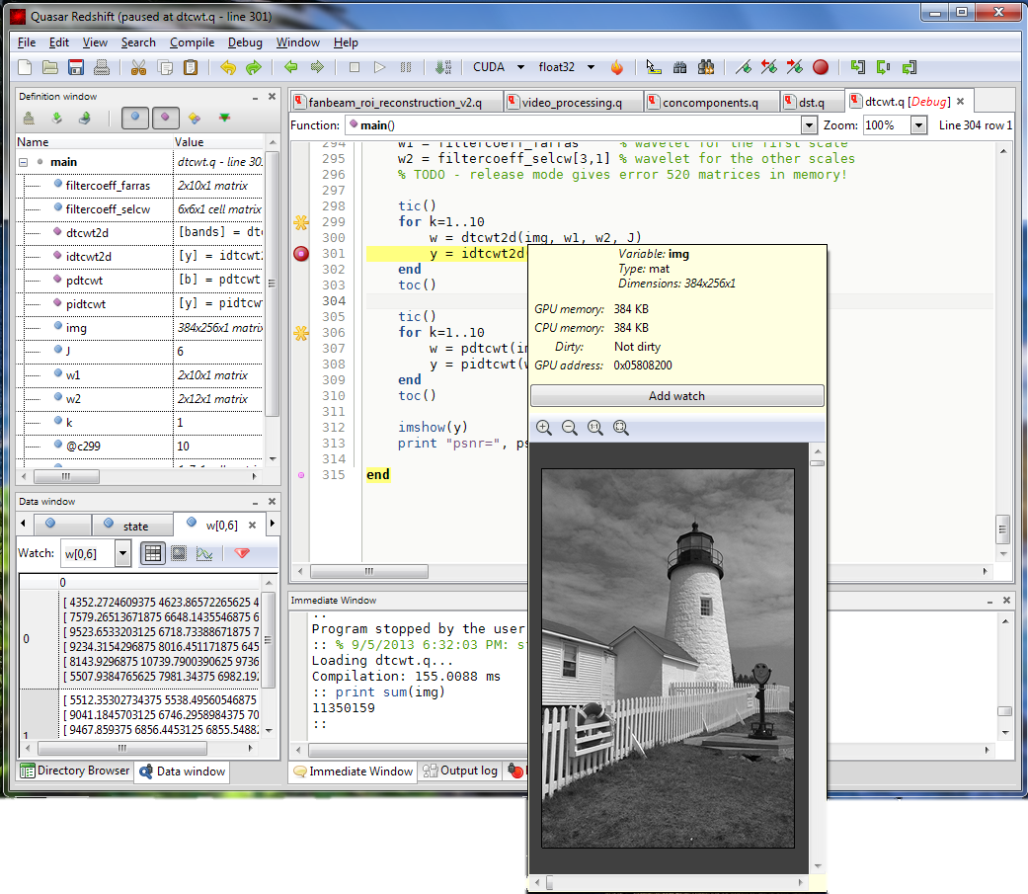
Quasar: new programming language for CPU and GPU
http://quasar.ugent.be [Goossens, 2014]
Easy development and debugging of image reconstruction algorithms!

Slide 29
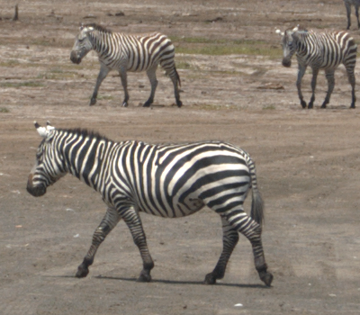
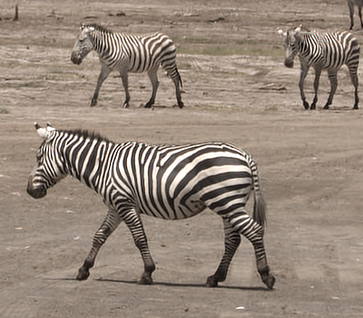
Results
RawTherapee (default profile)
Our unified reconstruction framework

Slide 30
Conclusion
Pushing physical limits of sensors
› need for better reconstruction techniques
Image denoising & demosaicking
Other post-processing steps (gamma correction, chromatic aberration correction, etc.) to be considered
Sequential approach: not optimal!
Unified reconstruction framework
New programming language Quasar helps to develop and debug new reconstruction algorithms

Slide 31
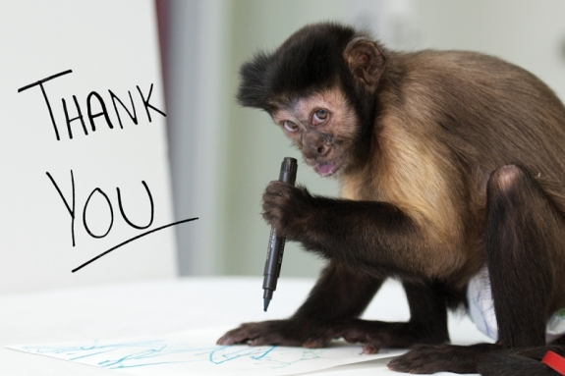
Questions?

Slide 32
Bibliography (I)
[Buades, 2005] A. Buades., B. Coll., and J. Morel, “A non local algorithm for image denoising,” SIAM interdisciplinary journal: Multiscale Modeling and Simulation, vol. 2, no. 2, pp. 60–65, 2005.
[Chang, 2000] Chang, S., Yu, B., and Vetterli, M. Spatially adaptive wavelet thresholding with context modeling for image denoising. IEEE Trans. Image Process., 9(9):1522–1531, 2000.
[Chatterjee, 2011] P. Chatterjee, N. Joshi, K. S. B., and Y. Matsushita, “Noise suppression in low-light images through joint denoising and demosaicing,” in Proc. IEEE Conf. Computer Vision and Pattern Recognition (CVPR), 2011, pp. 321–328.
[Condat, 2010] L. Condat, “A simple, fast and efficient approach to denoisaicking: Joint demosaicking and denoising,” in Proc. 17th IEEE Int Conf. Image Processing (ICIP), Hong Kong, China, 2010, pp. 905–908.
[Dabov, 2007] K. Dabov, A. Foi, V. Katkovnik, and K. Egiazarian, “Image denoising by sparse 3d transform-domain collaborative filtering,” IEEE Transactions on image processing, vol. 16, no. 8, pp. 2080–2095, 2007.
[Foi, 2008] A. Foi, “Practical denoising of clipped or overexposed noisy images,” in Proc. 16th European Signal Process. Conf. (EUSIPCO), Lausanne, Switzerland, 2008

Slide 33
Bibliography (II)
[Goossens, 2008] B. Goossens, H. Luong, A. Pižurica, and W. Philips, “An improved Non-Local Means Algorithm for Image Denoising,” in 2008 International Workshop on Local and Non-Local Approximation in Image Processing, Ghent, Belgium, dec 2008
[Goossens, 2011a] B. Goossens, J. Aelterman, H. Luong, A. Pizurica and W. Philips, "Design of a Tight Frame of 2D Shearlets Based on a Fast Non-iterative Analysis and Synthesis Algorithm, " SPIE Optics & Photonics 2011, Wavelets and Sparsity XIV, Aug. 21-25, San Diego, CA, USA, p. 81381Q (13 pages)
[Goossens, 2011b] B. Goossens, H. Luong, J. Aelterman, A. Pižurica, and W. Philips, “Reconstruction of High Dynamic Range Images with Poisson Noise Modeling and Integrated Denoising,” in IEEE Int. Conf. Image Processing (ICIP2011), Brussels, Belgium, Sept. 11-14 2011, pp. 3429–3432
[Goossens, 2013] B. Goossens, J. Aelterman, H. Luong, A. Pižurica, and W. Philips, “Complex wavelet joint denoising and demosaicing using gaussian scale mixtures,” in IEEE Int. Conf. Image Processing, Melbourne, Australia, Sept. 15-18 2013, pp. 445–448
[Goossens, 2014] B. Goossens, J. De Vylder and W. Philips, "Quasar - a New Heterogeneous Programming Framework for Image and Video Processing Algorithms on CPU and GPU, " IEEE Int. Conf. on Image Processing (ICIP2014), Oct. 27-30, 2014, Paris, France, p. 2183-2185.

Slide 34
Bibliography (III)
[Gunturn, 2005] B. Gunturk, J. Glotzbach, Y. Altunbasak, R. Schaffer, and R. Mersereau, “Demosaicing: color filter array interpolation,” IEEE Sig. Proc. Magazine, vol. 22, no. 1, pp. 44–54, 2005.
[Hirakawa, 2006] K. Hirakawa and T. W. Parks, “Joint demosaicing and denoising,” IEEE Trans. Image Process., vol. 15, no. 8, pp. 2146–2157, aug 2006.
[Hirakawa, 2008] Hirakawa, K. and Wolfe, P. J., Spatio-spectral color filter array design for optimal image recovery. IEEE Trans. Image Processing, 17(10):1876–1890, 2008.
[Kutyniok, 2007] G. Kutyniok and D. Labate, “Construction of Regular and Irregular Shearlets,” J. Wavelet Theory and Appl., vol. 1, pp. 1–10, 2007
[Luong, 2012] H. Luong, B. Goossens, J. Aelterman, A. Pižurica, and W. Philips, “A Primal-Dual Algorithm for Joint Demoisaicing and Deconvolution,” in IEEE Int. Conf. Image Processing (ICIP2012), Orlando, Florida, USA, Sep. 30 - Oct. 3 2012, pp. 2801–2804.
[Paliy, 2008] D. Paliy, A. Foi, R. Bilcu, V. Katkovnik, and K. Egiazarian, “Joint deblurring and demosaicking of Poissonian Bayer-data based on local adaptivity,” in Proc. European Sig. Proc. conf. (EUSIPCO), 2008
[Portilla, 2003] J. Portilla, V. Strela, M. Wainwright, and E. Simoncelli, “Image denoising using scale mixtures of gaussians in the wavelet domain,” IEEE Trans. on image processing, vol. 12, no. 11, pp. 1338–1351, Nov. 2003.

Slide 35
Bibliography (IV)
[Selesnick, 2005] I. W. Selesnick, R. G. Baraniuk, and N. G. Kingsbury, “The Dual-Tree Complex Wavelet Transform,” IEEE Signal Processing Magazine, vol. 22, no. 6, pp. 123–151, nov 2005.
[Soulez, 2009] F. Soulez and E. Thiebaut, “Joint deconvolution and demosaicking,” in Proc. IEEE Int. Conf. Image Proc., 2009, pp. 145–148.
[Tomasi, 1998] C. Tomasi and R. Manduchi, “Bilateral filtering for gray and color images,” International Conference on Computer Vision (ICCV), pp. 839–846, 1998.
[Weickert, 1998] J. Weickert, Anisotropic Diffusion in Image Processing, ser. ECMI Series. Teubner-Verlag, 1998.
[Zhang, 2005] Zhang, L. and Wu, X. Color demosaicking via directional linear minimum mean square-error estimation. IEEE Transactions on Image Processing, 14(12):2167–2178, 2005.

